Slide 1
Hybrid Machine Translation by Combining Multiple Machine Translation Systems
Matīss Rikters
Supervisor: Dr. sc. comp., prof. Inguna Skadiņa
May 10, 2019

Slide 2
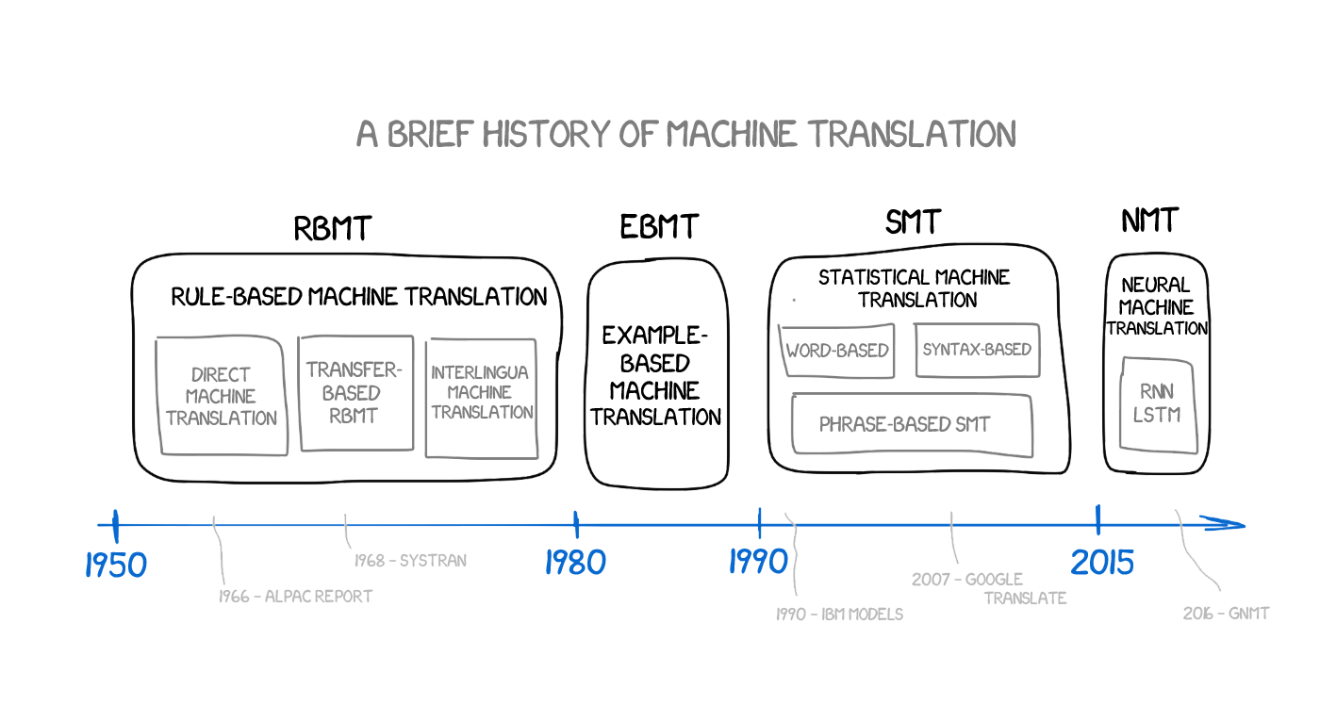
Introduction
This Thesis
HMT
https://medium.freecodecamp.org/a-history-of-machine-translation-from-the-cold-war-to-deep-learning-f1d335ce8b5
Notes:
Rule-based MT (RBMT) is based on linguistic information covering the main semantic, morphological, and syntactic regularities of source and target languages
Statistical MT (SMT) consists of subcomponents that are separately engineered to learn how to translate from vast amounts of translated text
Neural MT (NMT) consists of a large neural network in which weights are trained jointly to maximize the translation performance
Hybrid MT (HMT) employs different MT approaches in the same system to complement each other’s strengths to boost the accuracy level of the translation

Slide 3
Introduction
Automatic Evaluation MT
BLEU - one of the first metrics to report high correlation with human judgments
One of the most popular in the field
The closer MT is to a professional human translation, the better it is
Scores a translation on a scale of 0 to 100

Slide 4
Aim and objectives
The aim is to research and develop methods and tools that would be able to improve the quality of MT output for the Baltic languages that are small, have a rich morphology and little resources available.
For this research, the author has suggested the following hypothesis:
Combining output from multiple different MT systems makes it possible to produce higher quality translations for the Baltic languages than the output that is produced by each component system individually.
Objectives
Analyse RBMT, SMT and NMT methods as well as existing HMT methods
Experiment with different methods of combining translations
Evaluate quality of the resulting translations
Investigate applicability of methods for Latvian and other morphologically rich languages
Provide practical applications of MT combining

Slide 5
Combining SMT output
This Thesis
SMT NMT
Combining
SMT
output
1990 2014 2015
Notes:
Full sentence translations
Sentence fragments
Advanced sentence fragments
Neural network language models

Slide 6
Full sentence translations

Slide 7
Selection of the best translation
Perplexity on a test set is calculated using the language model as the inverse probability (P) of that test set, which is normalized by the number of words (N) (Jurafsky and Martin, 2014). For a test set W = w₁, w₂, ..., w_{N}:
$$perplexity(W)={P(w_{1}, w_{2}, …, w_{N})}^{−\frac{1}{N}}=\sqrt[N]{\frac{1}{P(w_{1}, w_{2}, …, w_{N})}}$$
Perplexity can also be defined as the exponential function of the cross-entropy:
$$H(W)=−\frac{1}{N}log P(w_{1}, w_{2}, …, w_{N})$$
$$perplexity(W)=2^{H(W)}$$

Slide 8
Experiments
En → Lv data
5-gram Language model trained with KenLM for the target language (Lv)
JRC Acquis corpus version 3.0 (legal domain - 1.4M sentences)
Parallel test sets
ACCURAT balanced test corpus for under resourced languages (general domain - 512 sentences)
Random (held-out) sentences from the JRC Acquis 3.0 (legal domain - 1581 sentences)
Automatic evaluation
Human evaluation
System | BLEU
Google Translate | 16.92
Bing Translator | 17.16
LetsMT | 28.27
Google + Bing | 17.28
Google + LetsMT | 22.89
LetsMT + Bing | 22.83
Google + Bing + LetsMT | 21.08
System | AVG human | Hybrid | BLEU
Bing | 31,88% | 28,93% | 16.92
Google | 30,63% | 34,31% | 17.16
LetsMT | 37,50% | 33,98% | 28.27

Slide 9
Sentence fragments

Slide 10
Experiments
Syntactic parsing
Berkeley Parser
Sentences are split into chunks from the top level subtrees of the syntax tree
Selection of the best chunk and test data
Same as in the previous experiment
Automatic evaluation
Human evaluation
System | BLEU
 | Full | Chunks
Google Translate | 18.09
Bing Translator | 18.87
LetsMT! | 30.28
Google + Bing | 18.73 | 21.27
Google + LetsMT | 24.50 | 26.24
LetsMT! + Bing | 24.66 | 26.63
Google + Bing + LetsMT! | 22.69 | 24.72
System | Fluency AVG | Accuracy AVG | Hybrid selection | BLEU
Google | 35.29% | 34.93% | 16.83% | 18.09
Bing | 23.53% | 23.97% | 17.94% | 18.87
LetsMT | 20.00% | 21.92% | 65.23% | 30.28
Hybrid | 21.18% | 19.18% | - | 24.72

Slide 11
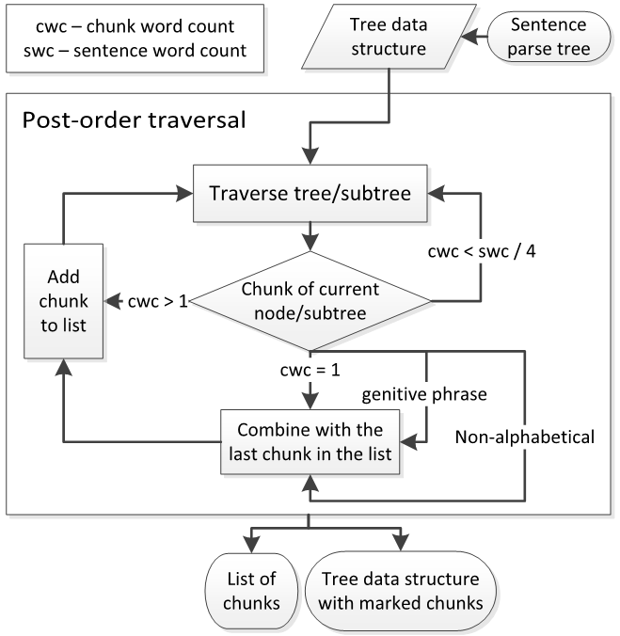
Advanced sentence fragments
An advanced approach to chunking
Traverse the syntax tree bottom up, from right to left
Add a word to the current chunk if
The current chunk is not too long (sentence word count / 4)
The word is non-alphabetic or only one symbol long
The word begins with a genitive phrase («of »)
Otherwise, initialize a new chunk with the word
In case when chunking results in too many chunks, repeat the process, allowing more words in a chunk (sentence word count / 4)
Changes in the MT API systems
LetsMT! API temporarily replaced with Hugo.lv API
Added Yandex API

Slide 12
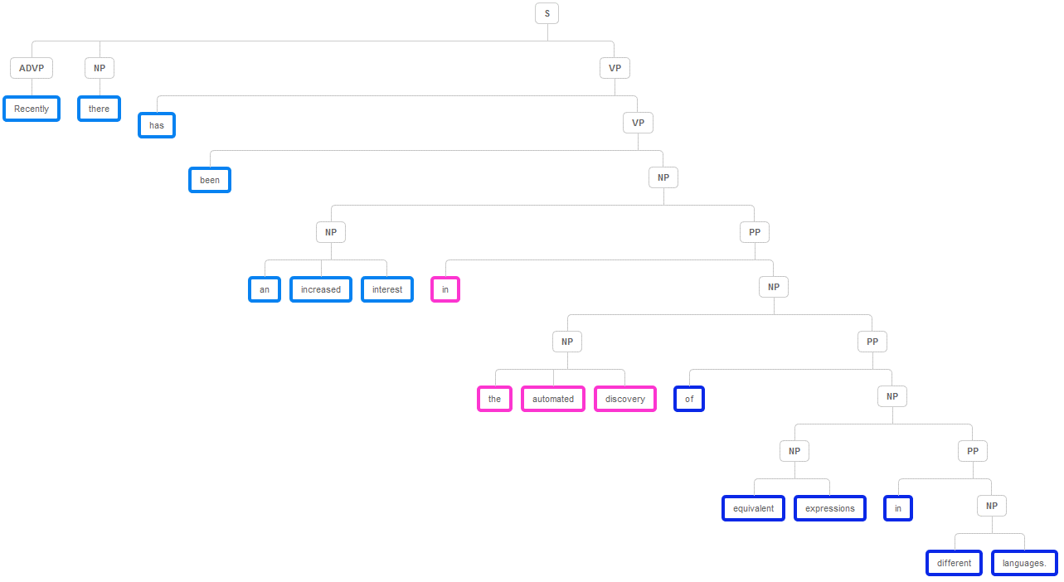
Experiments
System | BLEU
Full Google + Bing | 17.70
Full Google + Bing + LetsMT | 17.63
Chunks Google + Bing | 17.95
Chunks Google + Bing + LetsMT | 17.30
Advanced Chunks Google + Bing | 18.29
Advanced Chunks all four | 19.21

Slide 13
Neural network language models
MemN2N
End-to-end memory network (RNN with attention)
Char-RNN
RNNs, LSTMs and gated recurrent units (GRU)
Character level
System | Perplexity | BLEU
KenLM | 34.67 | 19.23
MemN2N | 25.77 | 18.81
Char-RNN | 24.46 | 19.53

Slide 14
Combining NMT output
This Thesis
SMT NMT
Combining
NMT
output
1990 2014 2015
Notes:
Experimenting with NMT attention alignments
System combination using neural network attention
System combination by estimating confidence from neural network attention
Data combination for training multilingual NMT systems
Incremental multi-pass training for NMT systems

Slide 15
Experimenting with NMT attention alignments
Goals
Improve translation of multiword-expressions
Keep track of changes in attention alignments
Workflow
Tag corpora with morphological taggers
MPAligner
Shuffle MWEs into training corpora;
Train NMT systems
UDPipe LV Tagger
Align identified MWE candidates
Neural Monkey
Identify MWE candidates
MWE Toolkit
Identify changes

Slide 16
Data
WMT17 News Translation Task
Training
En → Lv
4.5M parallel sentences for the baseline
4.8M after adding MEWs/MWE sentences
En → Cs
49M parallel sentences for the baseline
17M after adding MEWs/MWE sentences
Evaluation
En → Lv
2003 sentences in total
611 sentences with at least one MWE
En → Cs
6000 sentences in total
112 sentences with at least one MWE
En → Lv
En → Cs
1M
1M
2xMWE
1xMWE
2M
2xMWE
0.5M
2.5M
1xMWE
2.5M
2xMWE
5M
2xMWE
5M

Slide 17
Experiments
Two forms of the presenting MWEs to the NMT system
Adding only the parallel MWEs themselves (MWE phrases)
each pair forming a new “sentence pair” in the parallel corpus
Adding full sentences that contain the identified MWEs (MWE sentences)
Languages | En → Cs |  | En → Lv
Dataset | Dev | MWE | Dev | MWE
Baseline | 13.71 | 10.25 | 11.29 | 9.32
+MWE phrases | - | - | 11.94 | 10.31
+MWE sentences | 13.99 | 10.44 | - | -

Slide 18
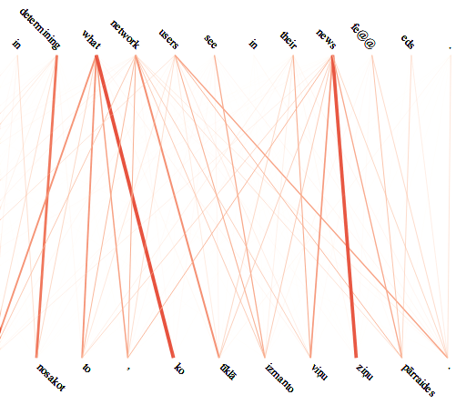
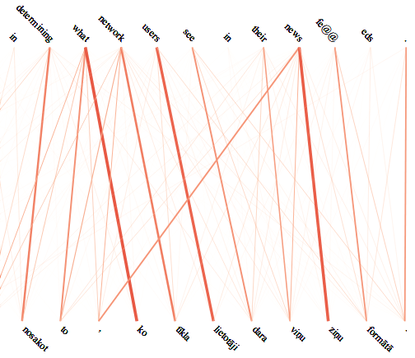
Alignment Inspection

Slide 19
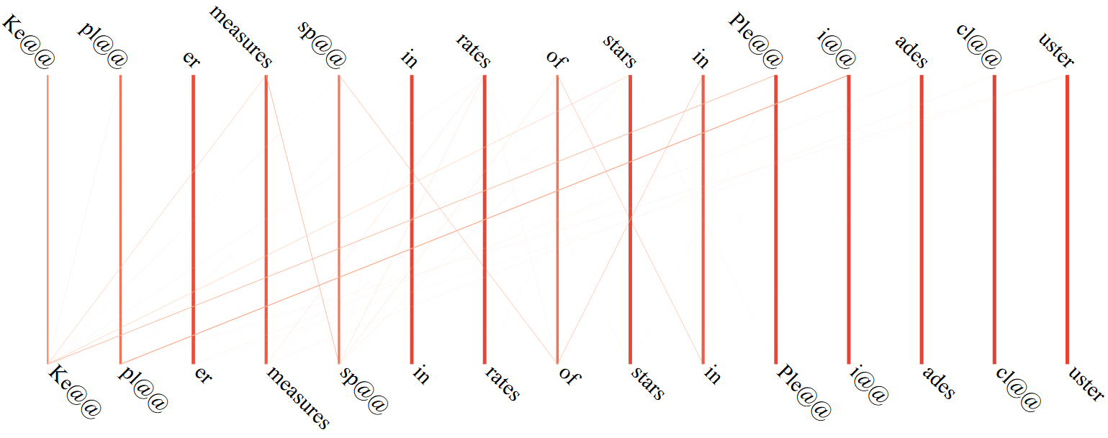
System combination using NMT attention

Slide 20
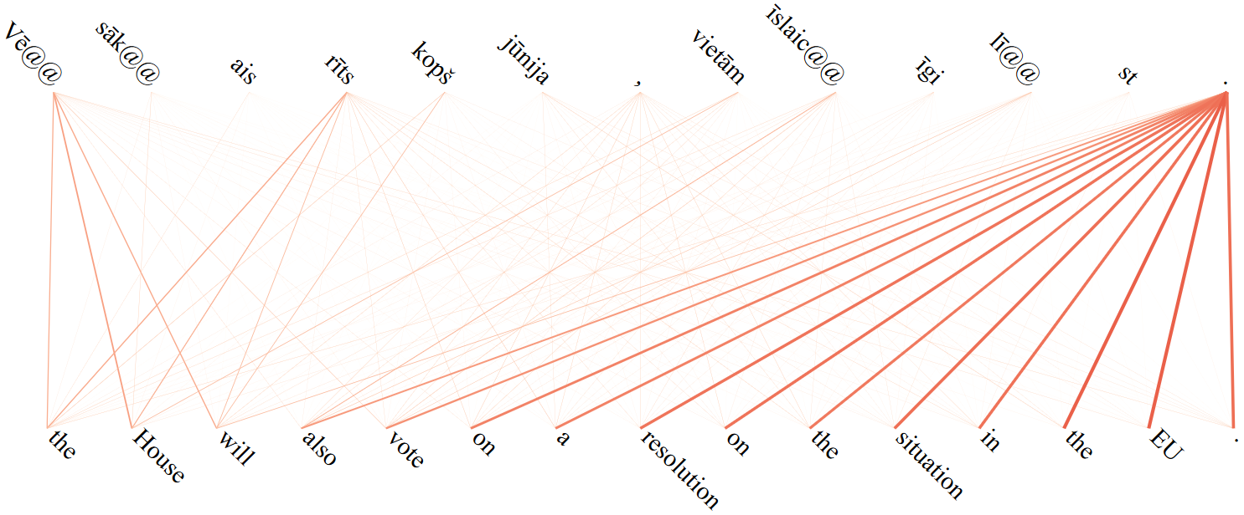
System combination using NMT attention

Slide 21
System combination using NMT attention
Workflow
Translate the same sentence with two different NMT systems and one SMT system
Save attention alignment data from the NMT systems
Choose output from the system that does not
Align most of its attention to a single token
Have only very strong one-to-one alignments
Otherwise - back off to the output of the SMT system
Data – WMT17
News translation Task
System | En->Lv |  | Lv->En
Dataset | Dev | Test | Dev | Test
LetsMT! | 19.8 | 12.9 | 24.3 | 13.4
Neural Monkey | 16.7 | 13.5 | 15.7 | 14.3
Nematus | 16.9 | 13.6 | 15.0 | 13.8
NM+NT+LMT | - | 13.6 | - | 14.3

Slide 22
System combination by estimating
confidence from neural network attention
$$CDP=\frac{1}{L_{src}}\sum_{j}{\log\left(1+{{\left(\sum_{i}{∝_{ji}}\right)}^{2}}\right)}$$
$${AP}_{out}=−\frac{1}{L_{src}}\sum_{i}{\sum_{j}{∝_{ij}∙log∝_{ij}}}$$
$${AP}_{in}=−\frac{1}{L_{trg}}\sum_{i}{\sum_{j}{∝_{ij}∙log∝_{ij}}}$$
$$confidence=CDP+{AP}_{out}+{AP}_{in}$$

Slide 23
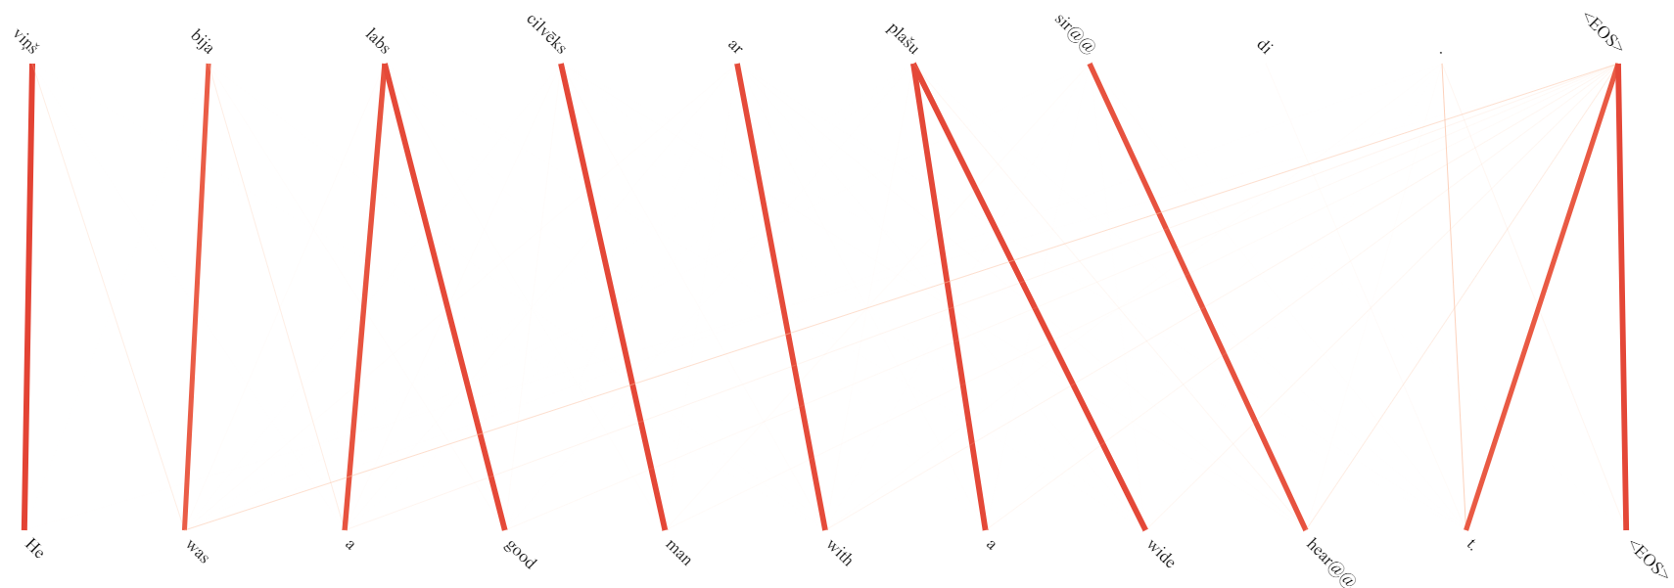
System combination by estimating confidence
Source | Viņš bija labs cilvēks ar plašu sirdi.
Reference | He was a kind spirit with a big heart.
Hypothesis | He was a good man with a wide heart.
CDP | -0.099
AP_{out} | -1.077
AP_{in} | -0.847
Confidence | -2.024

Slide 24
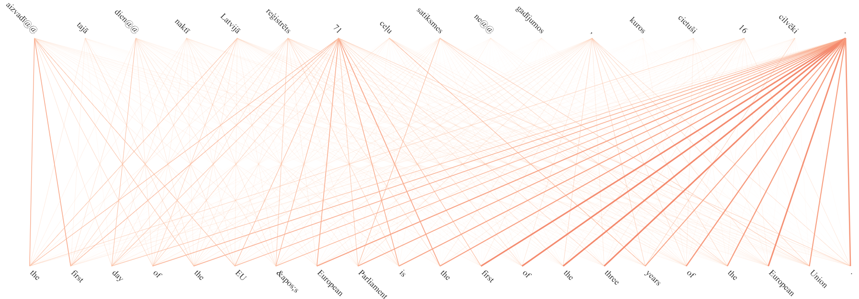
System combination by estimating confidence
Source | Aizvadītajā diennaktī Latvijā reģistrēts 71 ceļu satiksmes negadījumos, kuros cietuši16 cilvēki.
Reference | 71 traffic accidents in which 16 persons were injured have happened in Latvia during the last 24 hours.
Hypothesis | The first day of the EU’European Parliament is the first of the three years of the European Union .
CDP | -0.900
AP_{out} | -2.809
AP_{in} | -2.137
Confidence | -5.846

Slide 25
Experiments
Data – WMT17 News translation Task
 | BLEU
System | En->Lv | Lv->En
Neural Monkey | 13.74 | 11.09
Nematus | 13.80 | 12.64
Hybrid | 14.79 | 12.65
Human | 15.12 | 13.24
 | En->Lv | Lv->En
LM-based overlap with human | 58% | 56%
Attention-based overlap with human | 52% | 60%
LM-based overlap with Attention-based | 34% | 22%

Slide 26
Data combination for multilingual NMT
Poor MT between two non-English languages due to limited parallel data
Improve X↔Y MT be by adding X↔En and Y↔En data
Experiment with various NMT architectures
Language pair | Before filtering (Total/Unique) | After filtering (Unique)
English ↔ Estonian | 62.5M / 24.3M | 18.9M
English ↔ Russian | 60.7M / 39.2M | 29.4M
Russian ↔ Estonian | 6.5M / 4.4M | 3.5M

Slide 27
Data combination for multilingual NMT
 | Development |  |  |  | Evaluation
 | Ru → Et | Et → Ru | En → Et | Et → En | Ru → Et | Et → Ru | En → Et | Et → En
MLSTM-SO | 17.51 | 18.46 | 23.79 | 34.45 | 11.11 | 12.32 | 26.14 | 36.78
GRU-SM | 13.70 | 13.71 | 17.95 | 27.84 | 10.66 | 11.17 | 19.22 | 27.85
GRU-DO | 17.03 | 17.42 | 23.53 | 33.63 | 10.33 | 12.36 | 25.25 | 36.86
GRU-DM | 17.07 | 17.93 | 23.37 | 33.52 | 13.75 | 14.57 | 25.76 | 36.93
FConv-O | 15.24 | 16.17 | 21.63 | 33.84 | 7.56 | 8.83 | 24.87 | 36.96
FConv-M | 14.92 | 15.80 | 18.99 | 30.25 | 10.65 | 10.99 | 21.65 | 31.79
Transf.-O | 17.44 | 18.90 | 25.27 | 37.12 | 9.10 | 11.17 | 28.43 | 40.08
Transf.-M | 18.03 | 19.18 | 23.99 | 35.15 | 14.38 | 15.48 | 25.56 | 37.97
New state-of-the-art Russian ↔ Estonian MT
Significantly better than the previous systems

Slide 28
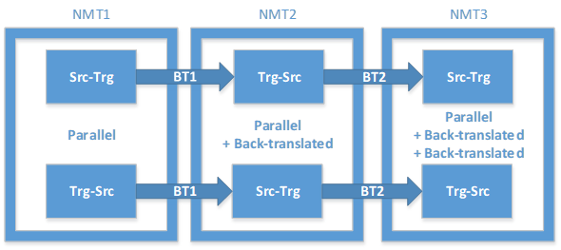
Incremental multi-pass training for NMT
NTM is more sensitive to noisy data – requires stricter data filtering
Back-translation has proven to be an easy way to increase MT quality
Filter data
Train NMT
Back-translate
Train Final NMT
Excessive filtering (details in future slides)
Multiple pass-throughs of back-translation

Slide 29
Incremental multi-pass training for NMT
System | BLEU
 | Score | Rank
Estonian → English | 28.0 | 7 of 23
English → Estonian | 23.6 | 3 of 18
Finnish → English | 23.0 | 5 of 17
English → Finnish | 16.9 | 5 of 18
System | Rank
 | BLEU | Human
 |  | Cluster | Ave %
Estonian → English | 7 of 23 | 1-7 of 9 | 3 of 9
English → Estonian | 3 of 18 | 1-3 of 9 | 3 of 9
New state-of-the-art English ↔ Estonian MT
Tied for 1st place in WMT 2018
Significantly better (p<=0.05) than the competition

Slide 30
Practical implementations
This Thesis
SMT NMT
Practical
implementations
1990 2014 2015
Notes:
Interactive multi-system machine translation
Visualising and debugging neural machine translations
Cleaning corpora to improve neural machine translation performance

Slide 31
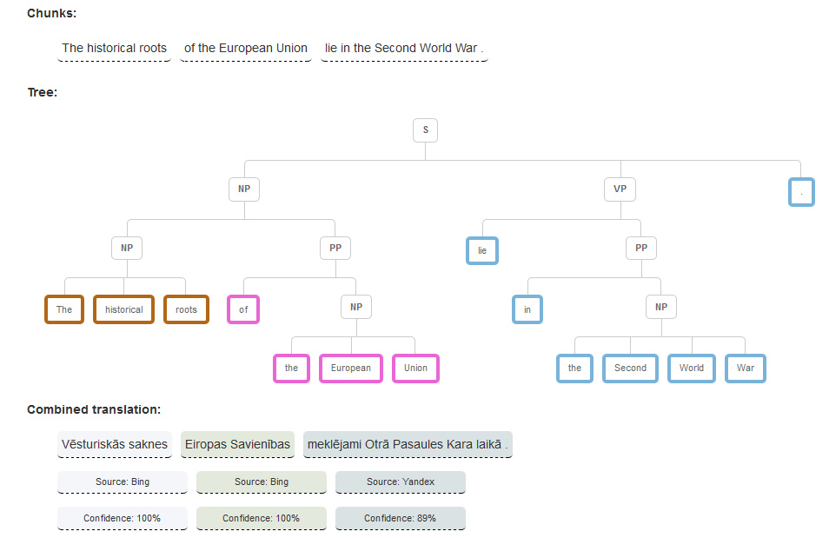
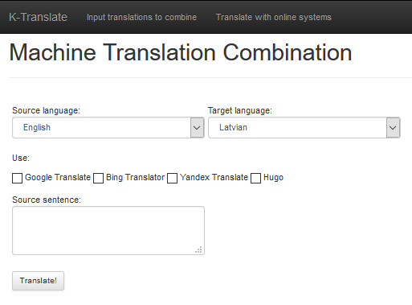
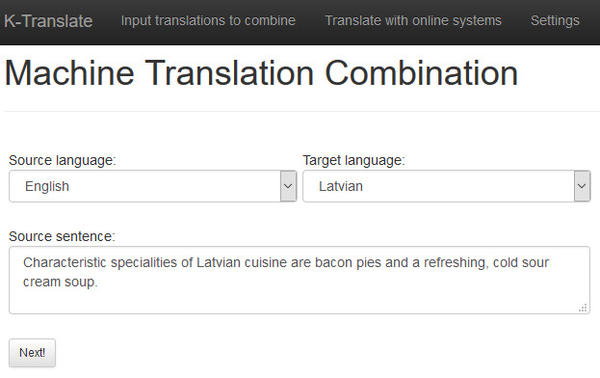
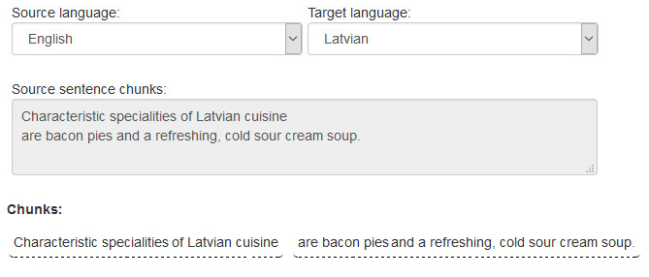
Interactive multi-system machine translation
A user-friendly web interface for ChunkMT
Draws a syntax tree with chunks highlighted
Designates which chunks where chosen from which component system
Provides a confidence score for the choices
Allows using online APIs or user provided translations

Slide 32
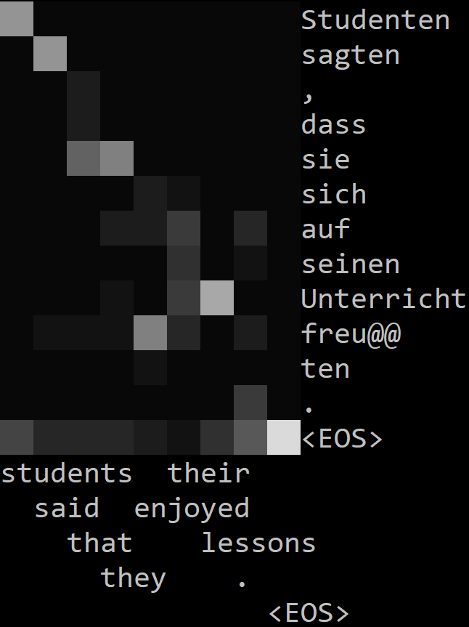
Visualising NMT attention and confidence
Works with attention alignment data from
Nematus
Neural Monkey
Marian
OpenNMT
Sockeye
Visualise translations in
Linux Terminal or Windows PowerShell
Web browser
Line form or matrix form
Save as PNG
Sort and navigate dataset by confidence scores
Directly compare translations of one sentence from two different systems

Slide 33
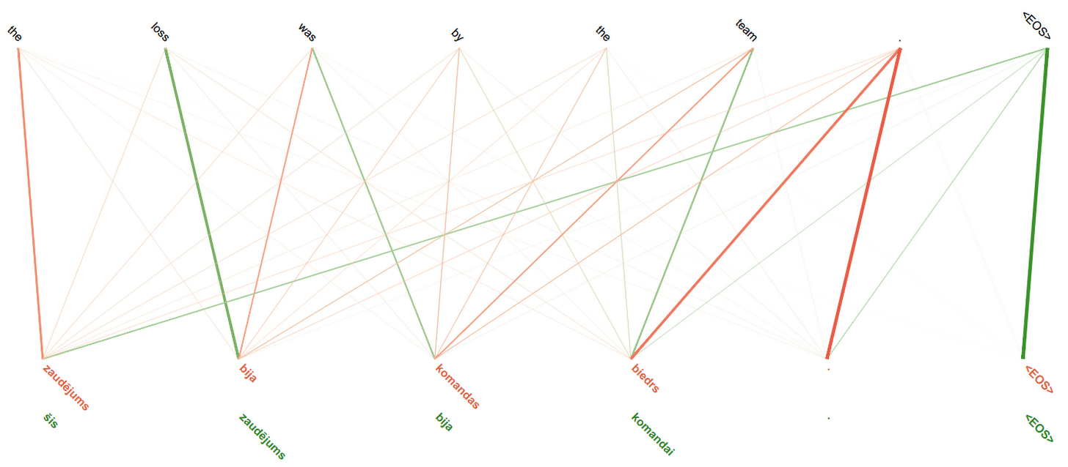
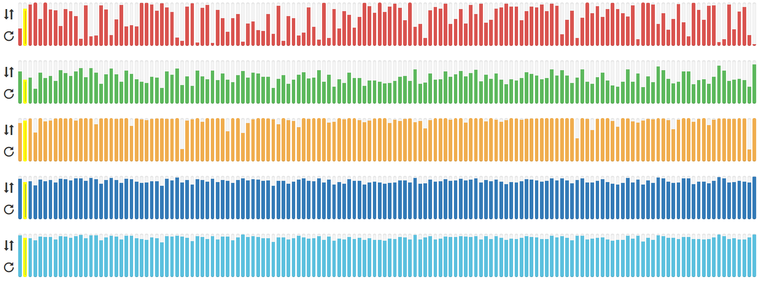
Visualising
NMT attention
and
confidence

Slide 34
Cleaning corpora to improve NMT performance
English | Estonian
Add to my wishlist | Hommikul (200 + 200 = 400 kcal)
Dec 2009 | ÊßÇÌí 2009
I voted in favour. | kirjalikult. – (IT) Hääletasin poolt.
I voted in favour. | Ma andsin oma poolthääle.
That is the wrong way to go. | See ei ole õge.
This is simply wrong. | See ei ole õge.
Zaghachi See okwu | 3 Comments
Täna mängitud: 25 910 | Täna mängitud: 25 929
1 If , , and are the roots of , compute . | 1 Juhul kui , Ja on juured , Arvutama .
we have that and or or or . | meil on, et ja või või või .
NXT Spray - NAPURA | NXT SPRAY NXT SPRAY

Slide 35
Cleaning corpora to improve NMT performance
Unique parallel sentence filter ­– removes duplicate source-target sentence pairs
Equal source-target filter - removes sentences that are identical in the source side and the target side of the corpus
Multiple sources - one target and multiple targets - one source filters – remove repeating sentence pairs where the same source sentence is aligned to multiple different target sentences and multiple source sentences aligned to the same target sentence
Non-alphabetical filters – remove sentences that contain > 50% non-alphabetical symbols on the source or the target side, and sentence pairs that have significantly more (at least 1:3) non-alphabetical symbols in the source side than in the target side (or vice versa)
Repeating token filter – removes sentences with consecutive repeating tokens or phrases.
Correct language filter – estimates the language of each sentence (Lui and Baldwin, 2012) and removes any sentence that has a different identified language from the one specified

Slide 36
Cleaning corpora to improve NMT performance
 | Paracrawl |  | Rapid |  |  | Europarl
 | En-Et | En-Fi | En-Et | En-Fi | En-Lv | En-Et | En-Fi | En-Lv
Corpus size | 1 298 103 | 624 058 | 226 978 | 583 223 | 306 588 | 652 944 | 1 926 114 | 638 789
Removed | 1 097 779 | 131 705 | 25 148 | 211 688 | 102 112 | 42 274 | 102 039 | 29 861
 | 85% | 21% | 11% | 36% | 33% | 6% | 5% | 5%
 | En-Et | Et-En | En-Fi | Fi-En | En-Lv | Lv-En
BLEU Unfiltered | 15.45 | 21.55 | 20.07 | 25.25 | 21.29 | 24.12
Corpus size after filtering | 46.50% |  | 82.72% |  | 35.85%
BLEU Filtered | 15.80 | 21.62 | 19.64 | 25.04 | 22.89 | 24.37
BLEU Difference | +0.35 | +0.07 | -0.43 | -0.21 | +1.60 | +0.25

Slide 37
Conclusions

Slide 38
Conclusions
Hybrid MT combination via chunking outperformed individual systems in translating long SMT sentences
Hybrid combination for NMT via attention alignments complies to the emerging technology of neural network MT systems and can distinguish low quality translations from high quality ones
It has also been used in MT quality estimation research (Ive et al., 2018; Yankovskaya et al., 2018)
The graphical tools help to inspect how translations are composed from component systems, and overview results of generated translations to locate better or worse results quickly
The NMT visualization and debugging tool is used to teach students in Charles University, the University of Tartu and in the University of Zurich. It is also currently the most cited (8) publication of the author and has received the most stars (31) and forks (12) on GitHub, indicating that it is appreciated by the research community

Slide 39
Main results
A method for hybrid MT combination using chunking and neural LMs
A method for hybrid neural machine translation combination via attention
A method for multi-pass incremental training for NMT
Graphical tools for overviewing the and debugging processes
State-of-the-art MT systems (Estonian ↔ Russian and Estonian ↔ English) along with details and required tools for reproducibility
The proposed hypothesis that it is possible to produce higher quality translations for the Baltic languages by combining output from multiple different MT systems than produced by each component system individually can be considered as proven.

Slide 40
Approbation in Research Projects
Research project “Neural Network Modelling for Inflected Natural Languages” No. 1.1.1.1/16/A/215. Research activity No. 3 “Usability of neural networks for automated translation”. Project supported by the European Regional Development Fund.
ICT COST Action IC1207 “ParseME: Parsing and multi-word expressions. Towards linguistic precision and computational efficiency in natural language processing.”
Research project “Forest Sector Competence Centre” No. 1.2.1.1/16/A/009. Project supported by the European Regional Development Fund.
Publications
17 publications
10 indexed in Web of Science and / or in Scopus
7 in other peer-reviewed conference proceedings
Presented in
10 international conferences
3 international workshops
2 local conferences

Slide 41
Publications
Rikters,M., Pinnis, M. (2018, December) Debugging Translations of Transformer-based Neural Machine Translation Systems. Baltic Journal of Modern Computing.
Pinnis, M., Rikters, M., Krišlauks, R. (2018, October). Tilde's Machine Translation Systems for WMT2018. In the proceedings of The 3rd Conference on Machine Translation.
Rikters, M. (2018b, September) Impact of Corpora Quality on Neural Machine Translation. In The 8th Conference on Human Language Technologies - the Baltic Perspective (Baltic HLT 2016)
Rikters, M., Pinnis, M., Rozis, R., Krišlauks, R. (2018b, September) Advancing Estonian Machine Translation. In The 8th Conference on Human Language Technologies - the Baltic Perspective (Baltic HLT 2016)
Rikters, M. (2018a, July). Debugging Neural Machine Translations. In The 13th International Baltic Conference on Databases and Information Systems
Rikters, M., Pinnis, M., Krišlauks, R. (2018a, May). Training and Adapting Multilingual NMT for Less-resourced and Morphologically Rich Languages. In Proceedings of The 11th International Conference on Language Resources and Evaluation (LREC 2018). Paris, France: European Language Resources Association (ELRA).

Slide 42
Publications
Rikters, M., Fishel, M. (2017, September). Confidence Through Attention. In the proceedings of The 16th Machine Translation Summit.
Rikters, M., Bojar, O. (2017, September). Paying Attention to Multi-word Expressions in Neural Machine Translation. In the proceedings of The 16th Machine Translation Summit.
Rikters, M., Amrhein, C., Del, M., Fishel, M. (2017b, September). C-3MA: Tartu-Riga-Zurich Translation Systems for WMT17. In the proceedings of The 2nd Conference on Machine Translation.
Rikters, M., Fishel, M., Bojar, O. (2017a, August). Visualizing Neural Machine Translation Attention and Confidence. In The Prague Bulletin for Mathematical Linguistics issue 109.
Rikters, M. (2016d, December). Neural Network Language Models for Candidate Scoring in Hybrid Multi-System Machine Translation. In CoLing 2016, 6th Workshop on Hybrid Approaches to Translation (HyTra 6).
Rikters, M. (2016c, October). Searching for the Best Translation Combination Across All Possible Variants. In The 7th Conference on Human Language Technologies - the Baltic Perspective (Baltic HLT 2016) (pp. 92-96).

Slide 43
Publications
Rikters, M. (2016b, September). Interactive multi-system machine translation with neural language models. In Frontiers in Artificial Intelligence and Applications.
Rikters, M. (2016a, July). K-Translate-Interactive Multi-System Machine Translation. In The 12th International Baltic Conference on Databases and Information Systems (pp. 304-318). Springer International Publishing.
Rikters, M., Skadiņa, I. (2016b, May). Syntax-based multi-system machine translation. In N. C. C. Chair) et al. (Eds.), In Proceedings of The 10th International Conference on Language Resources and Evaluation (LREC 2016). Paris, France: European Language Resources Association (ELRA).
Rikters, M., Skadiņa, I. (2016a, April) Combining machine translated sentence chunks from multiple MT systems. In The 17th International Conference on Intelligent Text Processing and Computational Linguistics (CICLing 2016).
Rikters, M. (2015, July). Multi-system machine translation using online APIs for English-Latvian. In ACL-IJCNLP 2015, 4th Workshop on Hybrid Approaches to Translation (HyTra 4).

Slide 44
Thank you!

Slide 45
Questions - Maja Popović
Section 3.5 - It is not clear why correlation between BLEU and perplexity is important at all, and also why specifically in relation to neural language models.
Neural LMs were gaining popularity at the time. The idea of relating BLEU and perplexity was that with improving LMs the translation selection should also improve.
Section 4.2.3 - A table with corpus statistics would be very helpful, because it is not clear which data were used for NMT systems, which for back-translation, which for training of LMs, etc
Section 4.4.5 - Table 33: There are no results for EN-RU and RU-EN
This language pair was out of the scope of the project.
Section 5.1.2 - Were the online systems in this experiment still based on PBMT, or already on NMT?
Still PBMT. Google introduced NMT only in November 2016.
Section 5.3 - It is not clear why the Finnish system is trained with only one back-translated data set and the Estonian system with two.
That was a business decision.

Slide 46
Purpose | En | De(-En) | Lv(-En)
NMT |  | 4.5 M | 4.5 M
LM |  | 4 M | 4 M
Back-translation | 4.5 M | 4.5 M | 4.5 M

