Slide 1
MODELLING LATVIAN LANGUAGE FOR AUTOMATIC SPEECH RECOGNITION
Askars Salimbajevs
Supervisor: Prof. Inguna Skadiņa University of Latvia

Slide 2
Outline
Introduction
Acoustic modelling
Automatic data acquisition
Pronunciation model
Language modelling
Text preprocessing
Word and sub-word N-gram models
Results

Slide 3
Research Area
The research area in the focus of this thesis is the Automatic Speech Recognition (ASR).
Automatic Speech Recognition is the ability of a machine to identify words and phrases in spoken language and convert them to a machine-readable format.

Slide 4
Relevance and motivation
Automatic speech recognition can have many useful applications, e.g.:
Natural communication interface
Audio record transcription, keyword search etc.
There were no publicly available services of this kind for Latvian language.
LETA/LUMII, Google, Speechmatics – appeared later during research
Latvian language is probably the least researched among languages of Baltic States.
Solutions and methods for Latvian can also benefit research for other “small” languages.

Slide 5
Concepts of Speech Recognition
$$T^{′}=arg\max_{T}{P(T|acoustic signal)}$$
$$T^{′}=arg\max_{T}{\frac{P\left(acoustic signal|T\right)P\left(T\right)}{P\left(acoustic signal\right)}}$$
P(X|T) is the acoustic model,
P(T) is the language model,
Modern speech recognition systems are built by combining several different statistical models, that represent different sources of knowledge, such as acoustics, language, and syntax.
Models are language specific and estimated from a large collection of statistical data, e.g. speech recordings, texts, pronunciation vocabularies etc.

Slide 6
Evaluation
Word Error Rate (WER)
insertions + substitutions + deletions
WER = ------------------------------------------------
word count
Example
Vasara ir īsts festivālu laiks
Recognized as «Asara īsts festivāla laiks»
WER = ( 0 + 2 + 1 ) / 5 = 60%

Slide 7
Aim and Objectives
The aim of the research is to find efficient algorithms and create optimal models and systems for Latvian language speech recognition.
Develop a speech recognition system for real business applications.
This research seeks answers to the following questions:
What data is needed to train models for speech recognition for Latvian?
What modelling methods and algorithms are the most appropriate for Latvian?
How to adapt speech recognition models and their output to specific applications?
Serve as a baseline for future Latvian speech recognition research.

Slide 8
ACOUSTIC MODEL

Slide 9
Acoustic Modelling for Latvian
P(acoustic signal | T) – how T sounds like?
Monophone HMM-GMM
Triphone HMM-GMM
Triphone HMM-GMM with LDA
…
TDNN, iVector, “chain” model ← the best WER
Kaldi framework Povey, D., Ghoshal, A., Boulianne, G., Burget, L., Glembek, O., Goel, N., … Vesely, K. (2011). The Kaldi speech recognition toolkit. In IEEE Workshop on Automatic Speech Recognition and Understanding

Slide 10
Acoustic Model Training Data
Corpus | Description | Size, h | % of all
LSRC | Balanced corpus specially designed for speech recognition | 100 | 34.0%
LDSC | Balanced corpus for dictation scenario | 8 | 2.7%
Saeima11 | Automatically created speech corpus from Saeima webpage | 186 | 63.3%
Total |  | 294 | 100%
Pinnis, M., Auziņa, I., & Goba, K. (2014). Designing the Latvian Speech Recognition Corpus. In Proceedings of the 9th edition of the Language Resources and Evaluation Conference (LREC’14) (pp. 1547–1553).
Pinnis, M., Salimbajevs, A., & Auzina, I. (2016). Designing a Speech Corpus for the Development and Evaluation of Dictation Systems in Latvian, In Proceedings of the 10th edition of the Language Resources and Evaluation Conference (LREC’16)
Salimbajevs, A. (2018). Creating Lithuanian and Latvian Speech Corpora from Inaccurately Annotated Web Data. In LREC 2018, 11th International Conference on Language Resources and Evaluation, Miyazaki, Japan, May 7-12, 2018.

Slide 11
Automatic Acquisition of Training Data
In recent years, improvements in technology have made it feasible to provide Internet users with access to large amounts of multimedia content.
For example, the Latvian Parliament (Saeima) website contains a large archive of video recordings and the written protocols.
However, these transcripts are not suitable for using directly
Unsegmented
No timing information
Not 100% accurate

Slide 12
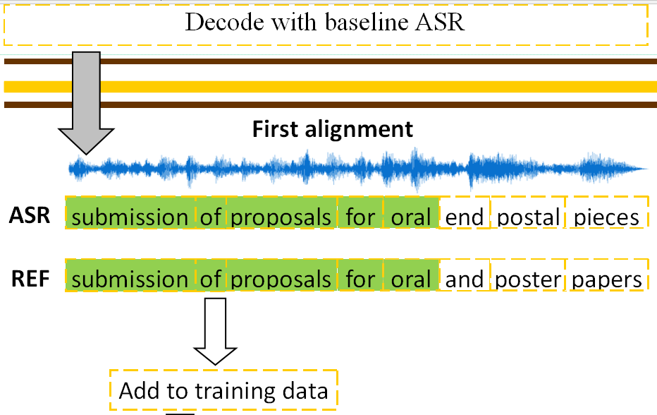
Automatic Acquisition of Training Data
Salimbajevs, A. (2018). Creating Lithuanian and Latvian Speech Corpora from Inaccurately Annotated Web Data. In LREC 2018, 11th International Conference on Language Resources and Evaluation, Miyazaki, Japan, May 7-12, 2018.

Slide 13
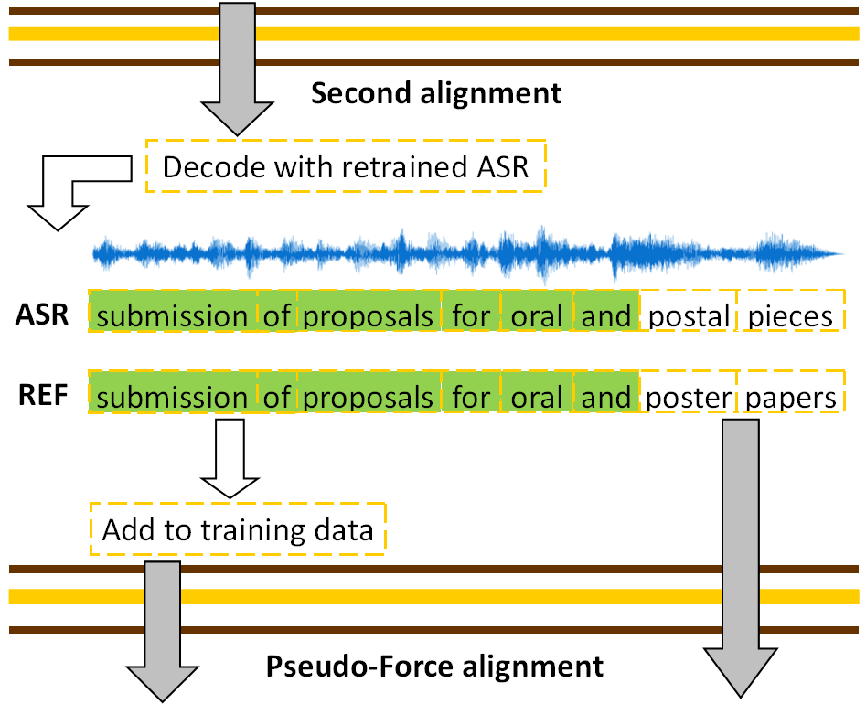
Automatic Acquisition of Training Data
Salimbajevs, A. (2018). Creating Lithuanian and Latvian Speech Corpora from Inaccurately Annotated Web Data. In LREC 2018, 11th International Conference on Language Resources and Evaluation, Miyazaki, Japan, May 7-12, 2018.

Slide 14
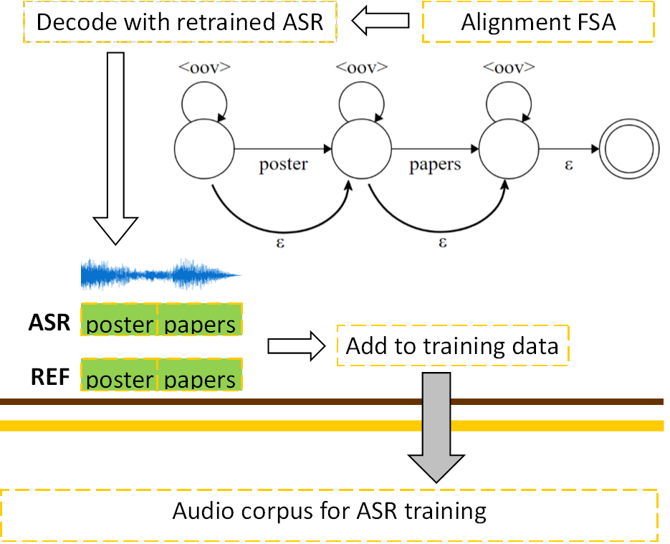
Pseudo-Force Alignment
Salimbajevs, A. (2018). Creating Lithuanian and Latvian Speech Corpora from Inaccurately Annotated Web Data. In LREC 2018, 11th International Conference on Language Resources and Evaluation, Miyazaki, Japan, May 7-12, 2018.

Slide 15
Automatic Acquisition of Training Data
300h of Saeima sessions from 2011-2014
Additional 186 hours of training data after alignment
ASR | WER, %
LSRC data only | 19.4%
After adding additional data | 16.9%
 | -2.5 (13%)

Slide 16
Data Augmentation
A copy of all data (294h) is created and different room impulse response are randomly applied to each utterance.
Two copies of each training utterance are created:
One is slowed down to 90% speed
The other is speed up to 110%
The amount of training data is increased 3 times
Randomly applying lowpass filtering to about 50% of corpus to make model robust to narrowband audio.
Total: 294 * 2 * 3 = 1764 hours

Slide 17
Data Augmentation
EvalGeneral, to evaluate WER on good quality wideband (16kHz) audio.
Narrowband version of EvalWebNews, to evaluate acoustic model robustness to mismatched audio conditions.
Data augmentation |  |  |  | WER, %
Reverb | Speed | Lowpass | Total size, h | EvalGeneral | EvalWebNews (narrowband)
No | No | No | 294 | 10.5 | 52.5
Yes | No | No | 588 | 10.0 | 18.9
Yes | Yes | No | 1764 | 10.1 | 17.0
Yes | Yes | Yes | 1764 | 10.1 | 13.9

Slide 18
Grapheme-to-phoneme Model
P(acoustic signal | T) – how text T sounds like? T is decomposed into words
P(phoneme sequence | word) – pronunciation model
Used to calculate: P(phoneme sequence | word sequence)
P(acoustic signal | phoneme sequence) – acoustic model

Slide 19
Grapheme-to-phoneme Model
Grapheme-based approach showed the best results
33 phonemes (one for each letter)
Dictionary of exceptions
Abbreviations, acronyms
Other (e.g. komats -> koma)

Slide 20
Grapheme-to-phoneme Model
Model | Phoneme error rate | WER
Grapheme-based (baseline set) | 8.14 % | 13.7%
Context-dependent (from Text-To-Speech) | - | 13.7%
Phonetisaurus WFST | 5.24 % | 14.0%
Statistical machine translation #1 | 3.26 % | 23.0%
Statistical machine translation #2 | - | 16.0 %
Phoneme set description | WER
Graphemes + 4 diphthongs* | 13.7%
Phonemes [o] and [uo] are distinguished | 14.2%
Phoneme [ss] is added | 14.1%
Phoneme [c] is removed and combination of [t]+[s] is used instead | 14.2%
Long phoneme [ā] is removed | 14.9%
[ei] diphthong is removed | 13.9%
[ui] diphthong is added | 14.2%
* Two letter combinations “ai”, “au”, “ei” and “ie” are replaced with corresponding diphthongs

Slide 21
Grapheme-to-phoneme Model
G2P model | General, WER | Saeima, WER
Baseline | 35.9% | 37.3%
TTS G2P | 36.3% | 38.2%
No diphthongs | 35.7% | 36.0%
No [c] phoneme | 36.2% | 36.8%
No diphones and no long vowels | 36.2% | 37.0%
No diphones and no [c] phoneme | 35.9% | 36.7%

Slide 22
LANGUAGE MODEL

Slide 23
Language Modelling for Latvian
P(W) – is unconditional probability of word sequence
Knowledge of the language, i.e. what sentences belong to language?
In this work N-gram language models were proven effective for modelling of Latvian language.

Slide 24
Language Modelling for Latvian
Word n-gram language models (LM) are probabilistic models that attempt to predict the next word based on the previous n-1 words.
Trained on WebNews corpus
46.6M automatically crawled sentences from Latvian news portals
$$P\left(w_{i} | w_{i−1},...,w_{\left(i−n)+1\right.}\right)=\frac{\left.cnt(w_{\left(i−n)+1\right.},..,w_{i−1},w_{i}\right)}{\left.cnt(w_{\left(i−n)+1\right.},..,w_{i−1}\right)}$$

Slide 25
Text Corpus Preprocessing
Tokenization and text normalization
Number conversion from digits to words with correct inflection 100km -> 100 km -> simts kilometri
All punctuation and special symbols (#, %, &, ... ) are filtered out. Mixed tokens are also filtered out: l0lz kas tas %)
True casing using spell-checker latvija -> Latvija, Esmu -> esmu, daRĪt -> darīt

Slide 26
Text Corpus Preprocessing
Process corpus with the Latvian spell-checker
Filtering sentences that contain more than 1 error septindesmit viens procents iedzīvotāju doma ...
Train n-gram model on remaining sentences
Select n-grams that contain only correct words
Max numbers of errors | WER, %
0 | 20.31
1 | 19.63
2 | 20.87

Slide 27
N-gram Language Model
Best results achieved with 3-gram LM
800K word vocabulary
Unpruned, 322M n-grams
Insignificant improvement from 4-gram model
But much higher hardware requirements

Slide 28
Sub-word Language Model
Traditional N-gram models treat inflected forms as independent words and does not recognize their similarity
Sub-word models can significantly decrease vocabulary size
Sub-word models enable open vocabulary ASR
There are many ways of decomposition and reconstruction
Morfessor, BPE, stemmers, morphological splitters…
Hidden event LM, markings, tags

Slide 29
Sub-word Language Model
Decomposition: Morfessor 2.0 and Byte-Pair Encoding
Reconstruction:
Integration into decoding graph
Marking style | Example
Boundary tag | <w> kā <w> pie dzīv ojums <w>
Left-marked | kā pie +dzīv +ojums
Right-marked | kā pie+ dzīv+ ojums
Left+right-marked | kā pie+ +dzīv+ +ojums
Smit, P., Virpioja, S., & Kurimo, M. (2017). Improved Subword Modeling for WFST-Based Speech Recognition. In Proc. Interspeech 2017 (pp. 2551–2555).

Slide 30
Sub-word Language Model
Test corpus | WER, %
 | Baseline | Morfessor sub-words | BPE sub-words
EvalWebNews | 10.3 | 10.2 | 10.1
EvalGeneral | 10.4 | 9.8 | 9.6
Saeima-test | 8.3 | 7.9 | 7.8
6-gram LM, models are pruned, so that the total n-gram count is similar to baseline bigram and trigram models.
Trained on segmented WebNews
234K units for Morfessor and 130K units for BPE

Slide 31
Sub-word Language Model
Test corpus | Process | Baseline ASR | BPE LM ASR
EvalWebNews | Decoding | 184 seconds | 189 seconds
 | Rescoring | 16 seconds | 16 seconds
Saeima-test | Decoding | 560 seconds | 586 seconds
 | Rescoring | 21 seconds | 21 seconds
BPE LM ASR correctly recognizes 38.9% of out-of-vocabulary in EvalWebNews.
It can be concluded that sub-word approach is able to partially overcome sparsity created by inflected forms and improve the speech recognition quality.

Slide 32
RESULTS

Slide 33
Adaptation
Latvian Speech-To-Text Transcription Service
Saeima Session Transcription
Dictation
Street Address Recognition
Punctuation Restoration
TASK | WER, %
EvalWebNews (general domain) | 10.1
EvalGeneral (general domain) | 9.6
Saeima (adapted LM) | 5.9
Saeima (general domain) | 7.8
Dictation (adapted ASR) | 12.2
Street address (adapted LM) | 7.9

Slide 34
Results
Applications
ASR web-service for Latvian
Publicly available using a web-page or API
Mobile app Reizrēķins
A software package Tildes Birojs
Audio and video file transcription
Dictation
Mobile app Tildes Balss Beta
since 2015 (Google Latvian ASR – 2017)
ASR | WER on EvalWebNews, %
This work | 10.1
Google* | 36.2-50.6
Speechmatics* | 25.2
* As evaluated in May, 2018

Slide 35
Results
Acoustic, pronunciation and language models for Latvian
Methods for preparing training data
Additional acoustic model training data (186 hours)
State-of-the-art recognition accuracy
Punctuation restoration
Adapted for several tasks
Following the same guidelines allowed to develop a large vocabulary ASR for Lithuanian
Salimbajevs, A., & Kapočiūtė-Dzikienė, J. (2018). General-purpose Lithuanian Automatic Speech Recognition System. In Human Language Technologies - The Baltic Perspective - Proceedings of the Seventh International Conference Baltic HLT 2018, Tartu, Estonia, September 27-29, 2018.

Slide 36
Publications
Varavs, A., & Salimbajevs, A. (2018). Restoring Punctuation and Capitalization Using Transformer Models. 6th International Conference on Statistical Language and Speech Processing (SLSP 2018), October 15-16, 2018. Contribution: 25% (SCOPUS, Web of Science, to be indexed).
Salimbajevs, A., & Kapočiūtė-Dzikienė, J. (2018). General-purpose Lithuanian Automatic Speech Recognition System. In Human Language Technologies - The Baltic Perspective - Proceedings of the Seventh International Conference Baltic HLT 2018, Tartu, Estonia, September 27-29, 2018.
Salimbajevs, A. (2018). Creating Lithuanian and Latvian Speech Corpora from Inaccurately Annotated Web Data. In LREC 2018, 11th International Conference on Language Resources and Evaluation, Miyazaki, Japan, May 7-12, 2018.
Salimbajevs, A., & Ikauniece, I. (2017). System for speech transcription and post-editing in Microsoft Word. In INTERSPEECH 2017, 18th Annual Conference of the International Speech Communication Association, Stockholm, Sweden, August 20-24, 2017 (pp. 825–826).

Slide 37
Publications
Pinnis, M., Salimbajevs, A., & Auzina, I. (2016). Designing a Speech Corpus for the Development and Evaluation of Dictation Systems in Latvian. In N. C. (Conference Chair), K. Choukri, T. Declerck, M. Grobelnik, B. Maegaard, J. Mariani, S. Piperidis (Eds.), Proceedings of the Tenth International Conference on Language Resources and Evaluation (LREC 2016). Paris, France: European Language Resources Association (ELRA).
Salimbajevs, A. (2016). Bidirectional LSTM for Automatic Punctuation Restoration. In I. Skadina & R. Rozis (Eds.), Human Language Technologies - The Baltic Perspective - Proceedings of the Seventh International Conference Baltic HLT 2016, Riga, Latvia, October 6-7, 2016 (Vol. 289, pp. 59–65). IOS Press. http://doi.org/10.3233/978-1-61499-701-6-59
Salimbajevs, A. (2016). Towards the First Dictation System for Latvian Language. In I. Skadina & R. Rozis (Eds.), Human Language Technologies - The Baltic Perspective - Proceedings of the Seventh International Conference Baltic HLT 2016, Riga, Latvia, October 6-7, 2016 (Vol. 289, pp. 66–73). IOS Press. http://doi.org/10.3233/978-1-61499-701-6-66
Salimbajevs, A., & Strigins, J. (2015). Latvian Speech-to-Text Transcription Service. In INTERSPEECH 2015, 16th Annual Conference of the International Speech Communication Association, Dresden, Germany, September 6-10, 2015 (pp. 723-725)

Slide 38
Publications
Salimbajevs, A., & Strigins, J. (2015). Error Analysis and Improving Speech Recognition for Latvian Language. In Recent Advances in Natural Language Processing, RANLP 2015, 7-9 September, 2015, Hissar, Bulgaria (pp. 563–569).
Salimbajevs, A., & Strigins, J. (2015). Using sub-word n-gram models for dealing with OOV in large vocabulary speech recognition for Latvian. In B. Megyesi (Ed.), Proceedings of the 20th Nordic Conference of Computational Linguistics, NODALIDA 2015, May 11-13, 2015, Institute of the Lithuanian Language, Vilnius, Lithuania (pp. 281–285). Link{ö}ping University Electronic Press / ACL.
Salimbajevs, A., & Pinnis, M. (2014). Towards Large Vocabulary Automatic Speech Recognition for Latvian. In Human Language Technologies – The Baltic Perspective (pp. 236–243). IOS Press.

Slide 39
Approbation in Research Projects
Research project “Competence Centre of Information and Communication Technologies” of EU Structural funds, contract nr. L-KC-11-0003 signed between the ICT Competence Centre (www.itkc.lv) and the Investment and Development Agency of Latvia, research No. 2.4 “Speech recognition technologies”.
Research project ”Competence Centre of Information and Communication Technologies” of EU Structural funds, contract No. 1.2.1.1/16/A/007 signed between ICT Competence Centre and Central Finance and Contracting Agency, Research No. 2.3 “Speech recognition and synthesis for professional application”.
Project “Automatic speech recognition, synthesis and creation and improvement of adaptation technologies in R & D” ("Speech Cloud"), No. J05-LVPA-K-01-0034. Supported by EU Investment Fund under 2014–2020 Economic Growth Operational Programme’s 1st priority "Scientific Research, Experimental Development and Innovation Promotion" measure "Intellect. Joint Science-Business Projects" (invitation No. J05-LVPA-K-01).
Research project "Neural Network Modelling for Inflected Natural Languages" No. 1.1.1.1/16/A/215. Research activity No. 4 “Neural network model for speech technologies (LV, LT)”. Project supported by the European Regional Development Fund.

Slide 40
Publications
11 publications
9 publications the thesis is based on
2 publications relevant to the topics discussed in the thesis.
10 indexed Scopus and/or Web of Science

Slide 41
Summary of Contributions
Automatic data collection
ASR for Latvian
Acoustic model
Pronunciation model
Text filtering and preprocessing
Language model
Sub-word language model
Shared rescoring
Decoding
Training data adaptation
Punctuation restoration
Adaptation
Practical applications
Integration into MS Word
Postprocessing
11 publications
9 publications the thesis is based on
2 publications relevant to the topics discussed in the thesis.
10 indexed Scopus and/or Web of Science

Slide 42
Q&A

