Slide 1
Sim2Real Transfer for Reinforcement Learning
Mg.sc.ing. Anatolijs Zencovs
Research assistant
Institute of Electronics and Computer Science
anatolijs.zencovs@edi.lv
+371 67558129
14 Dzerbenes street, Riga, Latvia, LV1006

Slide 2
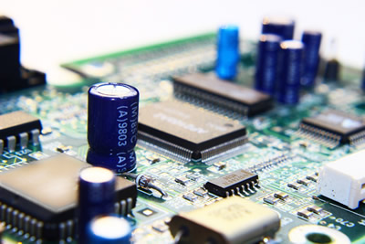
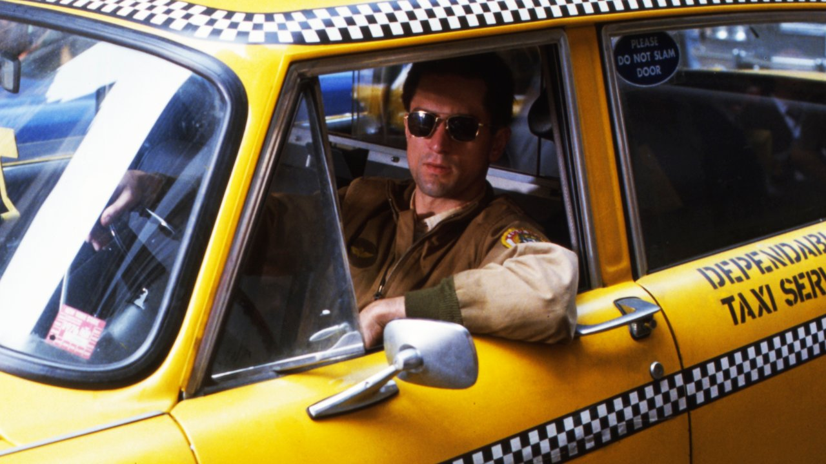
My road to Science
TIME

Slide 3
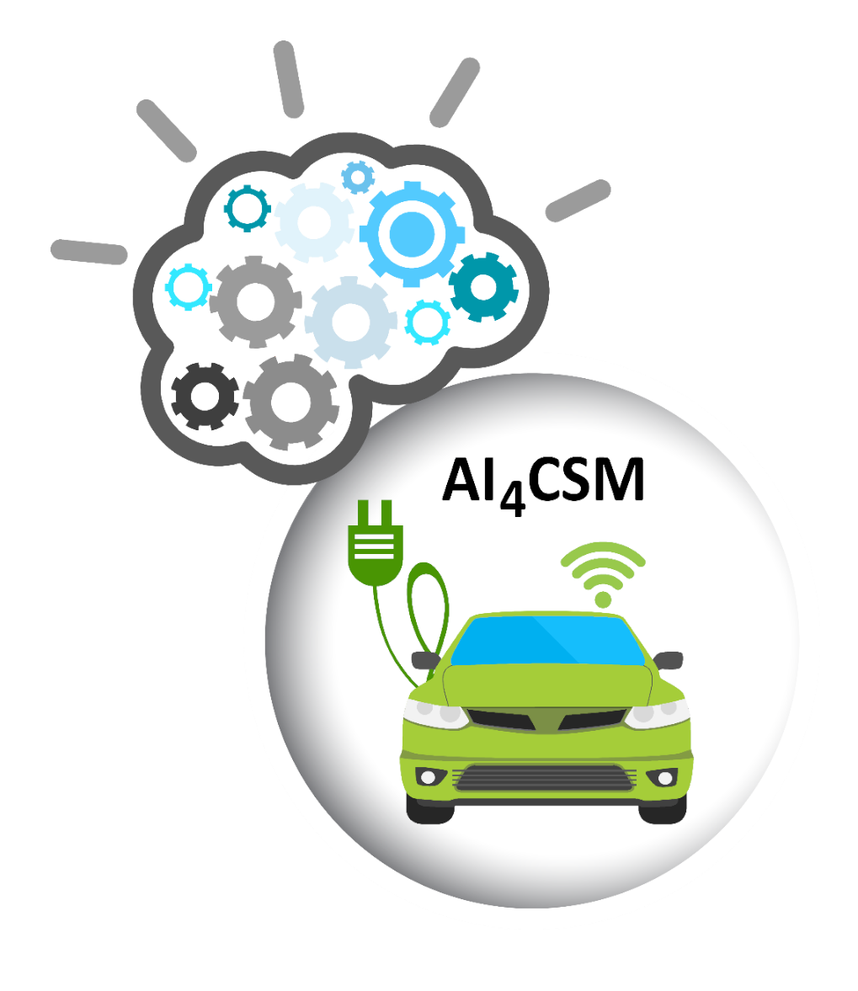
Institute of Electronics and Computer Science
Start working in December 2019
Past projects:
COV-CLEAN (Integration of reliable technologies for protection against Covid-19 in healthcare and high-risk areas)
VAPI (Efficient module for automatic detection of people and vehicles using video surveillance cameras)
Currently working on two Horizon 2020 projects:
AI4CSM - Automotive Intelligence for/at Connected Shared Mobility
IMOCO4.E - Intelligent Motion Control under Industry 4.E

Slide 4
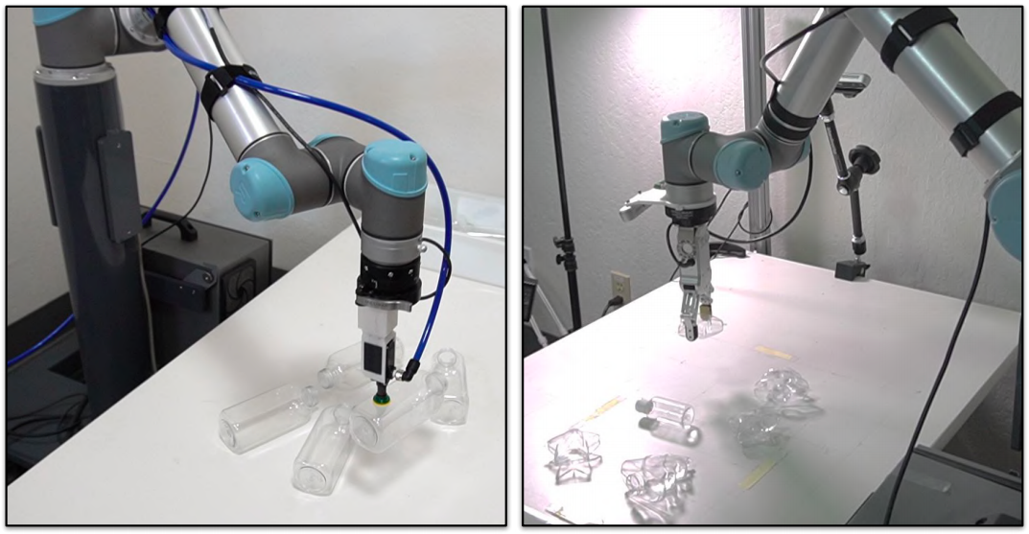
IMOCO4.E project
Madara cosmetics
UR5 robot arm
Bottle pick and place
RL algorithms to grasp objects

Slide 5
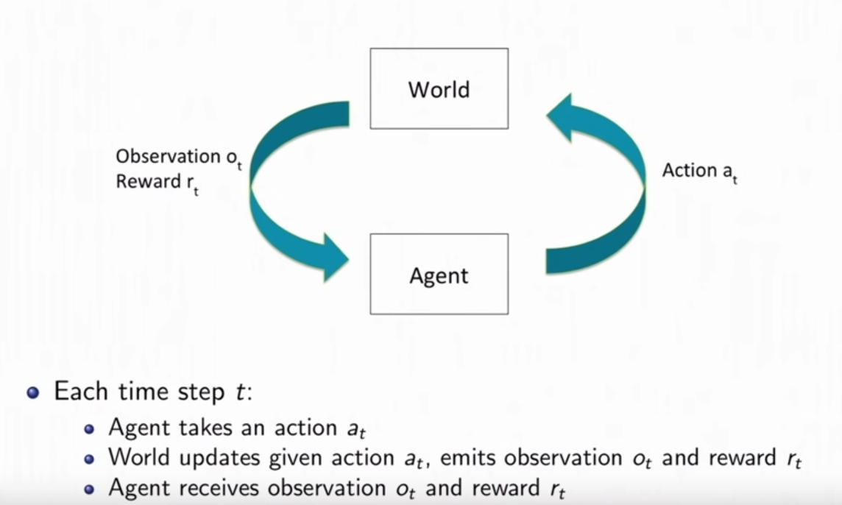
Reinforcement Learning
Image taken from Stanford CS234: Reinforcement Learning lecture

Slide 6
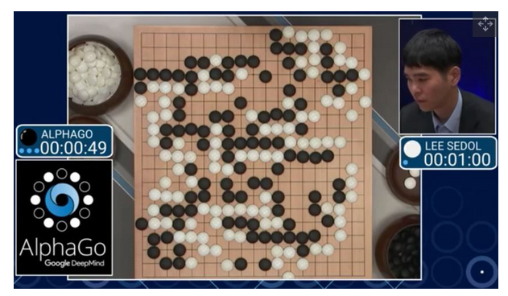
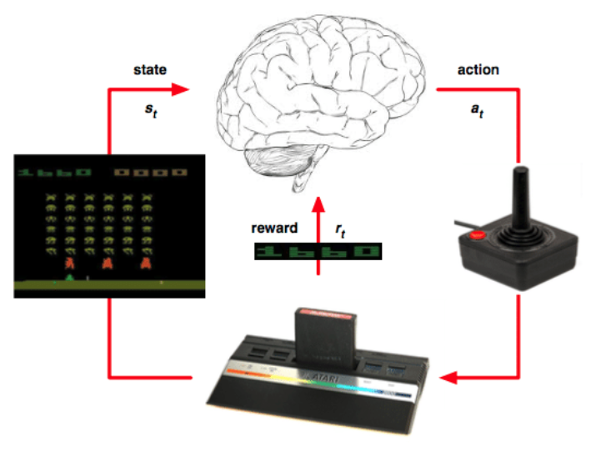
Use of Reinforcement Learning
Google DeepMind
Atari games
AlphaGo
defeat Lee Sedol, the 18-time world champion;
10³⁶⁰ possible moves
Source - https://www.tomshardware.com/news/alphago-defeats-sedol-second-time,31377.html
Source - https://www.researchgate.net/figure/Principal-sketch-of-Reinforcement-Learning-in-the-Atari-game-playing-domain-for-single_fig1_313469674

Slide 7
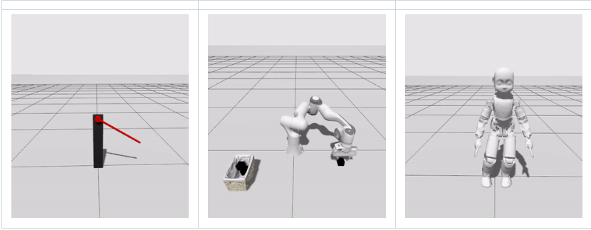
Simulator
RL needs a lot of data for training
Data acquisition is hard and expensive
Synthetic data (Buls, E., Kadikis, R., Cacurs, R., & Ārents, J. (2019, March). Generation of synthetic training data for object detection in piles)
Simulator – Ignition Gazebo + gym-ignition
ROS2 + Moveit2
Source - https://github.com/robotology/gym-ignition

Slide 8
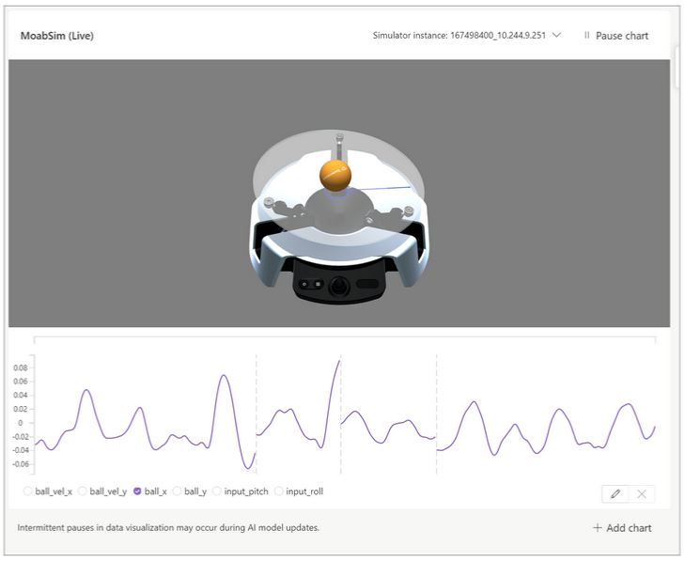
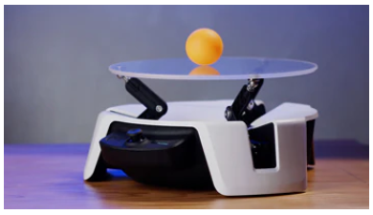
Use of RL algorithms in real life
Project Bonsai by Microsoft
Distributed Deep Q Network (APEX)
Proximal Policy Optimization (PPO)
Soft Actor Critic (SAC)
Source – www.microsoft.com

Slide 9
Sim2Real approaches
Zero-shot Transfer
Pros: transfer model to real world without further adjustments
Cons: realistic simulators with precise models of the real world have to be built
Domain Randomization
Visual randomization (textures, lighting, camera position)
Dynamics randomization (object dims, surface friction coefficients, actuator force gains)

Slide 10
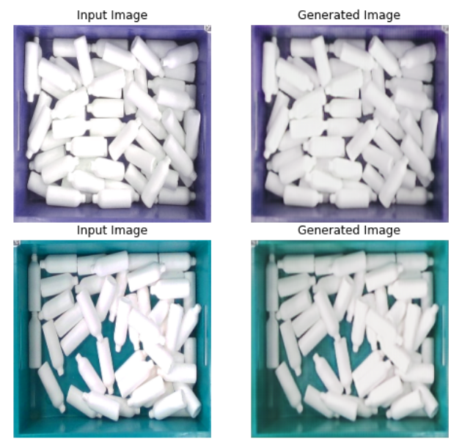
First steps in Sim2Real
CycleGAN – unlike GAN (Generative Adversarial Networks) involves the simultaneous training of two generator models and two discriminator models
Source – Diana Duplevska

Slide 11
Next steps
Improve CycleGAN algorithm to achieve better image translation results
Environment setup in simulator
Implementation of RL algorithms in gym-ignition
First attempts of training and evaluation
Next steps depends on previous one (fine-tuning, domain randomization, etc.)

Slide 12
References
W. Zhao, J. P. Queralta and T. Westerlund, "Sim-to-Real Transfer in Deep Reinforcement Learning for Robotics: a Survey," 2020 IEEE Symposium Series on Computational Intelligence (SSCI), 2020, pp. 737-744, doi: 10.1109/SSCI47803.2020.9308468.
K. Rao, C. Harris, A. Irpan, S. Levine, J. Ibarz, and M. Khansari, “RL-CycleGan: Reinforcement learning aware simulation-to-real” Proceedings of the IEEE Computer Society Conference on Computer Vision and Pattern Recognition, 2020. https://arxiv.org/abs/2006.09001.
M. Korber, J. Lange, S. Rediske, S. Steinmann, and R. Gluck, “Comparing Popular Simulation Environments in the Scope of Robotics an Reinforcement Learning,” Mar. 2021, arXiv:2103.04616v1. [Online]. Available: https://arxiv.org/abs/2103.04616
J. Collins, S. Chand, A. Vanderkop, and D. Howard, “A Review of Physics Simulators for Robotic Applications,” IEEE Access, vol. 9, pp. 51416-51431, Mar. 2021
O.-M. Pedersen, E. Misimi, and F. Chaumette, “Grasping Unknown Objects by Coupling Deep Reinforcement Learning, Generative Adversarial Networks, and Visual Servoing,” in 2020 IEEE International Conference on Robotics and Automation (ICRA), May 2020, pp. 5655–5662, doi: 10.1109/ICRA40945.2020.9197196.
[Internet resource] – www.microsoft.com

Slide 13
Thank you!

