Slide 1

Human BODY as Data Transmission Medium
Author: Juris Ormanis
Juris.Ormanis@edi.lv
Supervisor: Modris Greitāns

Slide 2
Objectives
Develop Human body signal transmission model
Characterize Human body from the communication channel point of view
Describe skin contamination influence on channel parameters

Slide 3
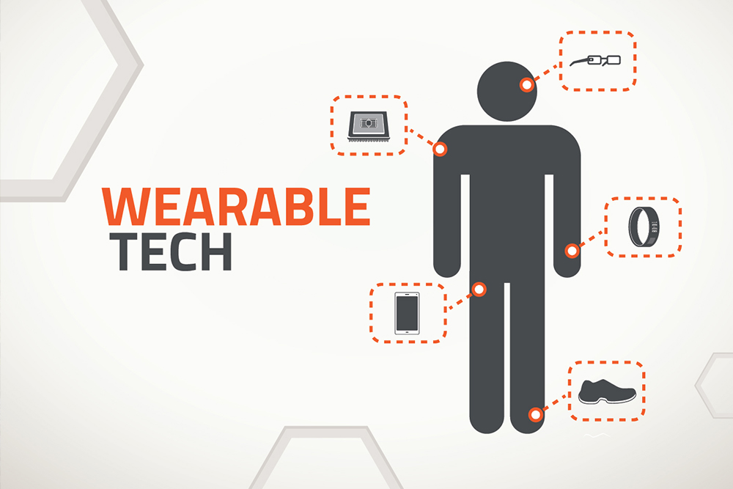
Introduction
Market growth by 210% in next 4 years [https://www.statista.com/]
In 2021 number of wearable devices will reach 500 million units
Notes:
As timely prevention, monitoring and feedback are recognized to reduce medical expenses and improve outcomes, wearable sensor systems are becoming more and more prevalent. The forecast for next 4 years is that market of wearable medical electronics will grow by 210%, and the number of wearable devices in the world will reach 500 millions. It is around 7-9 devices per user

Slide 4

Challenges in body sensor network area (BSN/BAN)
Easy wearing/using
Throughput limitation
Privacy and security
Energy efficiency
Notes:
According to such significant grow, we should prepare for this. We could define following challenges for body sensor networks.
Easy wearing/ usability
Throughput limitation
Privacy and security
And energy efficiency

Slide 5
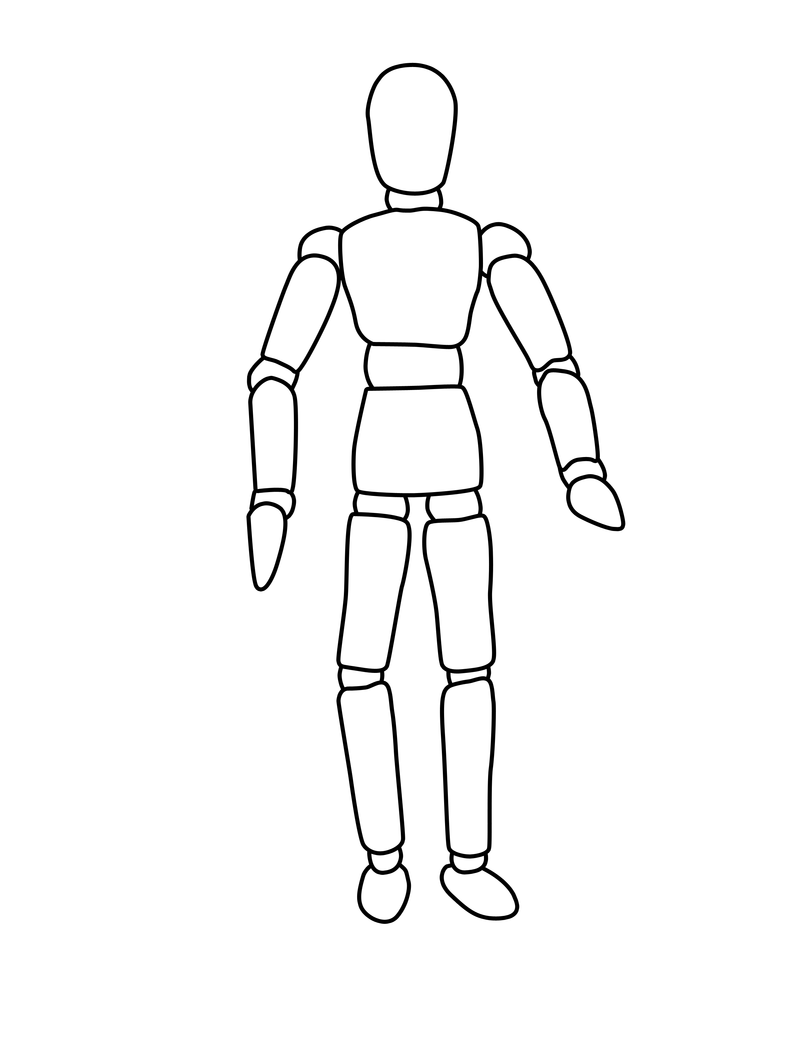
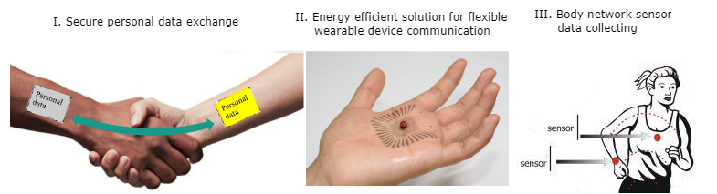
Body coupled communication
Communication link
Privacy and security as well as using wires
Easy to wear as wireless devices
Your body is your private transfer medium
Energy efficient
Wearable devices
Notes:
There were a few attempts to overcome previously mention problems using radically different technology. One of them was Body coupled communication (BCC), also known as intrabody communications (IBC). This means that the nodes on the wearable sensor network use the body of the wearer itself as the medium for communication.
BCC provides privacy and security level like wired communication
Devices that uses these technology are easy to wear and they does not limit everyday activities
Your own body becomes data transfer medium, so you don’t need to share you data link with other devices
And it is very energy efficient. Speaking about power consumption data transfer using Bluetooth low energy protocol consummates about 25miliwatts, so the Body coupled communication consumes about 5micro watts

Slide 6

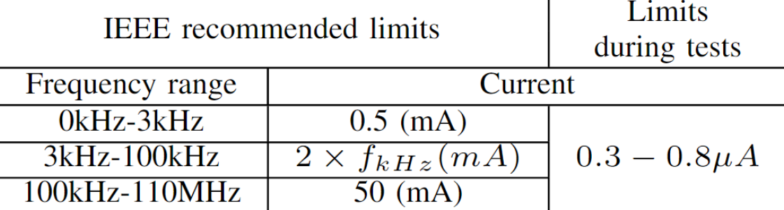
Safety
~300μA
Notes:
As to we are trying to apply some electrical signals to the human body, we should be sure that it will not harm people. In table we could see that According to IEEE standard the maximum current that could be applied to human person should not overcome half of miliamper for frequencies till 3 khz, 200mA fro frequencies till 100khZ and 50mA for frequencies till 110mhz. The currents in our experiment is more that 1000 times smaller, so that could not harm people in any way.

Slide 7
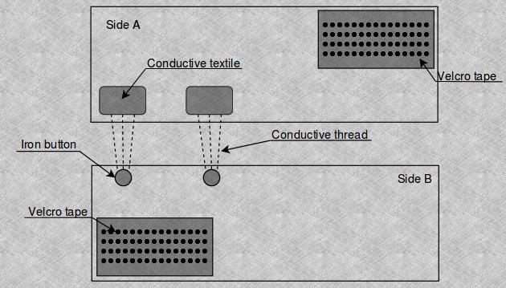
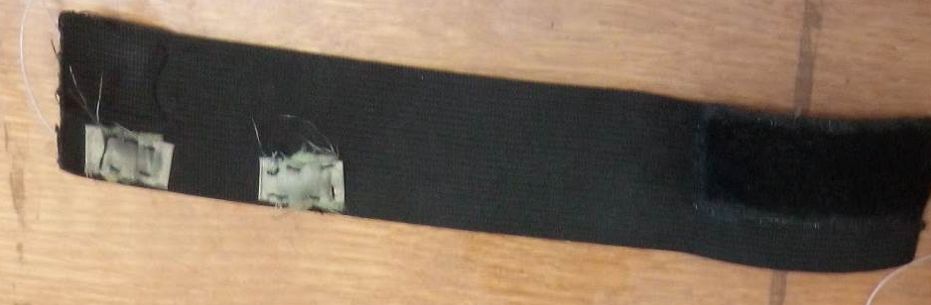
Setup
Side A
Notes:
As was mention before, many papers show that it is possible to transfer data through the body, but in these papers most common wireless modules are used. I mean that researchers are using 10mhz 100mhz 433mhz 2.4ghz transmitting modules and connect their antennas outputs to the skin. That gives us practical answer that intrabody communication is possible, but in this paper we wanted to find an answer on which frequency should we transmit our data.
For experiments two conductive bands were made. On the picture you could see schematic of 2 sides of the band and the photo of the band. To ensure signal source contact with the body, generator leads connects to the conductive textile. Each of two bands should be worn on participant

Slide 8
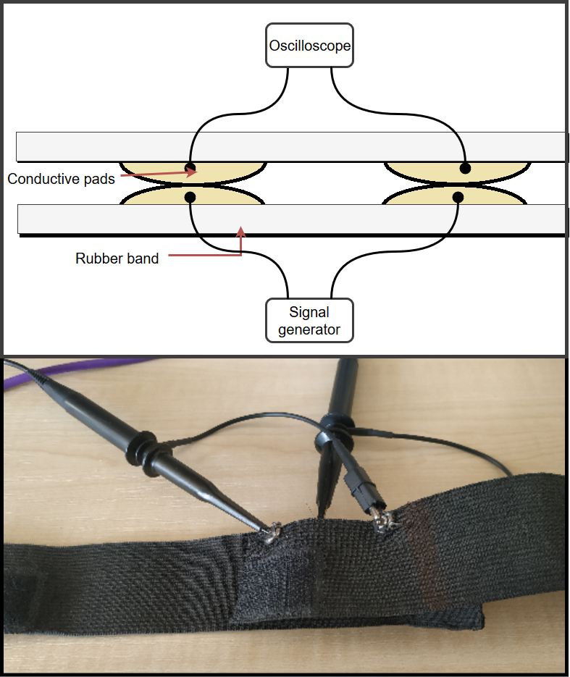
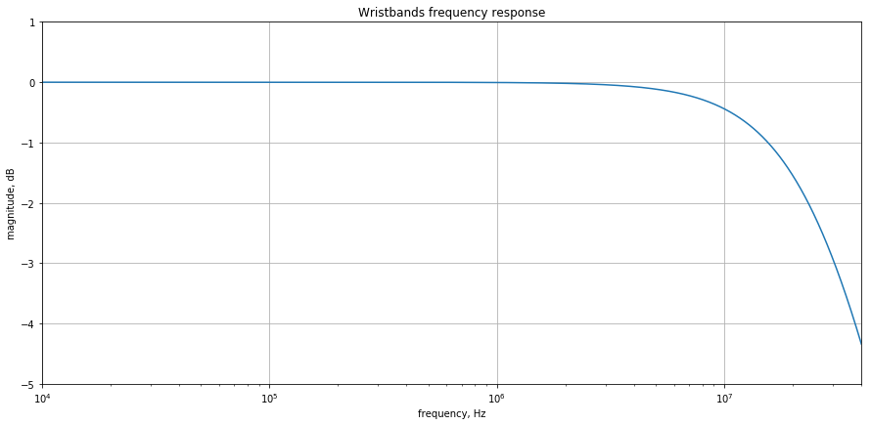
Frequency response of the bands

Slide 9
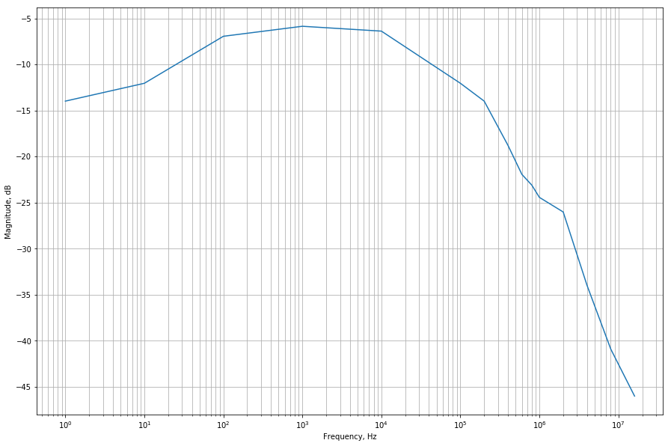
Results – Human Body Frequency Response

Slide 10
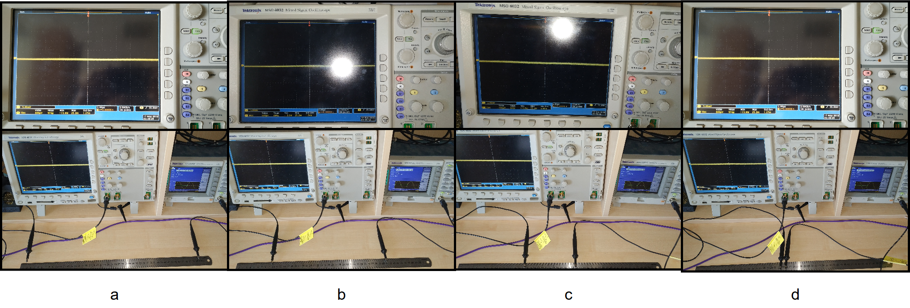
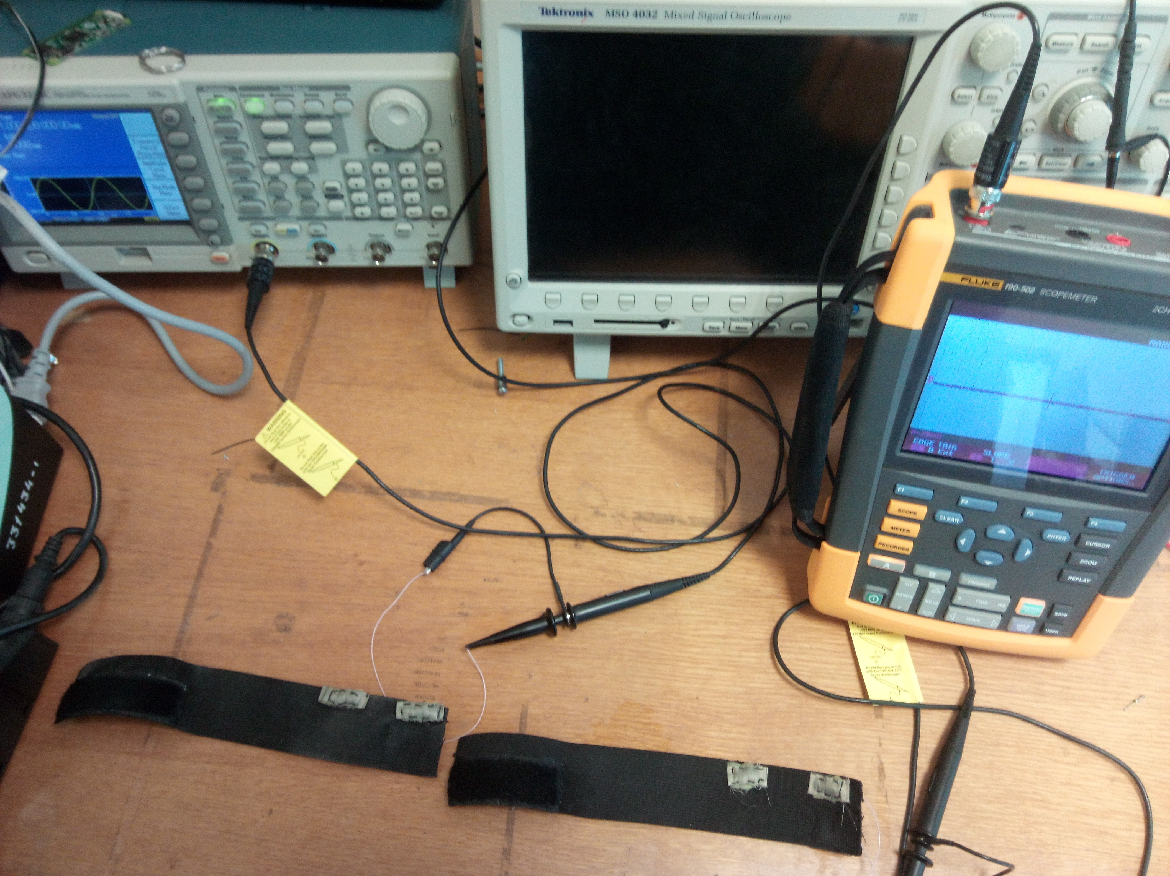
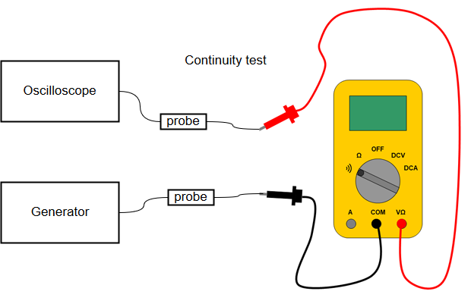
Validation

Slide 11
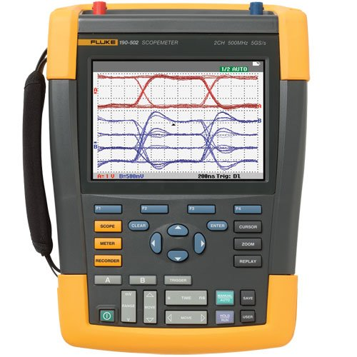
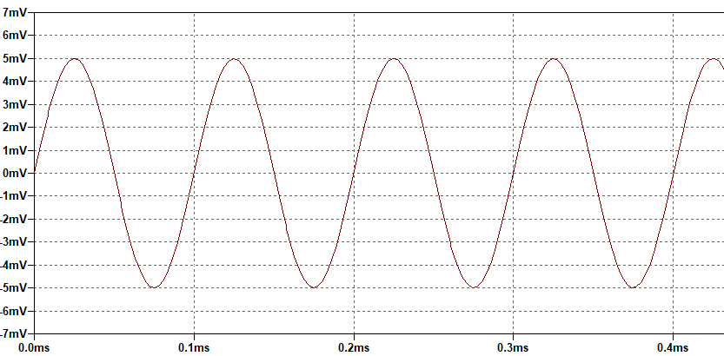
Validation results

Slide 12
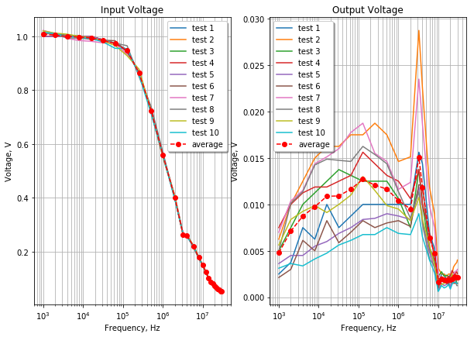
Results

Slide 13
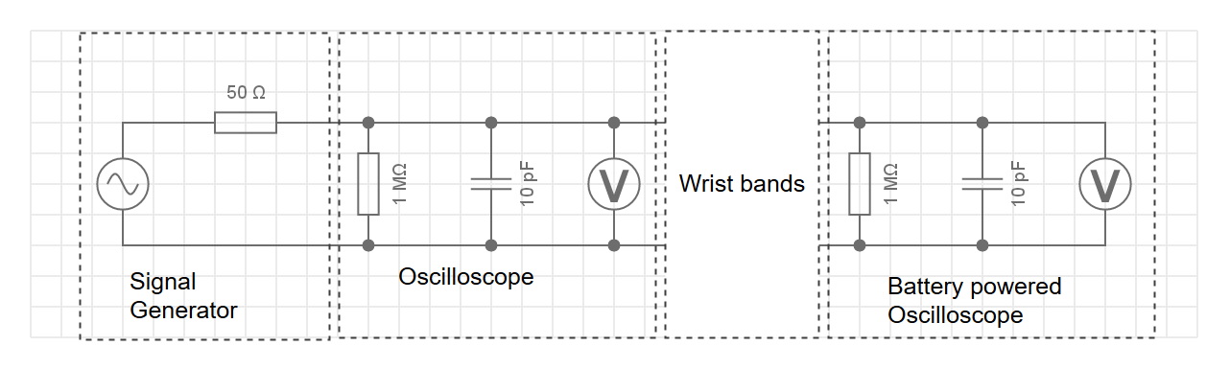
Results - Experiment schematic

Slide 14
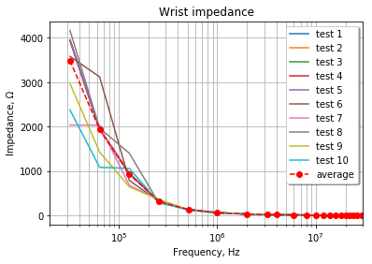
Results – Wrist Impedance

Slide 15
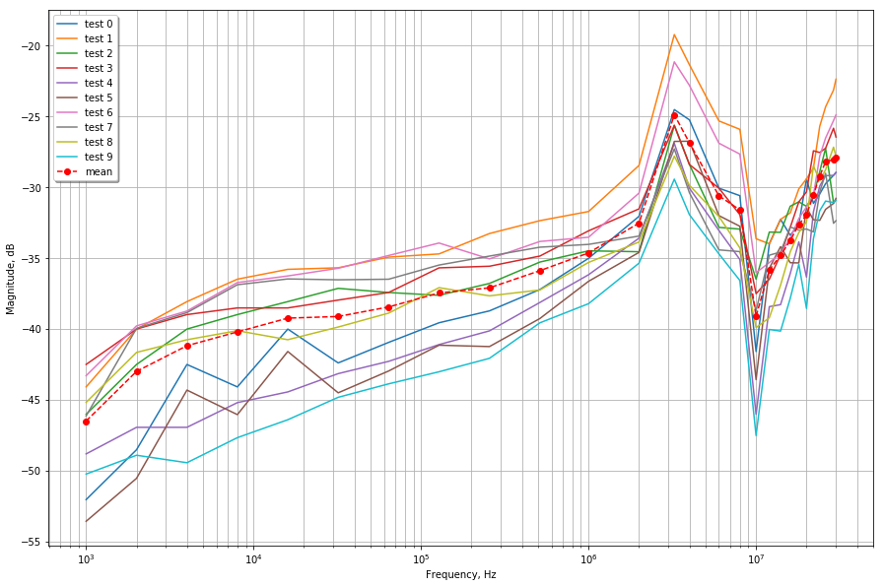
Results – Human body frequency response
Notes:
As the result we could see the obtained data in form of bode plot or frequency response. On the figure is the average value from 10 data sets. As you already noticed there exist two points of interest, one is at frequency about 3.2 MHz and second at frequencies about 10MHz. Using linear analysis tool from Matlab we could construct following equation

Slide 16
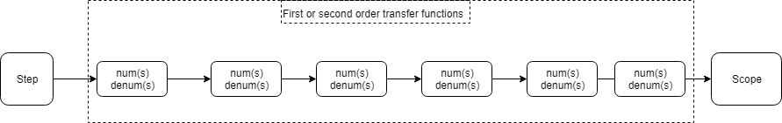
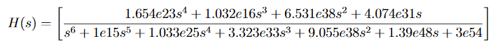
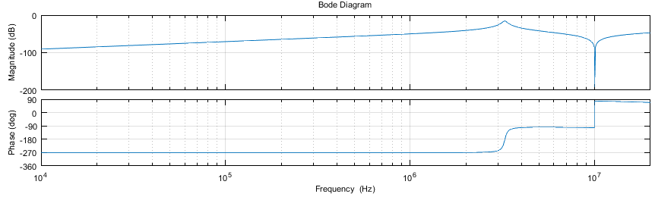
Results – Model

Slide 17
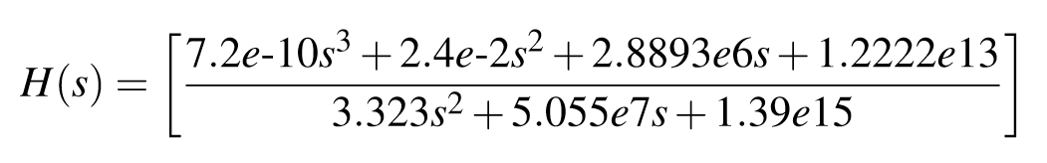
Results – Model adjusting

Slide 18
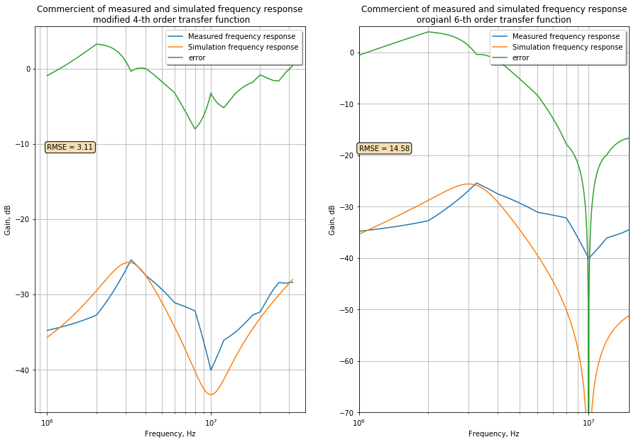

Slide 19
Results – Channel parameters
ΔF | 1MHz
Fc | 3.25MHz
Attenuation | −22dB÷−25dB
SNR | 16.9dB
Impedance at Fc | 120Ω

Slide 20
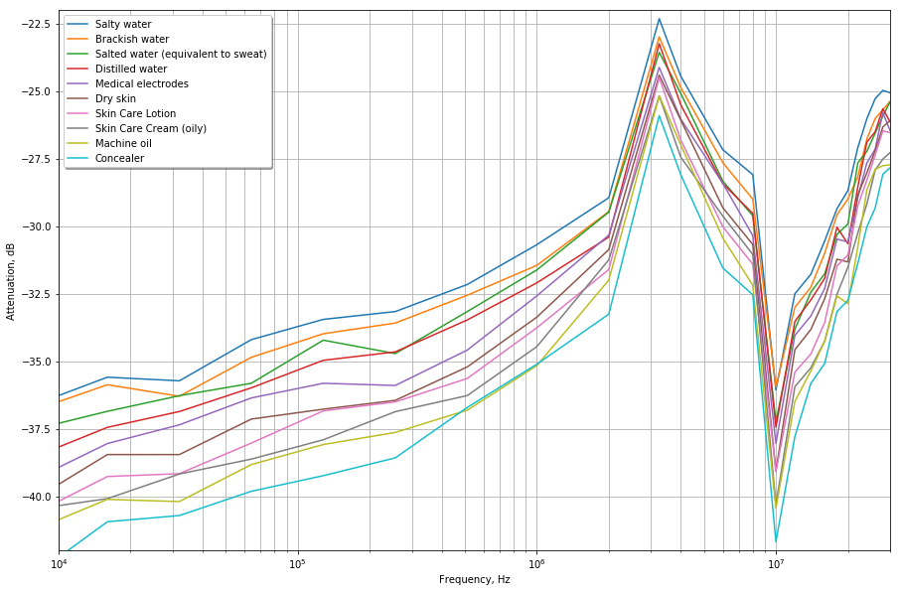
Results – influence of skin contamination on FR

Slide 21

Next steps
More measurements
Identify the relationship between the location of the electrodes and the output power
Find optimal signal power to ensure high SNR but minimize the signal interference on/from other users

Slide 22
Thank you for attention

