Slide 1
Artificial intelligence in stoichiometric model-based sustainable metabolic engineering of organism strains
Kristaps Bērziņš
PhD student
Notes:
Hello, my name is Kristaps Bērziņš and this is my first year in PhD studies. I will tell you about «Artificial intelligence in stoichiometric model-based sustainable metabolic engineering of organism strains»

Slide 2
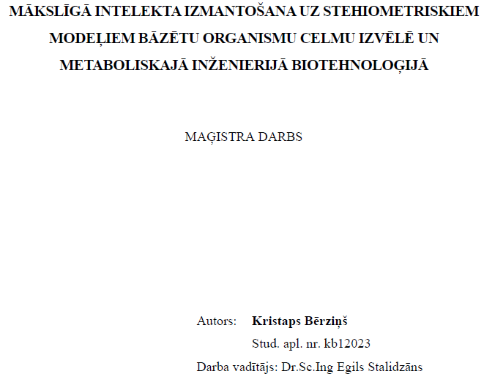
About me
Bachelor of Physics
Master of Computer Science
Scientific assistant of institute of Microbiology and Biotechnology
Application of artificial intelligence in stoichiometric model-based selection and metabolic engineering of organism strains for biotechnology
Notes:
I recieved my bachelors degree in 2015 and started work in unrelated field
In the end of year 2018 I met my current boss and started working in the institute of Microbiology and Biotechnology on stoichiometric models
In following year I began master studies in Computer Science in University of Latvia and 2 years later – last year - I recieved my diploma.
Master thesis had similar goals that were first steps towards current goals and I will be using and upgrading developed algorithms for PhD thesis

Slide 3
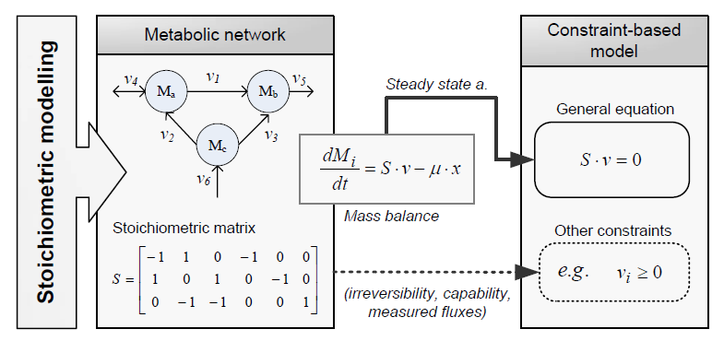
Stoichiometric modelling
Stoichiometric model
Matlab
Cobra toolbox
RAVEN²
Python
CobraPy
Notes:
What is stoichiometric model?
It is a model that describes organism metabolite fluxes. It consists of metabolites (circles) and reactions (arrows) which describes what happens to metabolites in the organism in question. These models can be genome-scale (several thousand reactions and metabolites), central metabolism (few hundred reactions/metabolites) or even contain only few reactions and metabolites. Size is dependant of tasks at hand.
It is represented with shoichiometric matrix. Using linear programming algorithms and defining objective function (usually biomass production) user can find out possible solutions.
Organism requires mass balance – what comes in must come out – and it is regulated using constraints – such as reaction reversibility and flux bounds.
Constraints are used to better describe organism in question.
I have been working on stoichiometric models for 3 years now using already created toolboxes for Matlab – Cobra and Raven, I have also used python and CobraPy (Cobra toolbox for python)

Slide 4
My PhD
Analysis of stoichiometric models of microorganism metabolism is becoming popular method for the analysis of organisms suitable for biotechnology. At the same time, the size of metabolic reactions, metabolites and gene databases is significantly increasing. This creates a demand for methods and algorithms that can process ever-increasing data and allow us to navigate the vast space of combinatorial solutions in search of the smallest set of manipulations that can help to achieve goals.
For my PhD I will develop a set of tools that use artificial intelligence algorithms to automatically generate and rank possible solutions for soichiometric problems according to various criteria.
Notes:
In my PhD

Slide 5
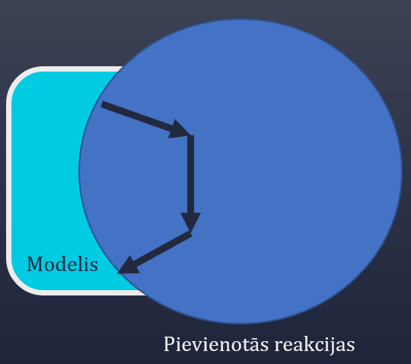
Beginning - master thesis
I developed algorithm that uses genetic algorithm to modify genome-scale model so it:
Can connect previously unconnected metabolites
Can create new patways to achieve results
Since then algorithm has been modified and will be modified for increased functionality
Notes:
In my masters thesis I developed algorithm that is able to connect unconnected metabolite or create pathways that did no exist
Since then I have improved and modified this algorithm for different similar tasks (i.e. Reducing size of model by removing least probable reactions or using it to reach some target objective)

Slide 6
Artificial intelligence
Evolutionary algorithms
Genetic algorithm
Neural networks
Notes:
In my masters thesis and now in PhD I am working on searching of potential organsim modifications for stoichiometric models using genetic algorithm.
Using «for loops» for average sized models (typically >500 reactions and metabolites) would take forever as it is combinatorial problem.
I haven’t delved in possible uses of neural networks yet, but it’s on the table for future modification for my algorithm.
In picture you can see example of algorithm in use for project where I am searching for reactions to delete so the model gives me optimal result
I have used said algorithm several times using different fitness functions – which means the algorithm is elastic for different tasks.

Slide 7
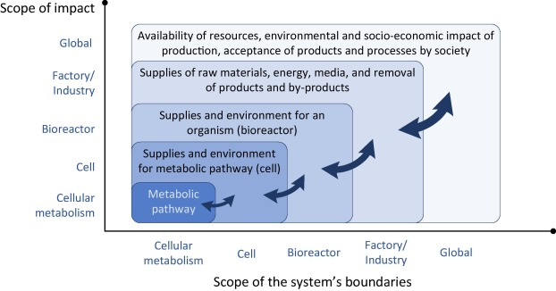
SME (Sustainable Metabolic Engineering)
Created algorithm would also be able to calculate sustainability
Sustainability – calculation of environmental, economical and social costs
Combine my algorithm and SME
Notes:
Another aspect for my PhD thesis is sutainable metabolic engineering. In this part i would cooperate with another group in the institute.
I would look at the model and analyze uptake and output reactions of model and respective metabolite costs to find out possible organism modificatiosn that would bring user in economical, environmental or social benefits
Economical – organism produces expensive metabolites while consuming less expensive ones
Environmental – organism consumes metabolites that contributes to global warming or earth pollution
Social – another way to describe impact of the metabolite to the society (i.e. Carbon tax)

Slide 8
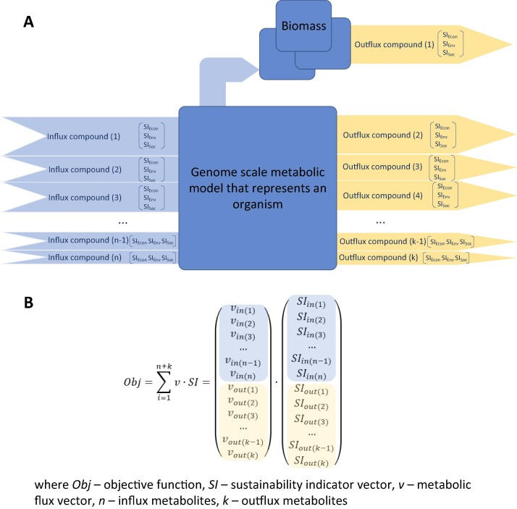
SME
Influx compound
Outflux compound
Biomass
Objective function
Notes:
Influx compounds consist of several impact factors (environmental, economical, social), same as outflux and biomass for organism.
Objective function is dot product of flux and impact factor.
No such algorithms have been added for cobra toolbox.

Slide 9
BTC – biotechnical center
Manufacturer of bioreactors for microorganism cultivation
Partners on project for which I am going to develop algorithms
My developed algorithm will be modified to assist in bioreactor control.
https://bit.ly/32rD32w
Notes:
I am involved in project GenCon in which our team in collaboration with latvian bioreactor manufacturers – bioreactors.net – will design a bioreactor control system that would use my created algoritm to automate bioreactor controls for efficient organism growth and SME
The project started in june last year and will continue for 3 more years

Slide 10
Thank you

