Slide 1

My progress so far
Oskars Teikmanis

Slide 2
What I’m doing now
Since September 2021:
Research assistant at the Institute of Electronics and Computer Science (EDI) and doctoral student at the University of Latvia

Slide 3




How I got here
Studies at the Technical University of Munich (TUM)
  B.Sc. in Engineering Science
  M.Sc. in Mechatronics and Information Technology
Master’s thesis in robot localization based on semantic information at the German Aerospace Center (DLR) in Oberpfaffenhofen
Work in the field of autonomous driving at Bosch/ITK Engineering in Holzkirchen

Slide 4
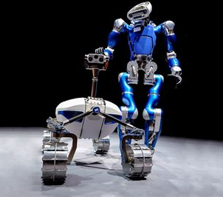
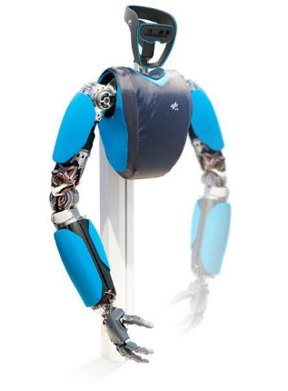
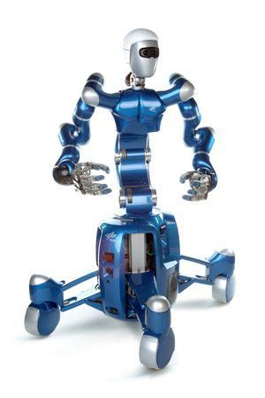
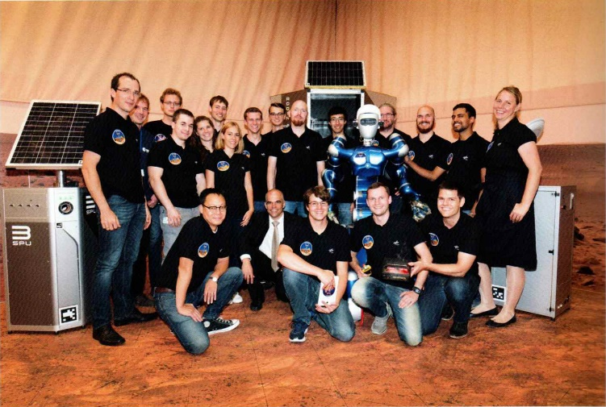
German Aerospace Center
Student work:
stereo vision algorithm evaluation
on graphics processors
Thesis:
Robot Localization in Dynamic Environment Using Semantic Cues
Publication (co-author):
Searching for Objects in Human Living Environments based on Relevant Inferred and Mined Priors (ECMR, 2021)

Slide 5
More on my master’s thesis
Goal: apply a human-like strategy to find (localize in 6 DoF) a lost robot with a depth camera and semantic information (from detected objects)
Steps:
  Create point map with additional semantically labelled points
  Create algorithm for matching such maps (using random sampling and iterative closest points)

Slide 6
More on the publication
Goal: find objects based on priors (where objects usually are) and concrete objects that have been seen in a room
My contribution: semantic point map, used as an additional input to the proposed method

Slide 7

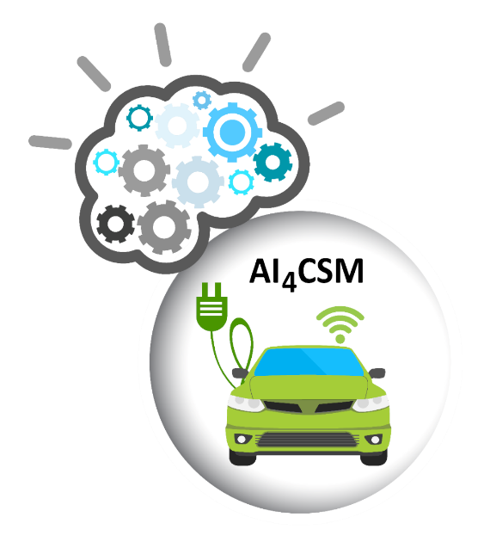
Back to the present
Current projects:
  5th Generation connected and automated mobility cross-border EU trials (5G-ROUTES)
  Automotive Intelligence for Connected Shared Mobility (AI4CSM)

Slide 8
5G-ROUTES
Current work:
  Research and develop algorithms for connected vehicle string control
  Simulated tests
  Make it work on real cars (at EDI)
Source: Aleksandrs Ļevinskis (EDI)

Slide 9

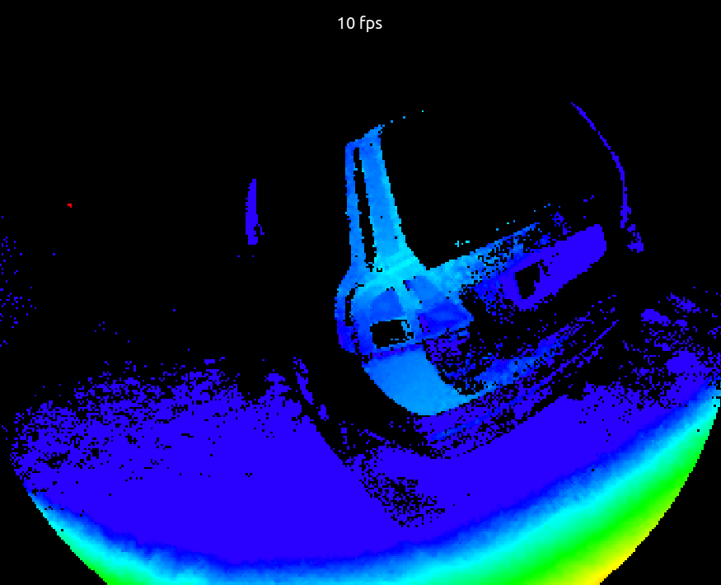
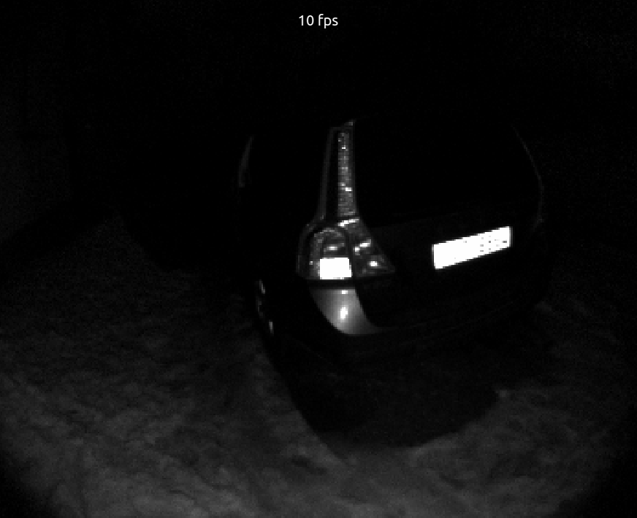
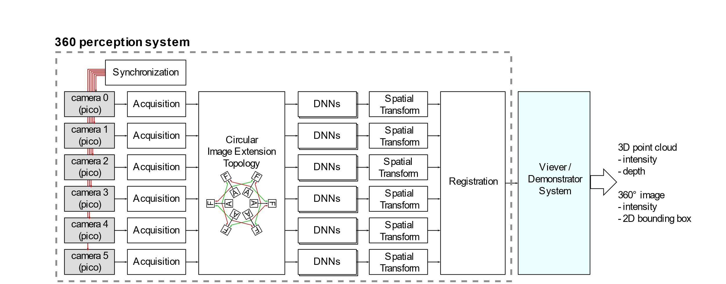
AI4CSM
Current work:
  Define architecture for 360° semantic perception system
  Research algorithms for image and point cloud transformation and stitching
Source: Anatolijs Zencovs (EDI)
Source: Rihards Novickis (EDI)

Slide 10
Ph.D. topic?
Cooperative transport system and robot control (vehicle cluster control and topologies, cooperative maneuvres)
Human-inspired perception systems (integration of semantic information in 3D environments)

Slide 11


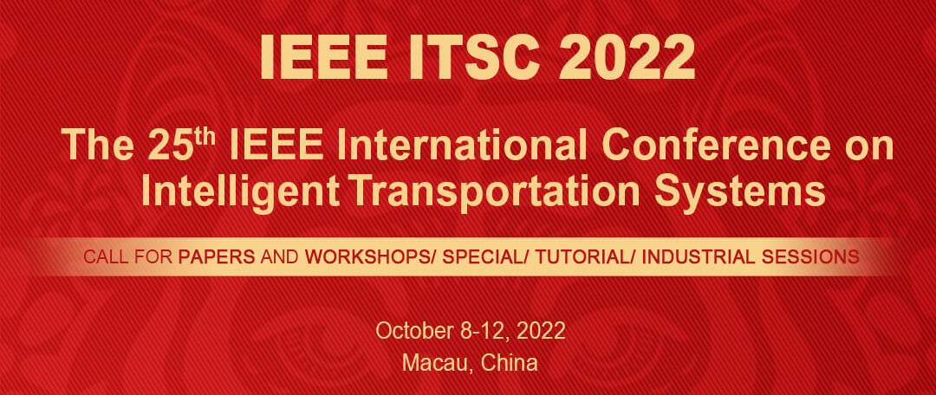
Upcoming conferences and events
3rd German-Baltic Digital Summit
(Lübeck, 11th May 2022)
EuCNC & 6G summit
(Grenoble, 7th June 2022)
IEEE ITSC 2022
(Macau, 8th October 2022)

Slide 12

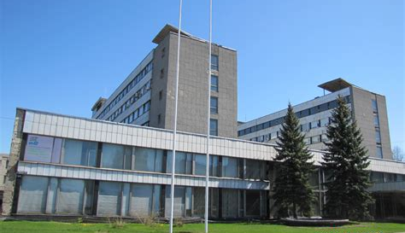
Q&A

