Slide 1
Few-shot learning
Vitālijs Feščenko, Institute of Electronics and Computer Science (EDI)
Supervisor: Roberts Kadiķis, Dr.sc.ing, EDI
Vitālijs Feščenko
Few-shot learning
11/11/2020
1

Slide 2
Motivation:
Problem: Machine Learning algorithms are data hungry, collecting labelled data is tedious
Goal: Explore few-shot learning and other labelled data reduction methods
Main Focus: Visual supervised tasks, Artificial Neural Networks
Vitālijs Feščenko
Few-shot learning
11/11/2020
2
2
2

Slide 3
Artificial Intelligence:
Artificial intelligence (AI) is intelligence demonstrated by machines, unlike the natural intelligence displayed by humans and animals¹¹
Some aspects of intelligence²:
planning
learning
reasoning
problem solving
perception
Types of AI tasks²:
Mundane tasks – perception, vision, speech, natural language understanding, etc.
Formal tasks – games(chess, GO), mathematics (Theorem proving, Logic)
Expert tasks – medical diagnosis, financial analysis, etc.
“All models are wrong, but some are useful” – George Box, 1976
1 - https://en.wikipedia.org/wiki/Artificial_intelligence
2 - https://www.massey.ac.nz/~mjjohnso/notes/59102/notes/l26.html
Vitālijs Feščenko
Few-shot learning
11/11/2020
3
3
3

Slide 4
Machine Learning(1):
Machine learning (ML) is the study of computer algorithms that allow computer programs to automatically improve through experience¹
Experience is gained by training algorithm on data^{3sdututachine ear}
Supervised Learning² | Unsupervised Learning² | Semi-Supervised Learning²
Predictive model: Given data x and labels y, model function y=F(x), s.t. k=F(u), for unseen data u and labels k | Descriptive model: Given data x and no y, find underlying data structure and features | Middle ground
Regression, Classification | Clustering, Anomaly detection, Association, Autoencoders | Supervised or unsupervised problems
Tedious to label data | No need to label | Small labeled dataset, large unlabeled dataset
1 - Tom M. Mitchell, Machine Learning, McGraw-Hill, 1997
2 – SuperVize Me: What’s the Difference Between Supervised, Unsupervised, Semi-Supervised and Reinforcement Learning?
3 - Y. Wang et al, Generalizing from a Few Examples: A Survey on Few-Shot Learning, 2019 Arxiv: 1904.05046
Vitālijs Feščenko
Few-shot learning
11/11/2020
4
4
4

Slide 5
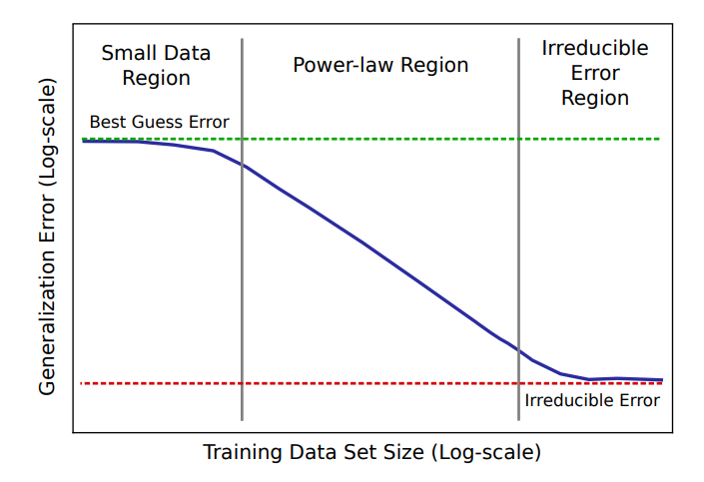
Machine Learning(2):
ML algorithms usually require a lot of data for learning.
For example:
Alpha GO program: requires 30 million recorded human expert moves¹
Curse of dimensionality – volume grow exponentially with dimensions³
Typical visual tasks datasets:
MNIST/CIFAR-10 ≈ 10 classes x 5000 examples
CIFAR-100 ≈ 100 classes x 600 examples
MS COCO ≈ 80 classes x 5000 examples
Artificial Neural Networks:
Dimensionality curse can be avoided⁴
Power-law relationship between dataset size and validation error²
Figure: Sketch of power-law learning curve²
1 – Y. Wang et al, Generalizing from a Few Examples: A Survey on Few-Shot Learning, 2019 Arxiv: 1904.05046
2 – J. Hestness et al (2017). Deep Learning Scaling is Predictable, Empirically. arXiv: 1712.00409
3 - DeepAI, Curse of Dimensionality
4 – A. Barron, Universal Approximation Bounds for Superpositions of a Sigmoidal Function, 1993, Online
Vitālijs Feščenko
Few-shot learning
11/11/2020
5
5
5

Slide 6
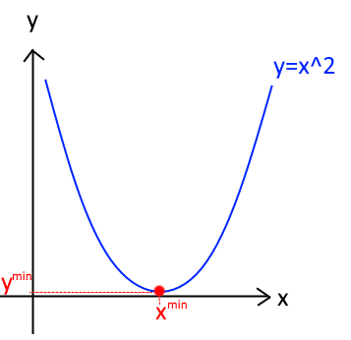
Gradient-Based function minimization(1):
Function: y = f(x) e.g. y=x²
Minimize function:
min f(x) – find smallest f(x) value
argmin f(x) – find x^{min} s.t. f(x^{min}) is smallest value
^{tachin - le ear}
Vitālijs Feščenko
Few-shot learning
11/11/2020
6
6
6

Slide 7
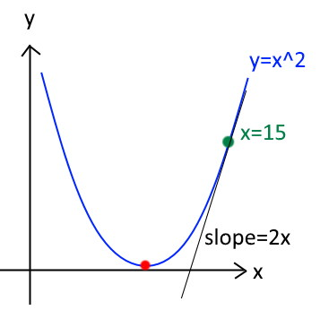
Gradient-Based function minimization(2):
Function: y = f(x) e.g. y=x²
Minimize function:
min f(x) – find smallest f(x) value
argmin f(x) – find x^{min} s.t. f(x^{min}) is smallest value
Gradient: y’ = f(x)’ = 2x – slope or direction, where function grows
For simplification, gradient can be though as -1 or +1
Vitālijs Feščenko
Few-shot learning
11/11/2020
7
7
7

Slide 8
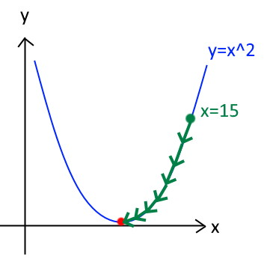
Gradient-Based function minimization(3):
Function: y = f(x) e.g. y=x²
Minimize function:
min f(x) – find smallest f(x) value
argmin f(x) – find x^{min} s.t. f(x^{min}) is smallest value
Gradient: y’ = f(x)’ = 2x – slope or direction, where function grows
For simplification, gradient can be though as -1 or +1
Gradient descent (python):
lr = 0.01 # learning rate i.e. step size
x = 15 # start from random starting point
for i in range(200): # repeat until convergence
gradient = 2*x # Compute gradient
x = x - gradient * lr # Update parameter
^{tachin - le ear}
Vitālijs Feščenko
Few-shot learning
11/11/2020
8
8
8

Slide 9
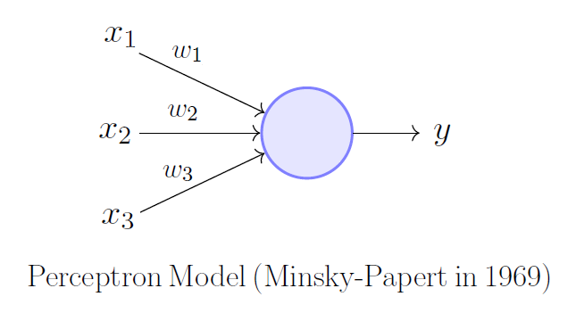
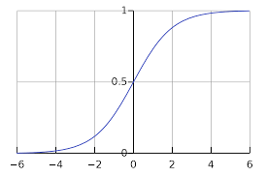
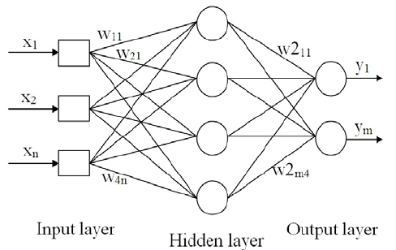
Artifical neural networks:
Inspired by biological neural networks
Abstract: F(θ,x), with weights θ (n-dimensional vector)
Example:
Linear Perceptron
Nonlinear Perceptron
$output=sigmoid(y$)
Multi-layer perceptron
Perceptron image from towardsdatascience.com¹
$$y=\sum_{i}{w_{i}}x_{i}$$
Sigmoid function from Wikipedia.com²
1 – “What is a perceptron?” towardsdatascience.com
2 – Sigmoid function. Wikipedia.com
3 – K. Z. Mokhtar et al.
An Oil Fraction Neural Sensor Developed Using Electrical Capacitance Tomography Sensor Data. 2013. Link.
Multi=layer perceptron image from researchgate.com³
Vitālijs Feščenko
Few-shot learning
28/10/2020
9
9
9

Slide 10
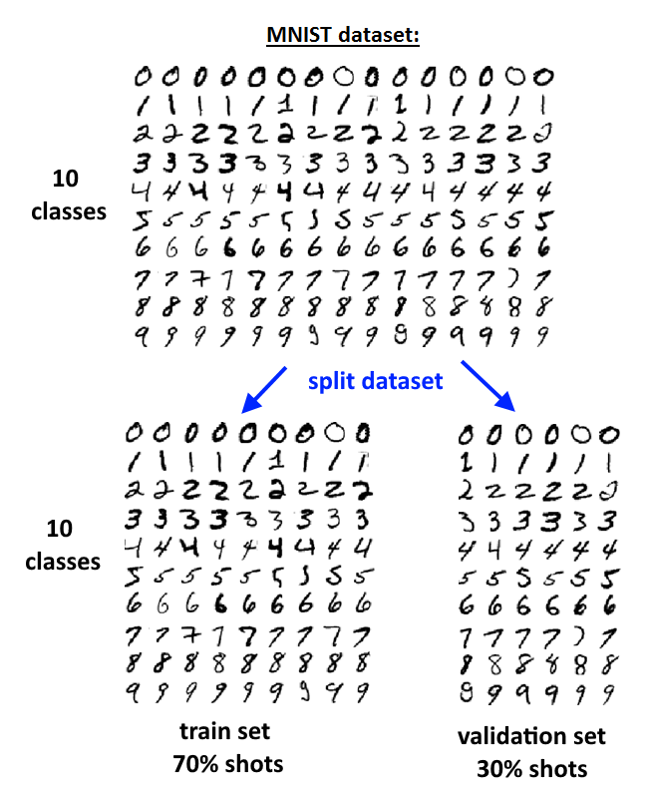
How to train NN ?
1. Get supervised dataset (e.g. MNIST for image classification). Split to train and test set
2. Select architecture i.e. function F(θ, x) with weights θ
3. Minimize loss with respect to labels
Goal: minimize error between prediction and true label for all data samples
Error: (F(θ, x) – y)²
Expected Error: AVG((F(θ, x) – y)²) for all (x,y) pairs
Vitālijs Feščenko
Few-shot learning
11/11/2020
10
10
10

Slide 11
Few-shot Learning:
Few-shot learning (FSL) is a branch of supervised machine learning, focused on learning from limited number of examples¹
Inspired by human/animal ability to rapidly generalize from few examples.
Typical scenarios¹:
Learning for rare cases – when obtaining labelled data is hard or impossible
Reducing data gathering effort and computational cost
Variations:
(<50, e.g. 5,10)-shot learning: General case, where only few examples are given
1-shot learning: Extreme case, where only one data example is given (e.g. 1 image per class)
0-shot learning: Instead of image, we have description of new class
‘Less than 1’-shot learning²: N classes, M examples, M<N, use soft-labels
Why does it work?
In ML, experience is gained by fitting data.
In FSL we also have prior knowledge¹. Two training phases:
Gain prior knowledge by fitting large amount of examples that are similar to goal task
Gain experience on small dataset for goal task.
1 – Y. Wang et al, Generalizing from a Few Examples: A Survey on Few-Shot Learning, 2019 Arxiv: 1904.05046
2 – I. Sucholutsky et al, ‘Less Than One’-Shot Learning, 2020, Arxiv: 2009.08449
Vitālijs Feščenko
Few-shot learning
11/11/2020
11
11
11

Slide 12
Few-shot learning literature:
A lot of image classification papers (paperswithcode.com show 69 papers)
In 2018 FSL starts object detection (paperswithcode.com show 12 papers, we can find more)
Other topics include image generation, NLP, regression, etc.
Note: 2018 is undersampled
Vitālijs Feščenko
Few-shot learning
11/11/2020
12
12
12
12
12
12
Notes:
12

Slide 13
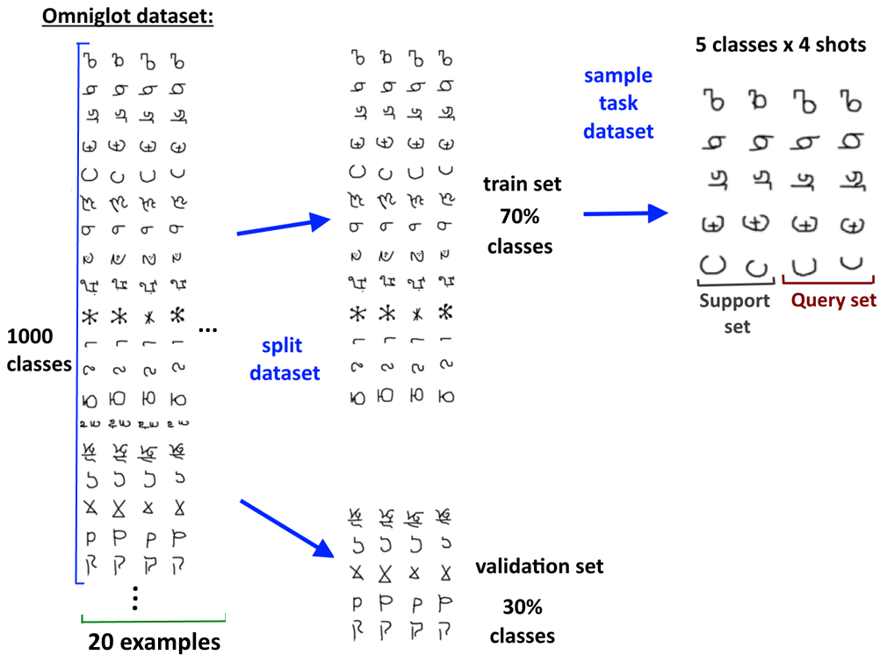
Few-shot image classification and object detection(1)
Goal: Train classifier or detector that can learn N classes/objects using M examples
Datasets used:
Omniglot (1000 classes x 20 shots)
Mini-ImageNet (100 classes x 600 shots)
MS COCO (80 classes x 5000 shots)
Pascal VOC
Training:
For training, datasets have to be transformed into smaller N-way M-shot datasets, where N is number of classes and M is number of shots/examples¹
1 – O. Vinyals et al, Matching Networks for One Shot Learning, 2017, Arxiv: 1606.04080
Vitālijs Feščenko
Few-shot learning
11/11/2020
13
13
13
13
13
13
Notes:
13

Slide 14
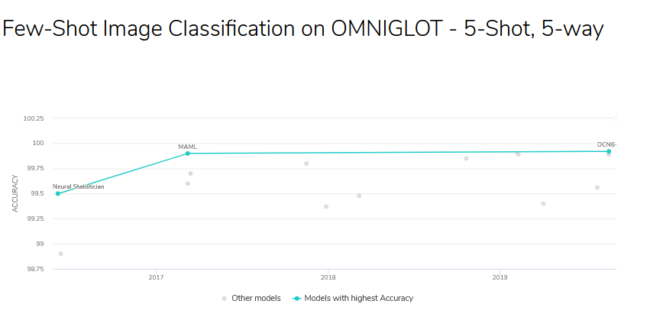
5-way 5-shot classification on Omniglot dataset:
Goal: Model that can train classifier on 5 classes/objects using only 5 examples
Figure from paperwithcode.com¹
1 – paperswithcode.com
Vitālijs Feščenko
Few-shot learning
11/11/2020
14
14
14
14
14
14
Notes:
14

Slide 15
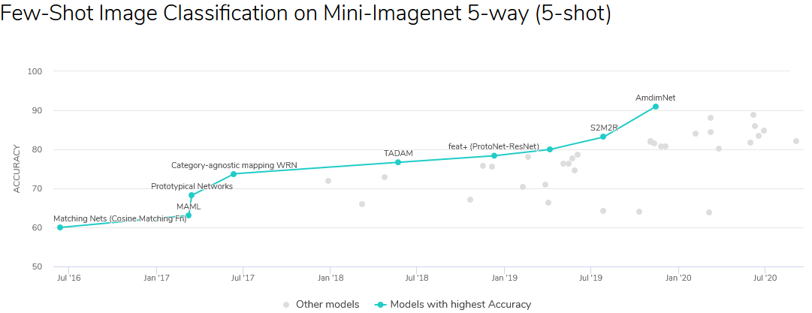
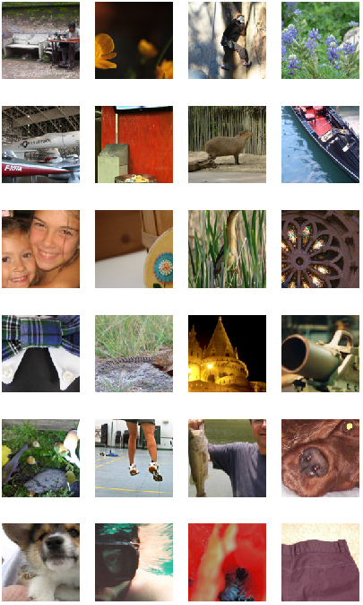
5-way 5-shot classification on mini-ImageNet² dataset:
Goal: Model that can train classifier on 5 classes/objects using only 5 examples
mini-ImageNet sample³
Figure from paperwithcode.com¹
1 – paperswithcode.com
2 – miniImageNet
3 –Online post: How to create and use custom PyTorch Dataset from the ImageNet
Vitālijs Feščenko
Few-shot learning
11/11/2020
15
15
15
15
15
15
Notes:
15

Slide 16
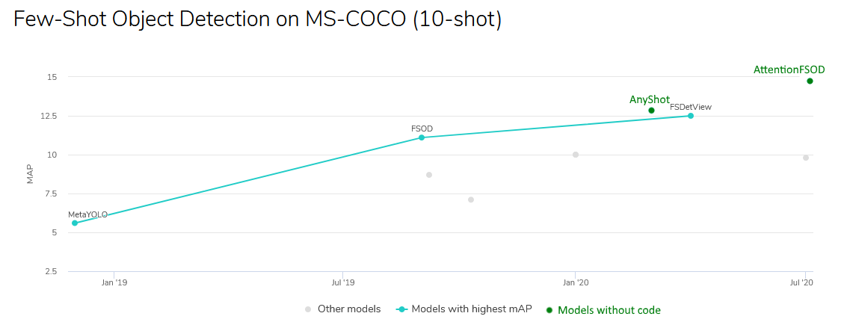
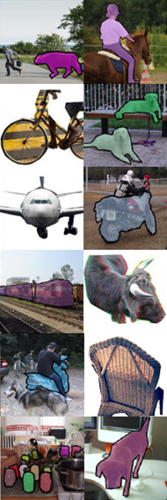
5-way 10-shot object detection on MS COCO² dataset:
Goal: Model that can train detector on 5 classes/objects using only 10 examples
MS COCO sample²
Figure mostly from paperwithcode.com¹
1 – paperswithcode.com
2 – Microsoft COCO dataset
Vitālijs Feščenko
Few-shot learning
11/11/2020
16
16
16
16
16
16
Notes:
16

Slide 17
My progress with few-shot visual tasks(1):
Omniglot:
A toy example (like MNIST)
Many research papers only test on Omniglot
Prototypical Networks(FS method) train very fast on Omniglot:
Reason: Even random network gives 80% accuracy
Current visual few-shot methods depend on datasets with many classes:
Many distinct classes (symbols, animals, cars, persons, etc)
Practical tasks not explored by Few-shot literature:
Small amount of classes
4 seasons in year
car build type (sedan, coupe, universal, etc)
classify type of plastic bottles (with bottle caps, with labels, clean/dirty, etc)
Vitālijs Feščenko
Few-shot learning
11/11/2020
17
17
17
17
17
17
Notes:
17

Slide 18
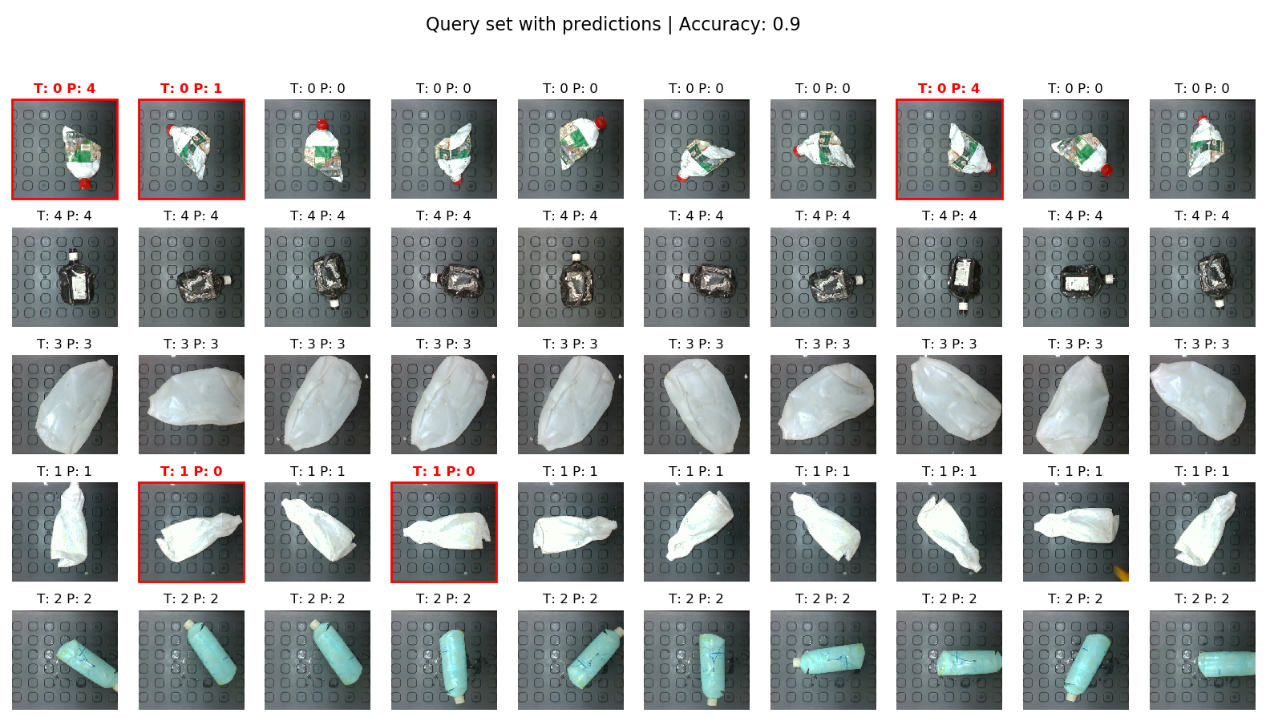
My progress with few-shot visual tasks(2):
Original task at workplace: classify type of plastic bottles (plastic type, with bottle caps, with labels, clean/dirty, etc)
Modified task: classify distinct bottles
Results not bad (Prototypical Network)
Model might be useful in different application, but still a different task
Figure: EDI collected dataset
Vitālijs Feščenko
Few-shot learning
11/11/2020
18
18
18
18
18
18
Notes:
18

Slide 19
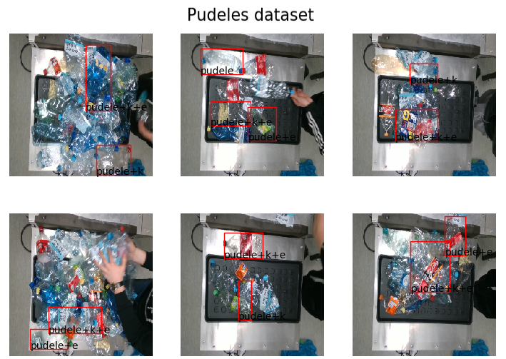
My progress with few-shot visual tasks(2):
Current task at workplace: detect and classify type of plastic bottles (plastic type, with bottle caps, with labels, clean/dirty, etc)
Current method: Classical Object Detection using YOLO, collect data manually
Other approaches: Generate synthetic labelled data
Figure: EDI collected dataset
Vitālijs Feščenko
Few-shot learning
11/11/2020
19
19
19
19
19
19
Notes:
19

Slide 20
Thanks for attention! Questions?
Vitālijs Feščenko
Few-shot learning
11/11/2020
20
20
20
20
20
20
Notes:
20

