Slide 1

My progress so far
Oskars Teikmanis
3rd semester

Slide 2

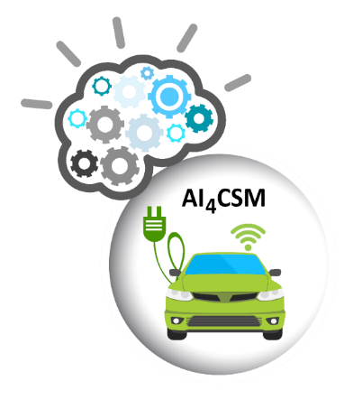
Recap of last time
Since September 2021:
Research assistant at the Institute of Electronics and Computer Science (EDI) and doctoral student at the University of Latvia
Presented last time:
  Master’s thesis
  Publication
  Projects (5G-ROUTES and AI4CSM)

Slide 3
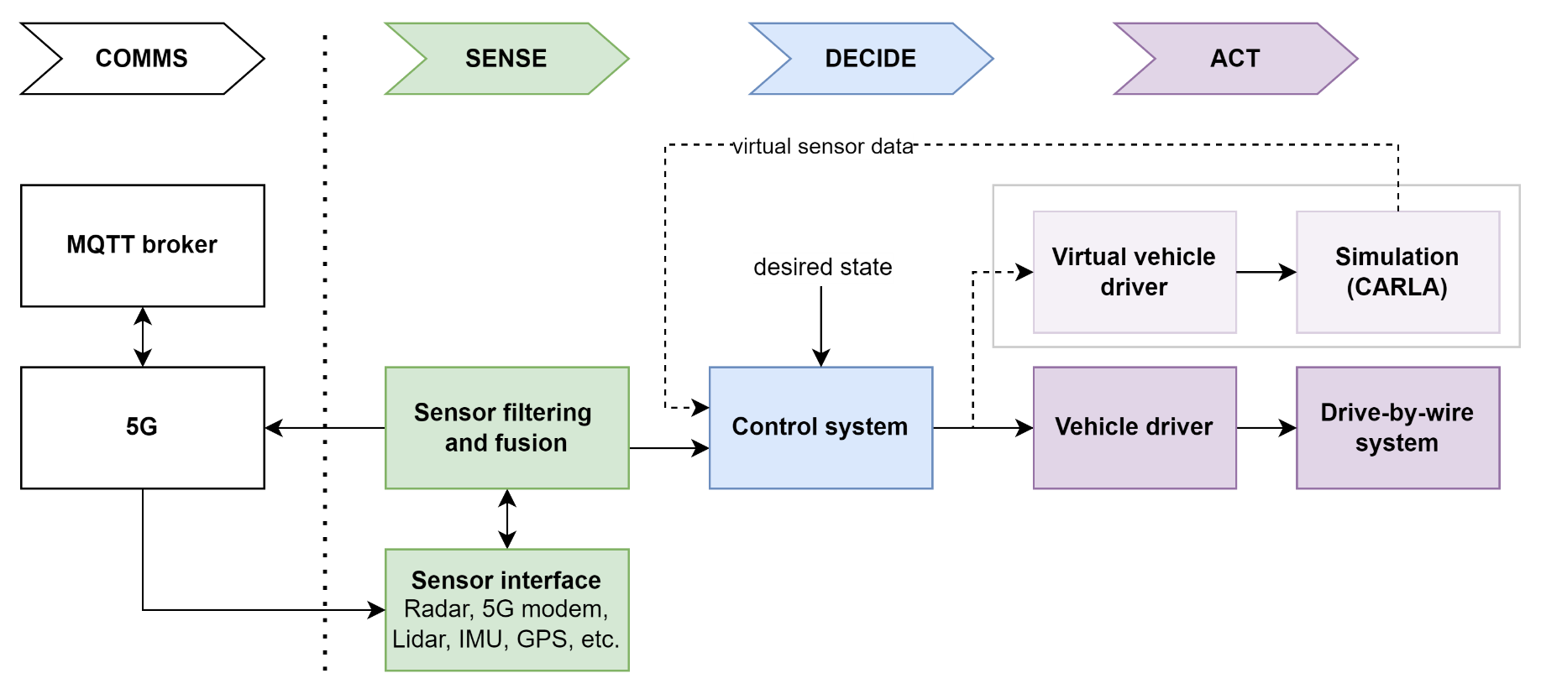
5G-ROUTES
Current work:
  Research and develop algorithms for connected vehicle string control
  Simulated tests
  Make it work on real cars (at EDI)
  Compile information for publication

Slide 4
5G-ROUTES
Current work:
  Research and develop algorithms for connected vehicle string control
  Simulated tests
  Make it work on real cars (at EDI)
  Compile information for publication

Slide 5
5G-ROUTES
Current work:
  Research and develop algorithms for connected vehicle string control
  Simulated tests
  Make it work on real cars (at EDI)
  Compile information for publication
https://www.youtube.com/watch?v=40KXoSbIznA

Slide 6
5G-ROUTES
Current work:
  Research and develop algorithms for connected vehicle string control
  Simulated tests
  Make it work on real cars (at EDI)
  Compile information for publication
Publication topic:
  Design philosopy of the platform (architecture, custom hardware and software aspects)
  Completed experiments and results

Slide 7

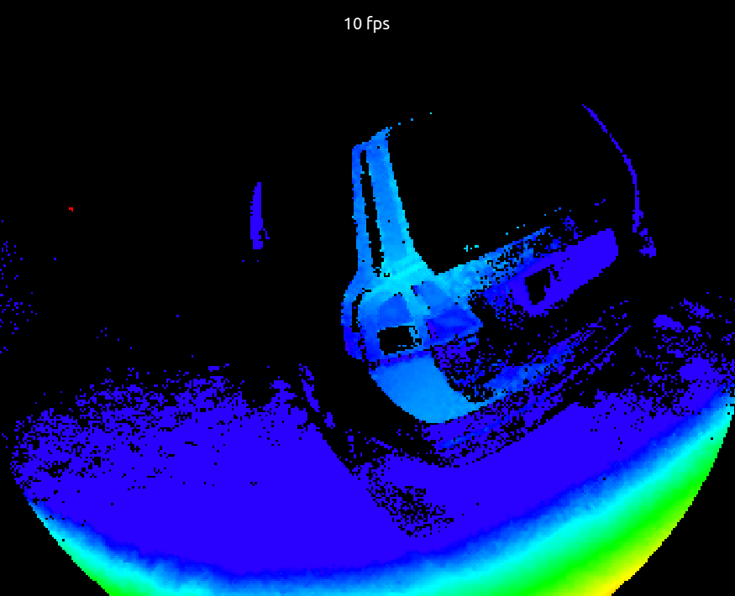
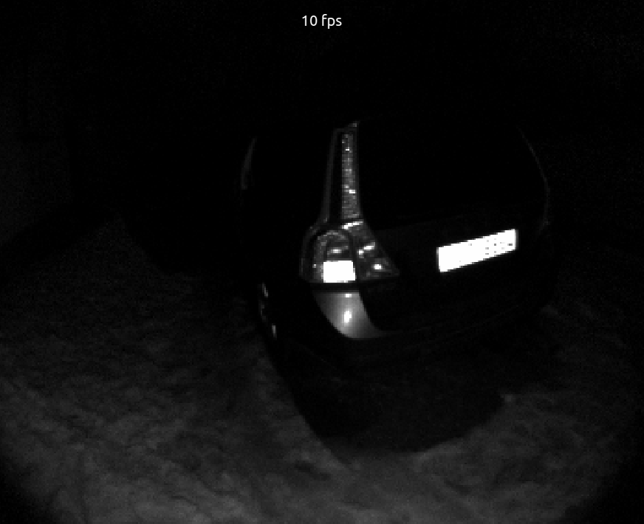
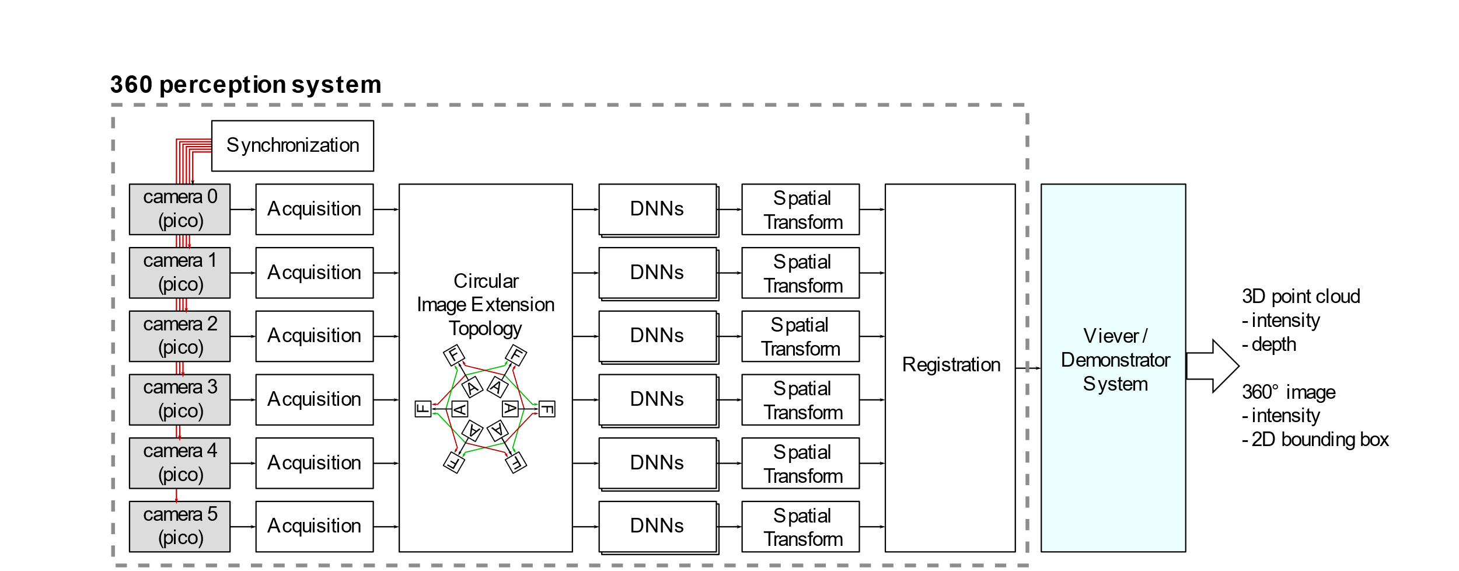
AI4CSM
Current work:
  Define architecture for 360° semantic perception system
  Research algorithms for image and point cloud transformation and stitching
Source: Anatolijs Zencovs (EDI)
Source: Rihards Novickis (EDI)

Slide 8

VPP: upcoming project
From the proposal (Robotics/IoT subtask): develop and demonstrate a common framework enabling flexible multi-modal robot control in weakly structured environments and operations to ensure cooperative and emergent behaviour.
My goal: use physics-informed neural networks to teach robots complex motions (in complex environments), and try to do it in a way that’s as generic as possible → Ph.D. Thesis
Example of similar work: https://danijar.com/project/daydreamer/

Slide 9
VPP: potential applications
Complex physical actions (like catching a pendulum toy)
Autonomous robots on difficult terrain (rovers, quadrupeds etc.)
Adaptive, context-aware motion planning (e.g. avoid human contact for industrial robots)
Driving on slippery surfaces
Soft body manipulation
Actuation via air flow control
  Useful for drones in highly turbulent conditions
  Move objects with fluids

Slide 10
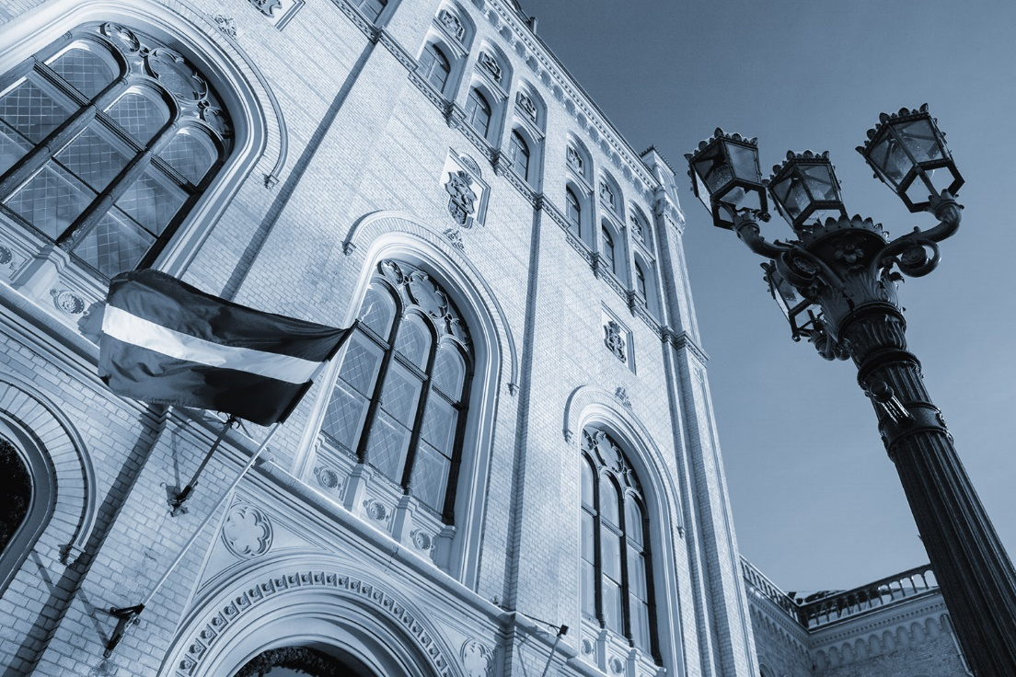
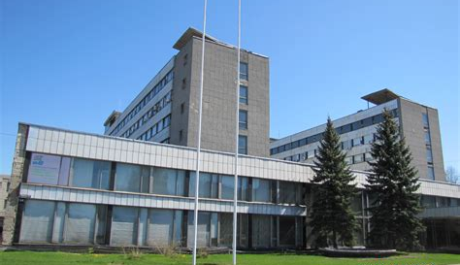
Q&A

