Slide 1

Romans Dinuls
Reliable and explainable artificial intelligence
http://www.edi.lv/branch/kosmoss/
https://dynland.com/

Slide 2

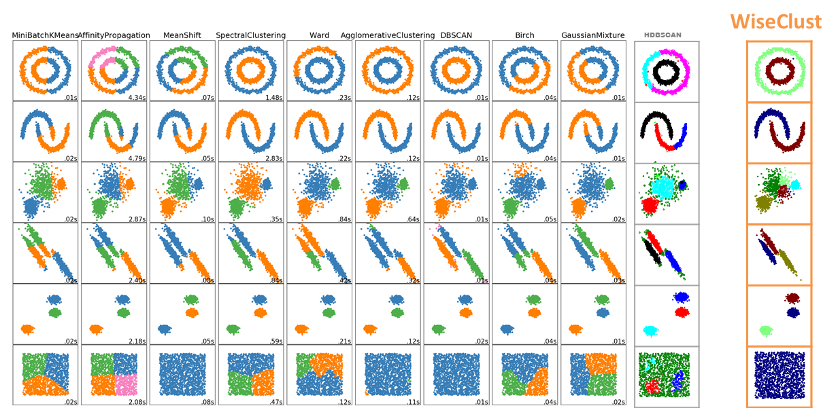
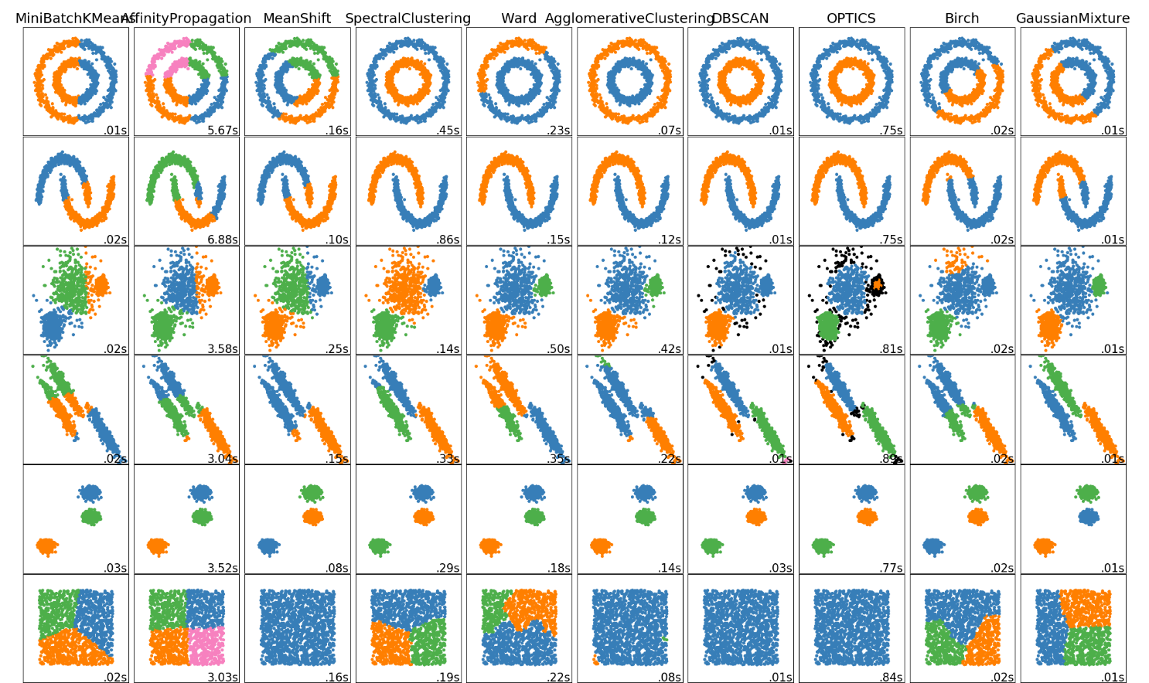
Better to see once…
Notes:
There are multiple advantages of such approach:
It eliminates overfitting because there is no adjustment of the function coefficients to the data
The result is not hierarchical, it allows for complex groups to be separated and merged
There is no need for feedback propagation, the process is much closer resembles how the brain actually works
It has strong theoretical basis both from the points of view of statistical modeling and replication of the human intelligence
The supervised part allows for small amounts of training data, which can be imprecise and unrepresentative

Slide 3






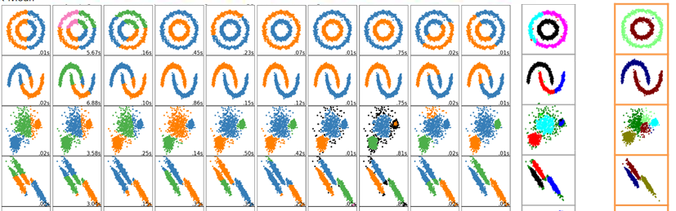
All the algorithms can do that…
More complicated stuff is a problem

Slide 4
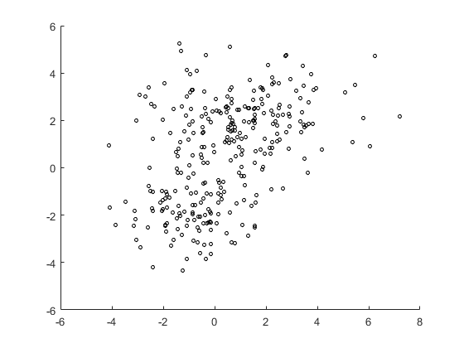
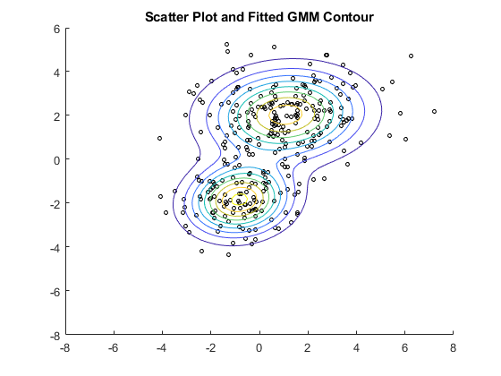
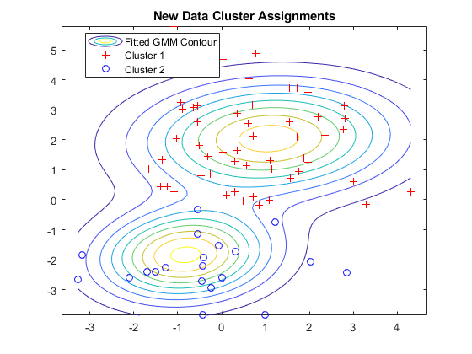
The primitive case of Gaussian Mixture
(illustrative example)
Black shapes:
Labeled data
1st class:
2nd class:
The class is assigned
by a max. of
votes
Notes:
It can be used to perform classification using not necessarily representative and imprecise ground truth and other data.
For example, in the primitive case of Gaussian Mixture, we can automatically separate the set into clusters and then assign the classes automatically using the miniscule amounts of the ground truth data even when it is not representative and contains errors.

Slide 5
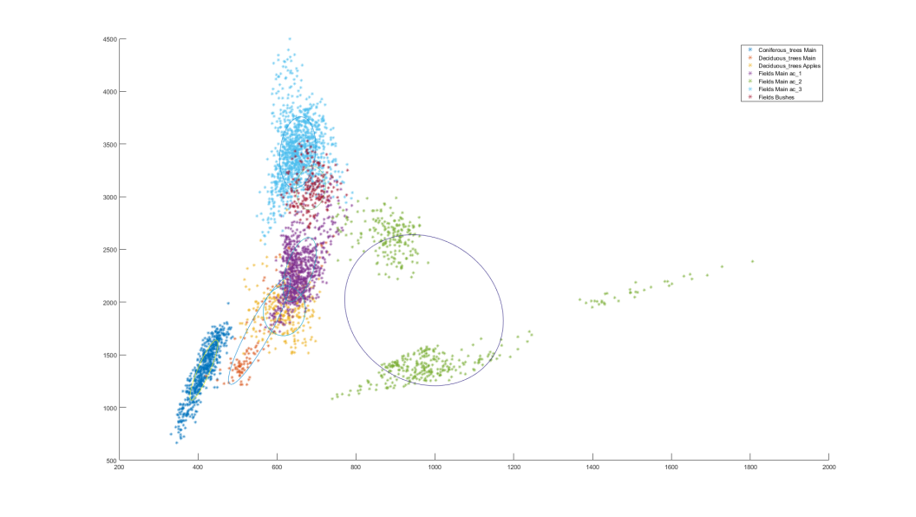
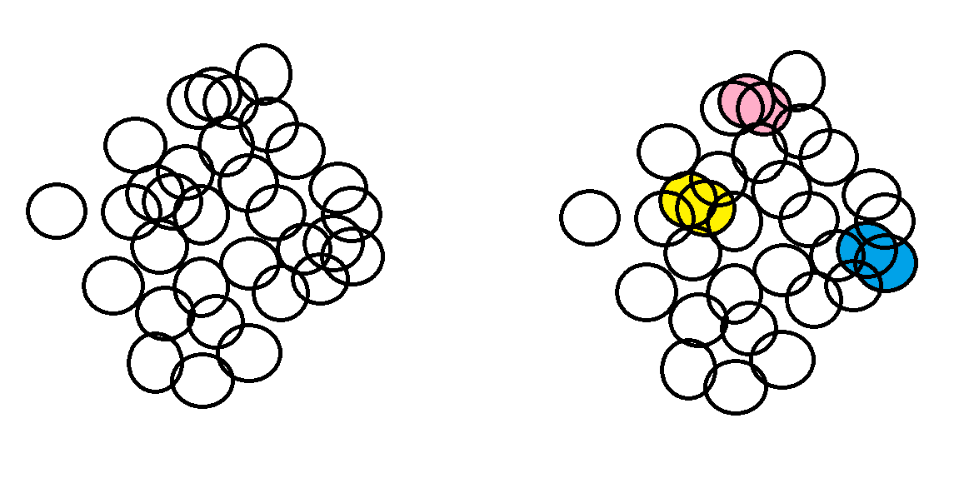
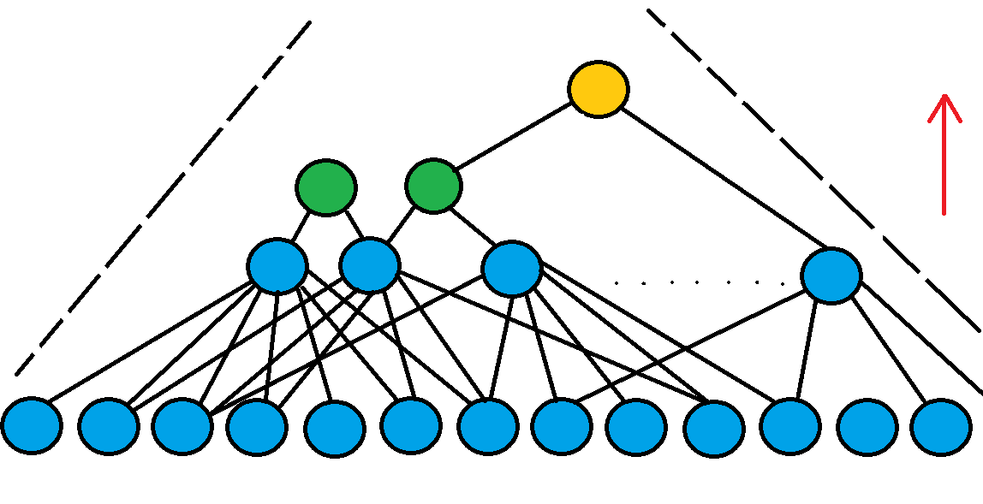
Novel clustering approach
No Normal distribution
No Normal distribution.
Counterintuitively in more than 2 dimensions even with Normal distribution pixels are not concentrated near the center. E.g. the consequence of it is
Stein’s example.
The clusters emerge from pixels during the simulation with union, cleaning and growth rules
on the graph of the 10 nearest neighbors for each pixel (using locally parametric distance).
The process can be described as the self-building tree-like network.
Notes:
In the real life having the data with the Normal Distribution is rather a luxury.
So, we can start with building the small clusters in the feature space around each pixel and then do union of the clusters that are likely to be very similar. In this principle one pixel can be assigned to the multiple clusters without any related probabilities.
That way in the end, if we want to have each pixel in the separate cluster, we need to launch cluster separation procedure.
We also employ the cluster cleaning procedures and realistic decisions about what to do when all clusters seem to be dissimilar.
Defining those rules formally, we launch the simulation procedure in which the separate clusters emerge from pixels using self-building network.
Note that those clusters are not described by some abstract functions or distributions, or borders. They are emerging from the set of pixels, each of the clusters have the properties that the separate pixels don’t have on their own.

Slide 6
Self-learning network
Replication of how humans unite objects into groups
Notes:
Here you can see a self-building network. The connections of the successive layers are building from the previous levels. If number of the common firing neurons on the lowest level is high enough then the neurons on the highest levels get ‘wired’ together. Generating a tree-like network.
The advantage is that this tree-like network doesn’t have a hierarchical structure. Each layer also represents the layer of clusters which, in our experience is explainable. It is a big step forward from the previous unexplainable network models.
It is plausible that, thought the physiology of the process in the brain might be different, the behavioral part of the uniting the objects into the groups and then into the larger groups as described might be similar. In the real brain all the connections most likely are there already, just some of them get enforced while others get weaker.

Slide 7
In practice
Old algorithms:
Our new solution:
ISODATA
ISODATA mixes city buildings with different kinds of meadow green and arable land.
Doesn’t miss a point…

Slide 8
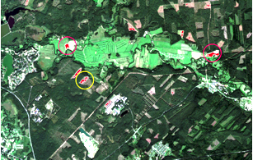

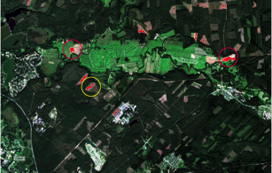
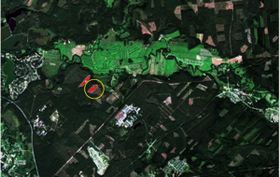
Example of comparison to de-facto standard unsupervised algorithms
ArcGIS IsoClust
DYNLAND
Notes:
Here is the comparison to the de-facto standard unsupervised algorithms

Slide 9
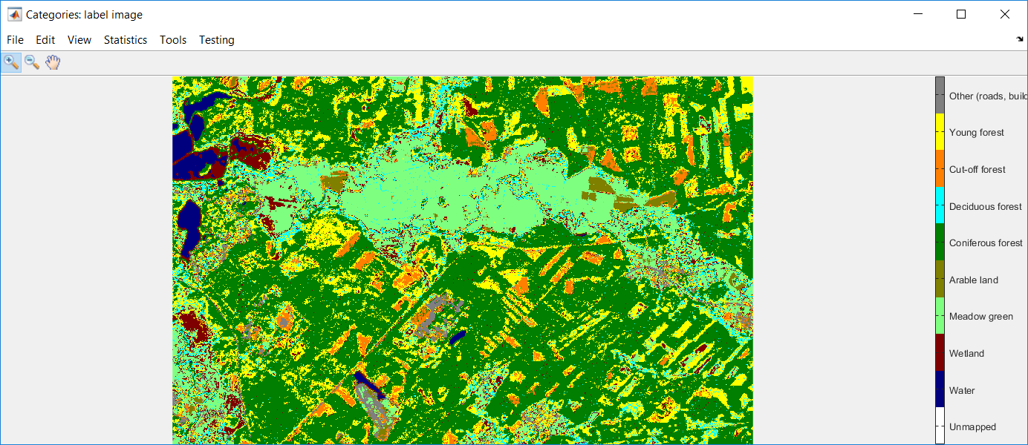
Land cover classifier testing results
Original Sentinel-2 image for single region Classified Sentinel-2 image
Tested by Silava for the single example area:
Error matrix prepared from
testing points on the
100m x 100m grid
Accuracy targets achieved:
  Forest/ no forest- 97% (goal 95%)
  Deciduous/ other forest- 77% (70%)
  Coniferous/ other forest- 98% (95%)
  Water/ other- 97% (95%)
  Agriculture/ other- 83% (70%)
  Wetland/ other- 89% (80%)
Notes:
It has sound theory and gives reliable results in practice.

Slide 10
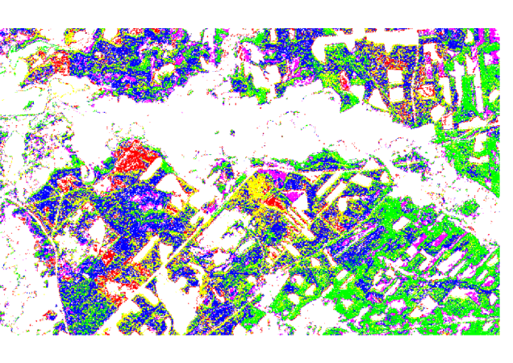
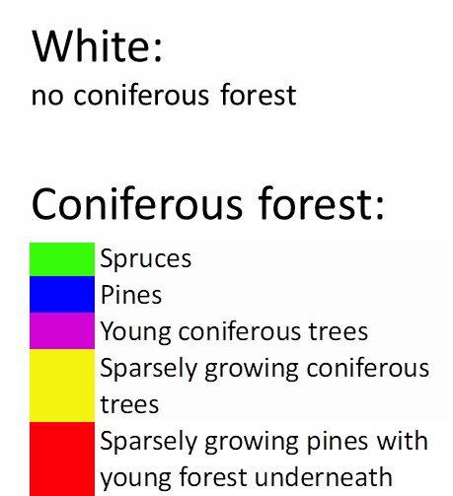
Identification of pure stands from Sentinel-2 data only
Notes:
The identification of pure stands from satellite data only.

Slide 11
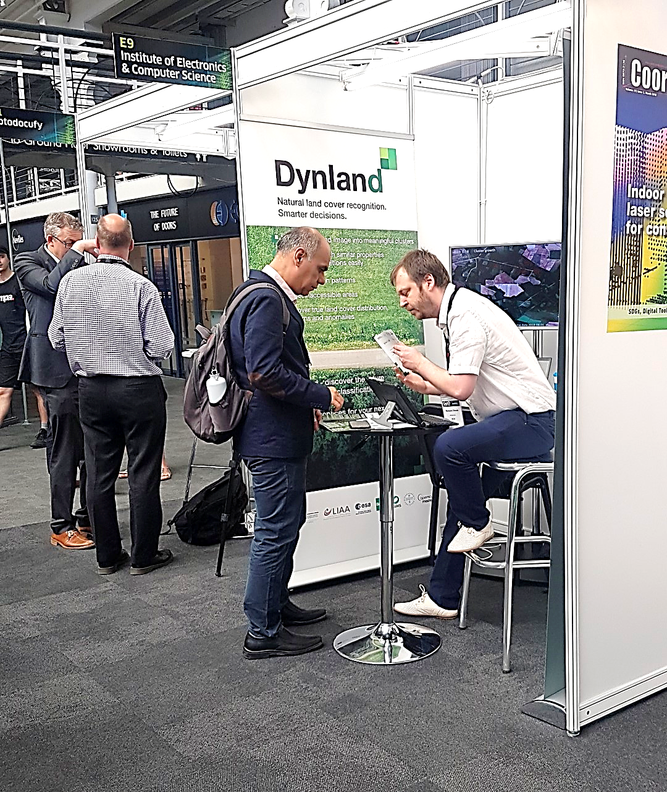
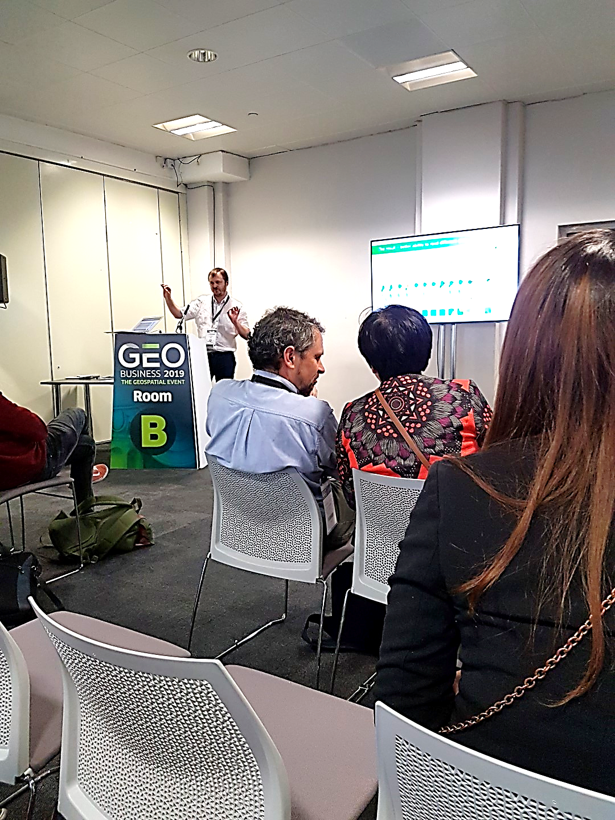
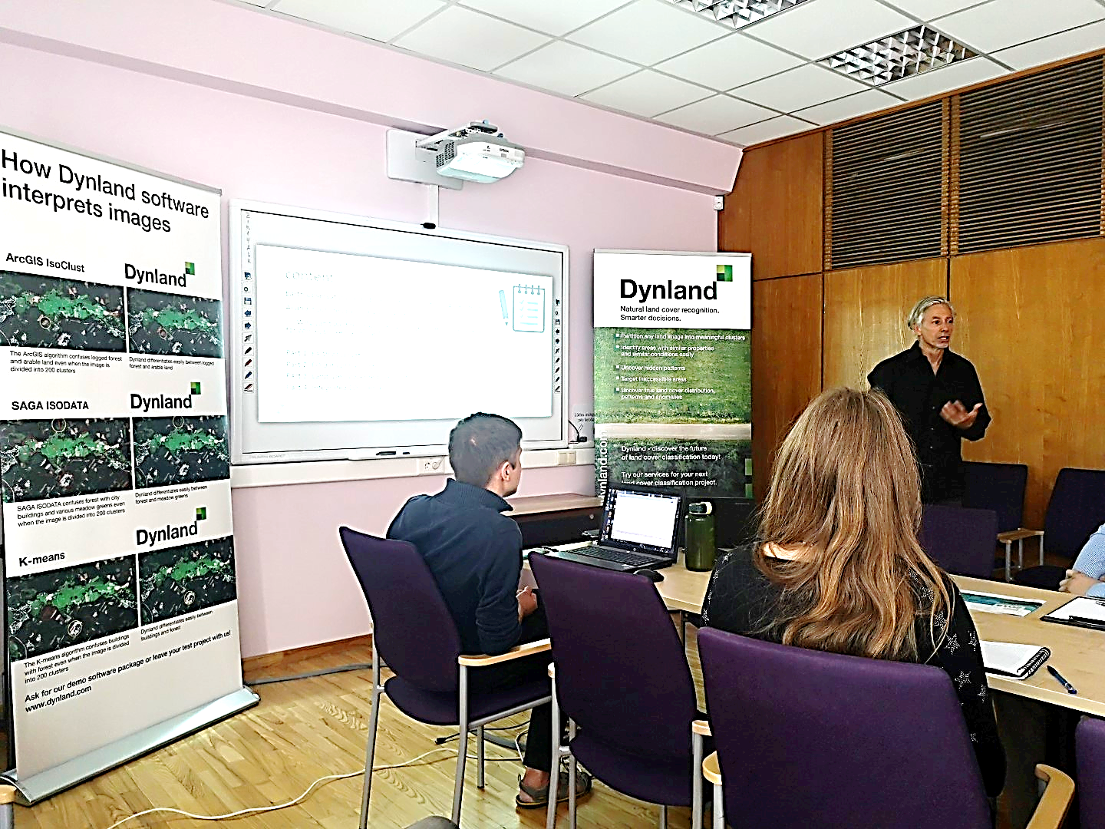
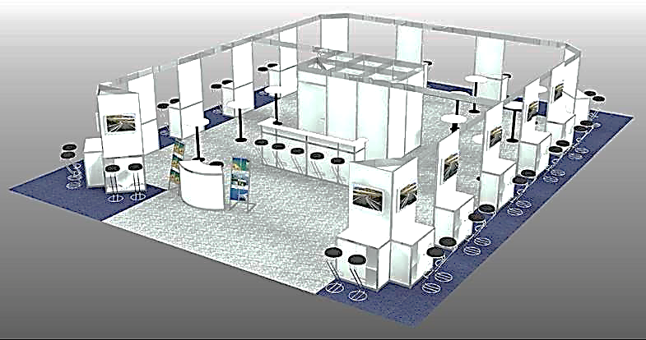
Showcasing the algorithm
GEOBUSINESS 2019
With mentor from Copernicus Accelerator Dr. Thomas Blaschke
At stand
In workshop
INTERGEO 2019
A stand among start-ups
A pitch in front of investors
as a part of Copernicus Accelerator Closing Bootcamp

Slide 12


Projects based on the algorithm
Nevklas – commercialisation of the algorithm
for use in the analysis of remote sensing data
  Optimisation of the algorthm
  Cloud services and webgis
  Container for licensing
Woodstock – estimatation of forest stock using satellite data, including tree species identification
MireClass – monitoring of development and regeneration of peat extraction sites and protected mire habitats
www.dynland.com

Slide 13
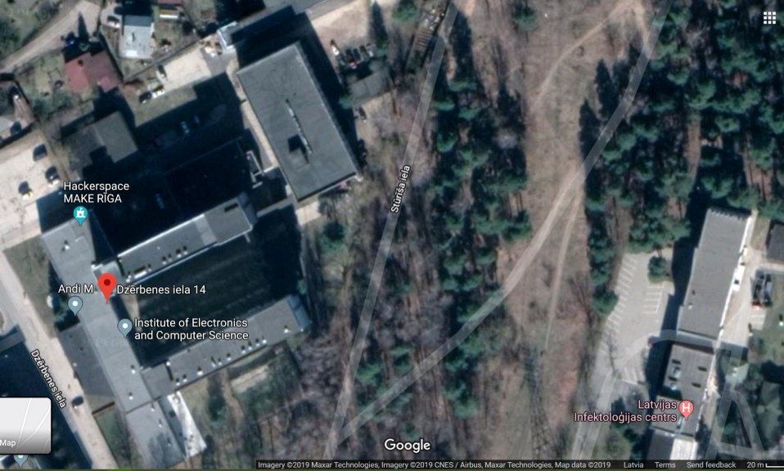
The future
< 10 years
  Computer will be able to see same as human looking at google maps
  Will be
    able to group the complex objects
    aware of the context

Slide 14
Eventually
Land monitoring will help to automatically
  Manage natural resources
  Produce enough food for everybody
  Keep the planet healthy
  Make cities better for living
http://www.edi.lv/branch/kosmoss/
https://dynland.com/

Slide 15
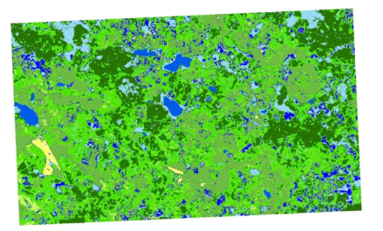
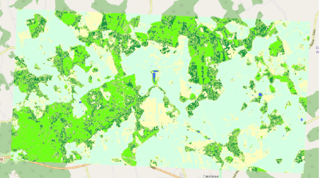
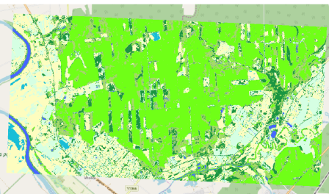
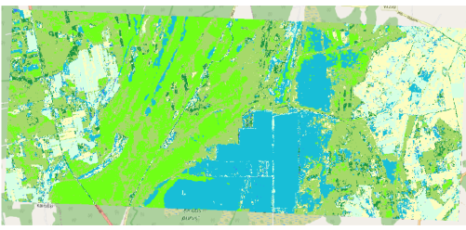
Multiple testing areas
All together
 |  | Ground information
 |  | Water | Wetland | Agriculture | Coniferous | Deciduous | Other | Total | Precision
Classification | Water | 131 | 3 | 0 | 0 | 0 | 0 | 134 | 98%
 | Wetland | 3 | 165 | 38 | 15 | 8 | 1 | 230 | 72%
 | Agriculture | 2 | 9 | 2706 | 12 | 25 | 65 | 2819 | 96%
 | Coniferous | 1 | 8 | 2 | 2110 | 87 | 9 | 2217 | 95%
 | Deciduous | 2 | 10 | 5 | 58 | 704 | 4 | 783 | 90%
 | Other | 0 | 3 | 2 | 0 | 0 | 21
 | Total | 139 | 198 | 2753 | 2195 | 824 | 100 | 6209
 | Recall | 94% | 83% | 98% | 96% | 85%
 |  |  |  |  |  |  | Overall : | 94%
 |  |  |  |  |  |  | Kappa: | 0.91
Notes:
When all areas are combined the resulting classification accuracy shows how reliable the algorithm is when classifying large enough areas.
The results are good, but we have to extend the use of algorithm to the optical and other kinds of more precise data.

Slide 16
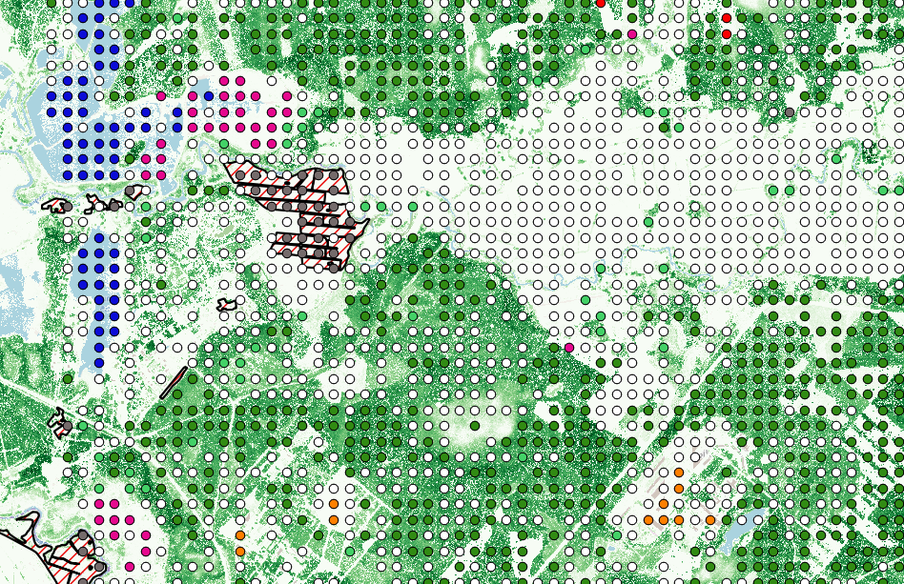
Additional ground truth
Data from State forest service
Lidar data (canopy height model)
Rural support service data
Notes:
Here you can see the sample of the data used.

Slide 17
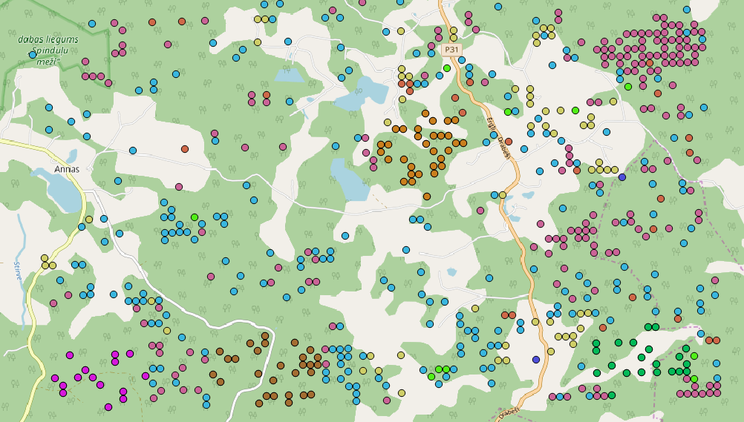
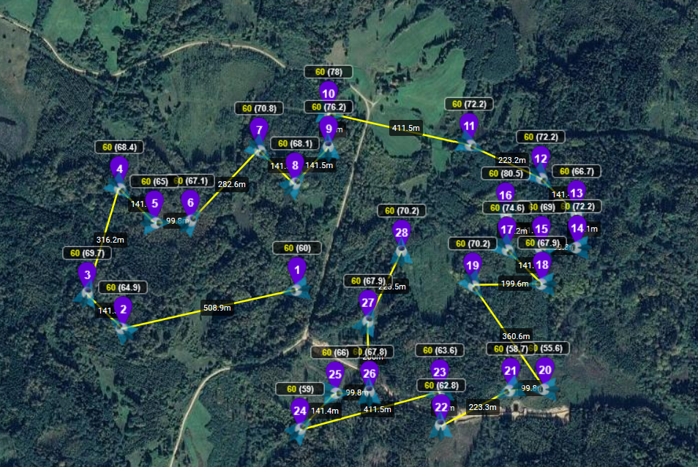
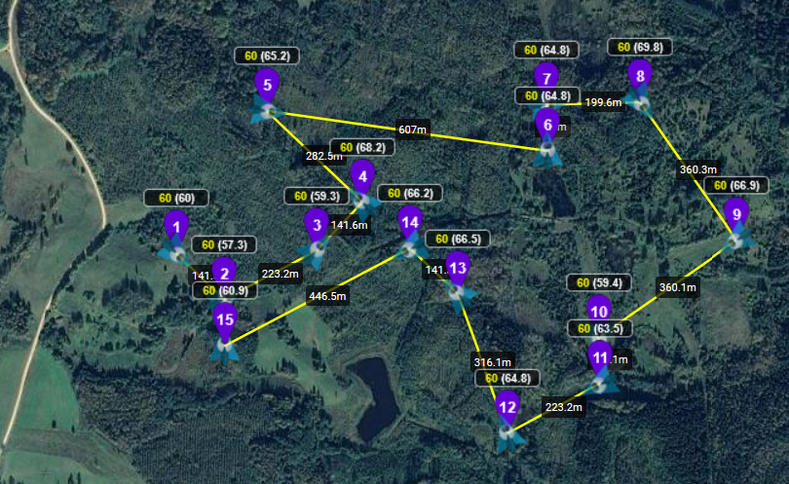
Drone mission samples
Select generated grid points
Mission planning
Notes:
Also used drones for the additional data collection

