Slide 1
Biomedicīnisko datu agregēšana un to analizatora izstrāde slimību risku noteikšanai agrīnās stadijās, kā arī šādu sistēmu lietojamība
Author: Emil Syundyukov
Scientific Advisor: prof. Jurgis Skilters

Slide 2
Aim
Study how a biomedical research pipeline can be accelerated using technological approach.
Propose a novel architecture for extendable ecosystem for compliant biomedical data identification, collaborative research, patient identification and engagement

Slide 3
Identification
Onboarding
Engagement

Slide 4
Identification
(?) How to provide an ecosystem that would allow real-time, borderless, biomedical data or/and patient identification, ensuring:
Data privacy and security
Bioethics compliance
at the same time:
Providing an ability to ensure a “personalization” of data

Slide 5
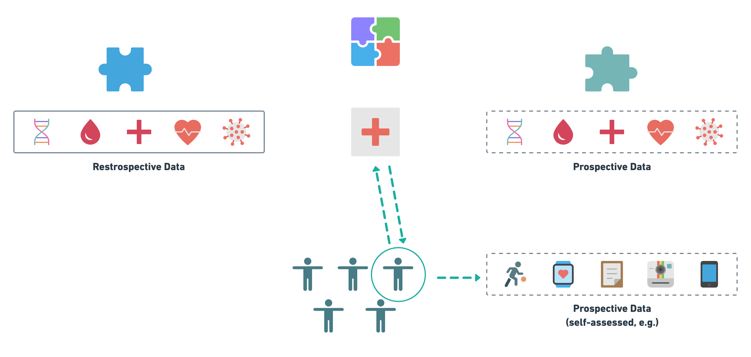

Slide 6
State-of-art approach
Centralization of data being curated
Process followed by data ingestion
Examples:
Cloud-based EHR/EMR systems
Majority of data processing platforms
Data lakes architecture
Pros:
United data structuring
Centralized analytics performed
Cons:
full data anonymization
Higher costs
Security vulnerabilities
Not following a “Data stays local” principle

Slide 7
Proposed Solution
“A centralized meta-data curation ecosystem with a decentralized data storage approach”

Slide 9
Meta-data challenges
Meta-data = data about data
In many cases no meta-data available
Structure -> standarts are there, need to follow and transform accordingly
Data types -> .xml, .csv, .xlsx, .json, …. ,
Is there any way to create a robust experience of curation?

Slide 10
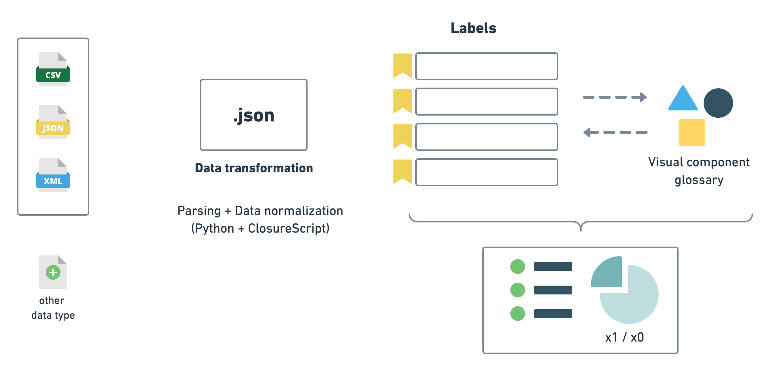

Slide 11
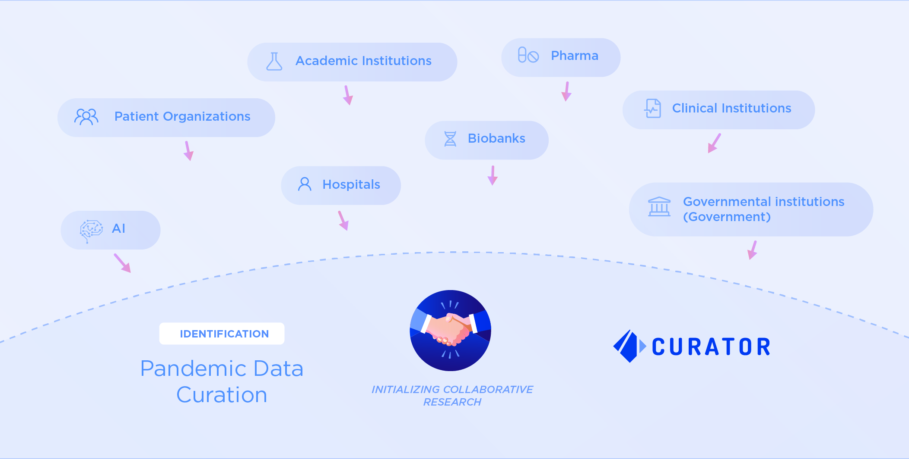

Slide 12
Interface Demo
www.longenesis.com/curator

Slide 13
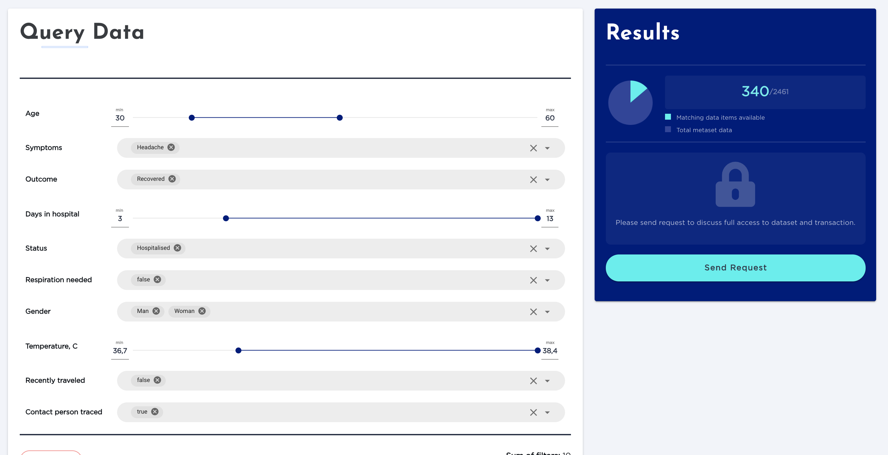

Slide 14
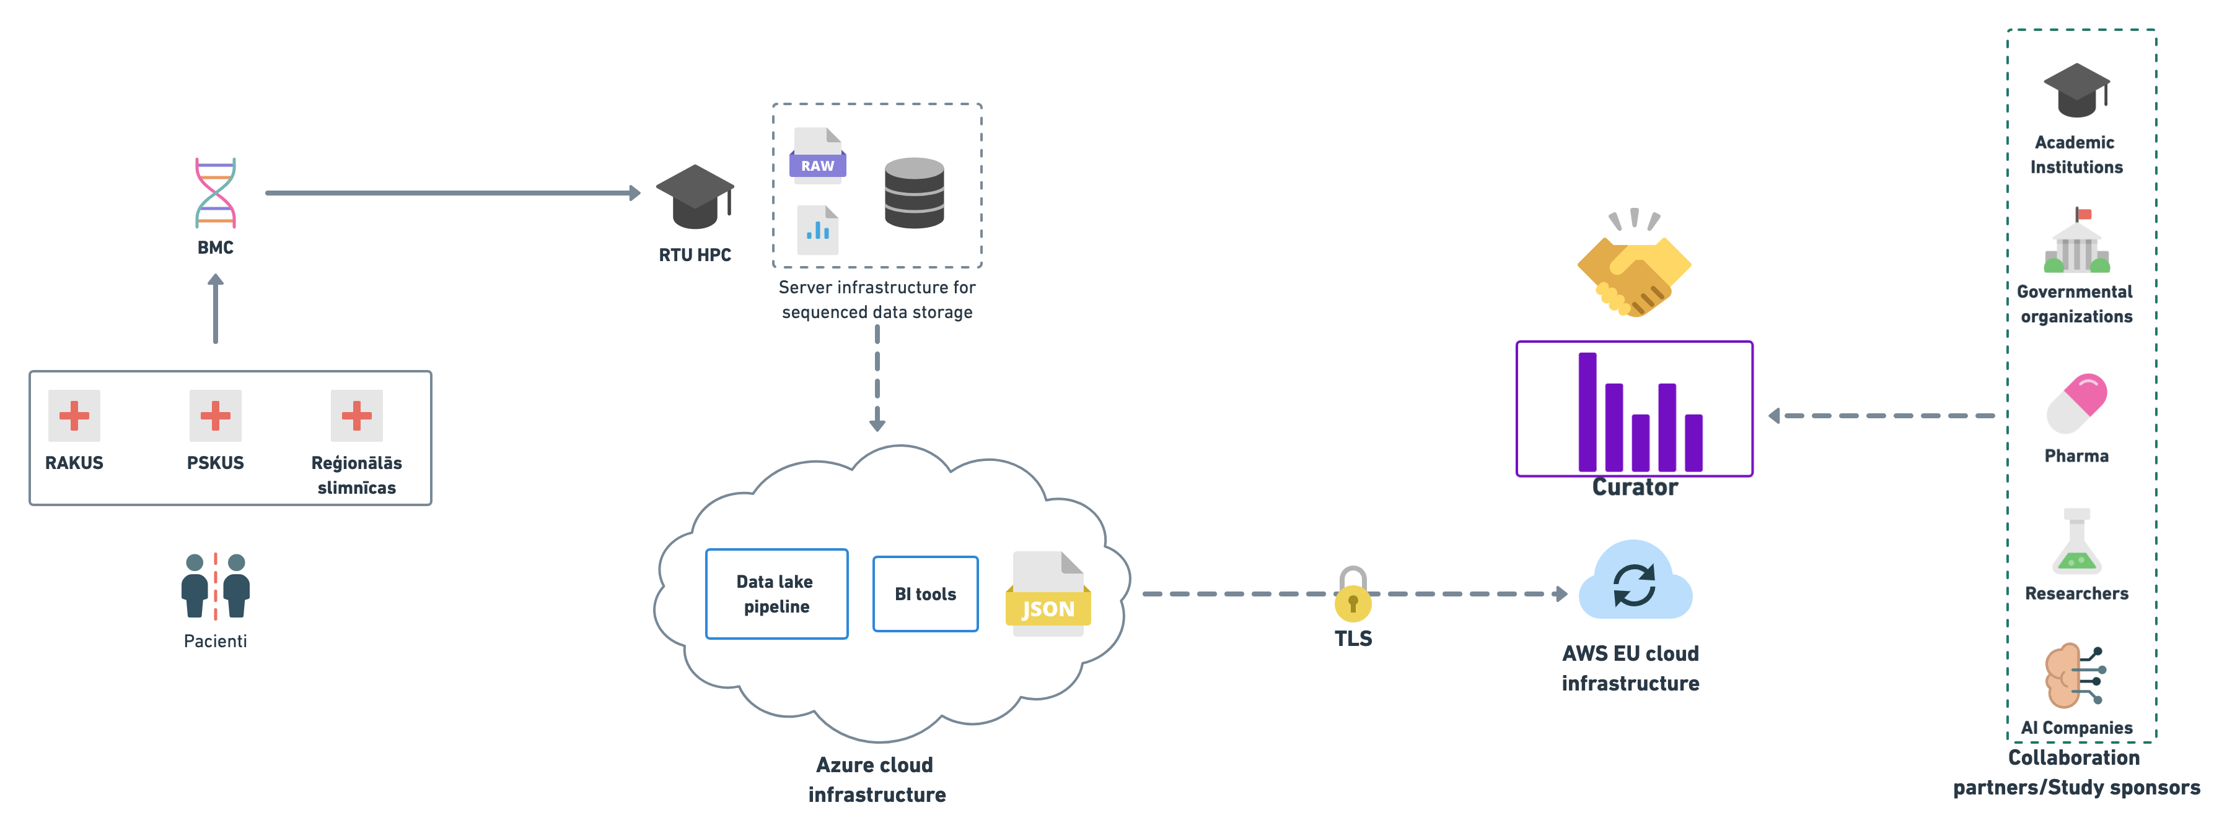
Longenesis announces Curator platform for privacy-preserving data use for COVID-19 research Available: https://www.eurekalert.org/pub_releases/2020-12/im-lac120920.php

Slide 15
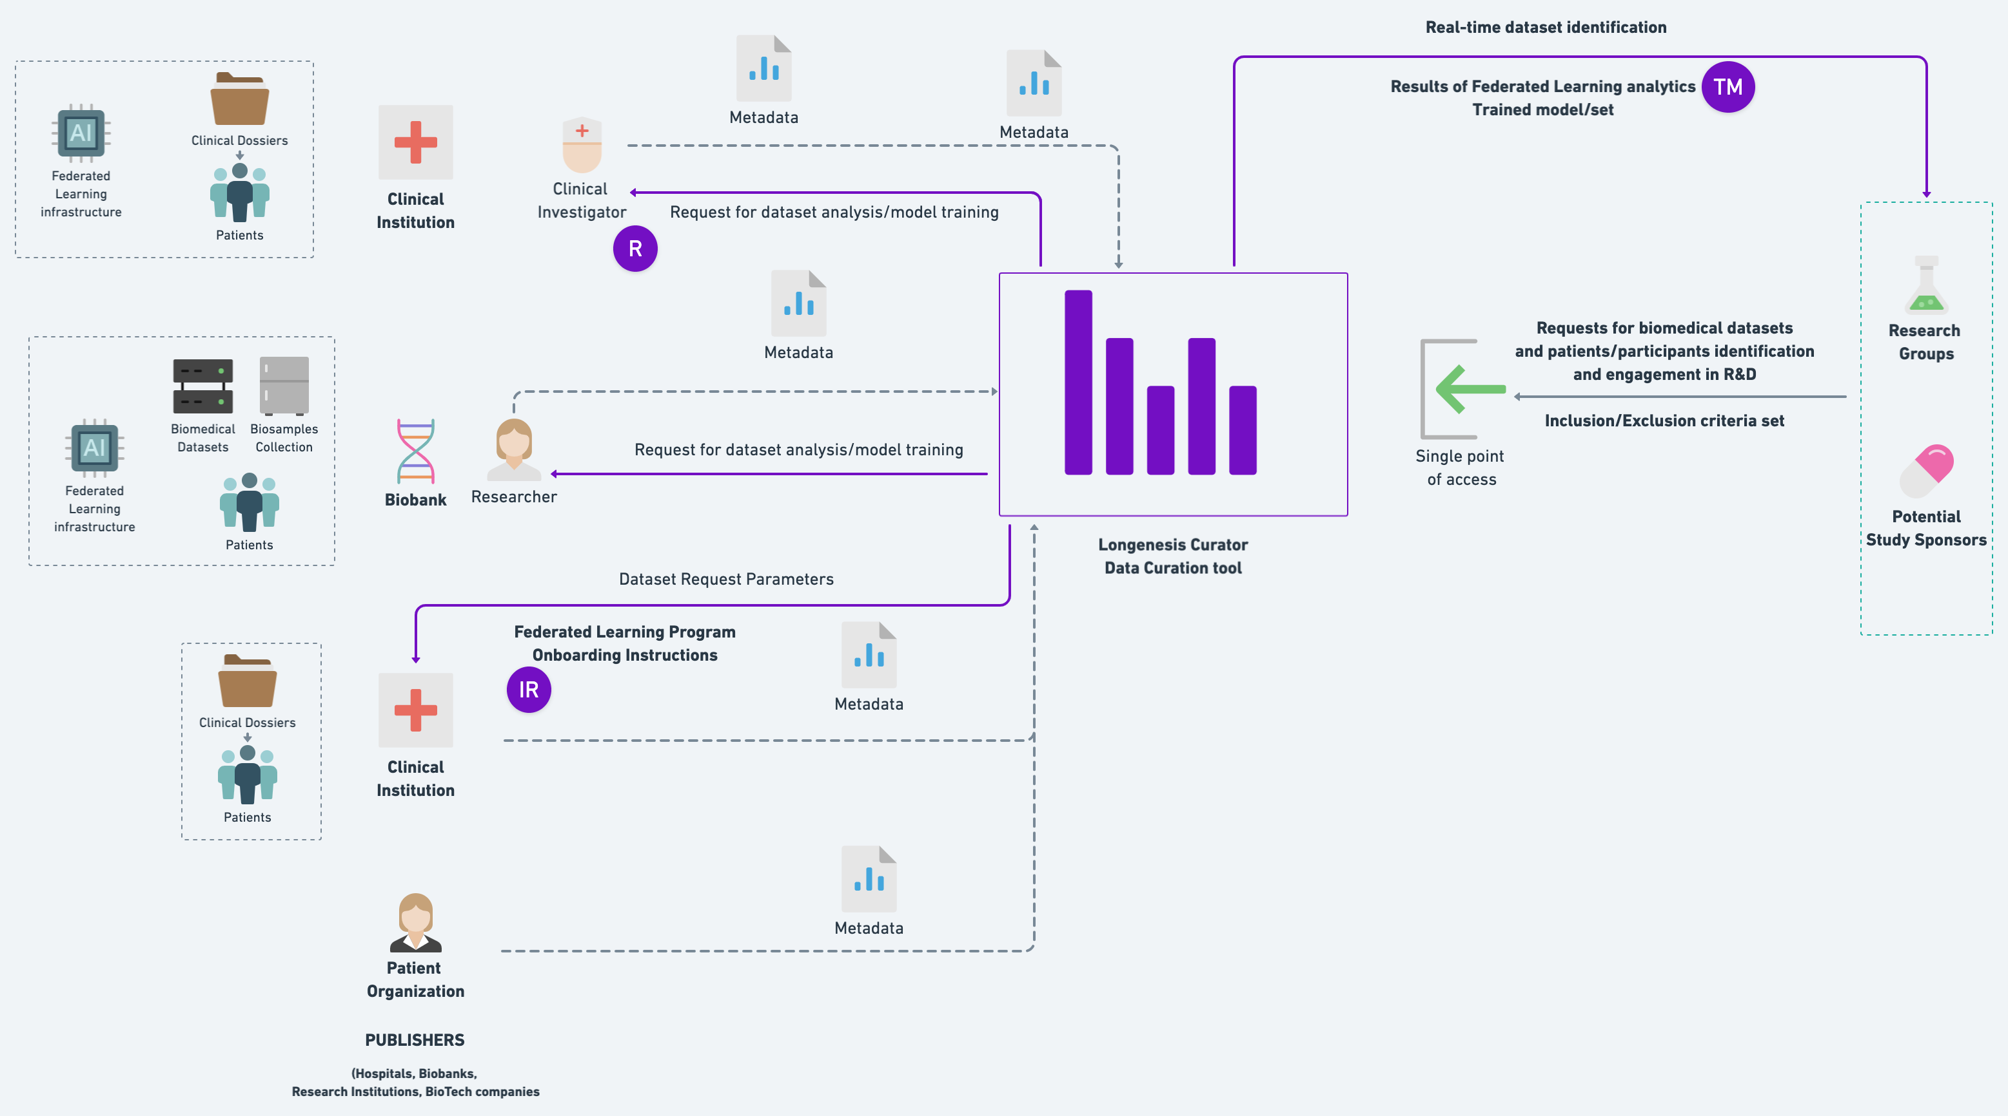

Slide 16
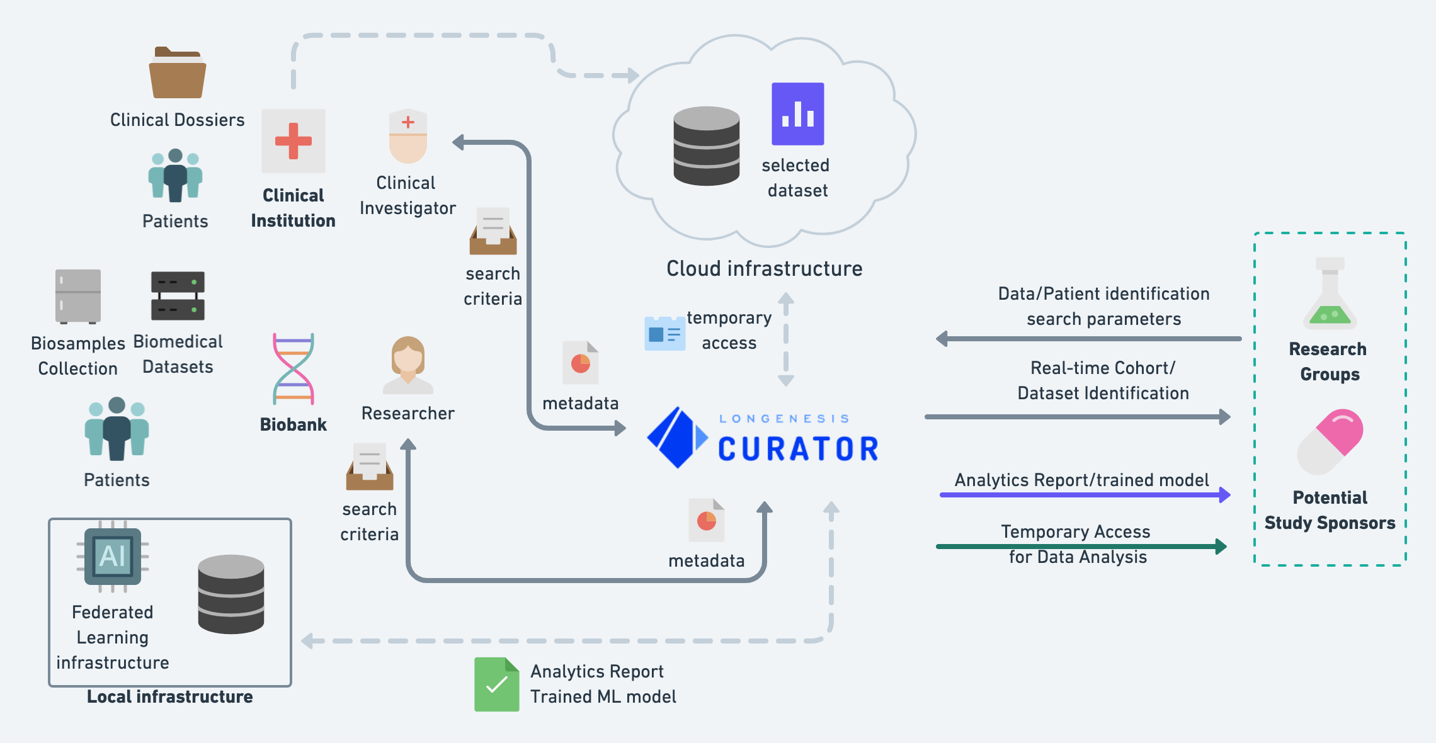

Slide 17
Onboarding
(?) How to provide a patient/study participant-centric approach towards the use of retrospective data with an ability of participant dynamic engagement into prospective studies.
“Ensuring privacy/ethics-by-design, while providing a dynamic engagement approach”

Slide 18
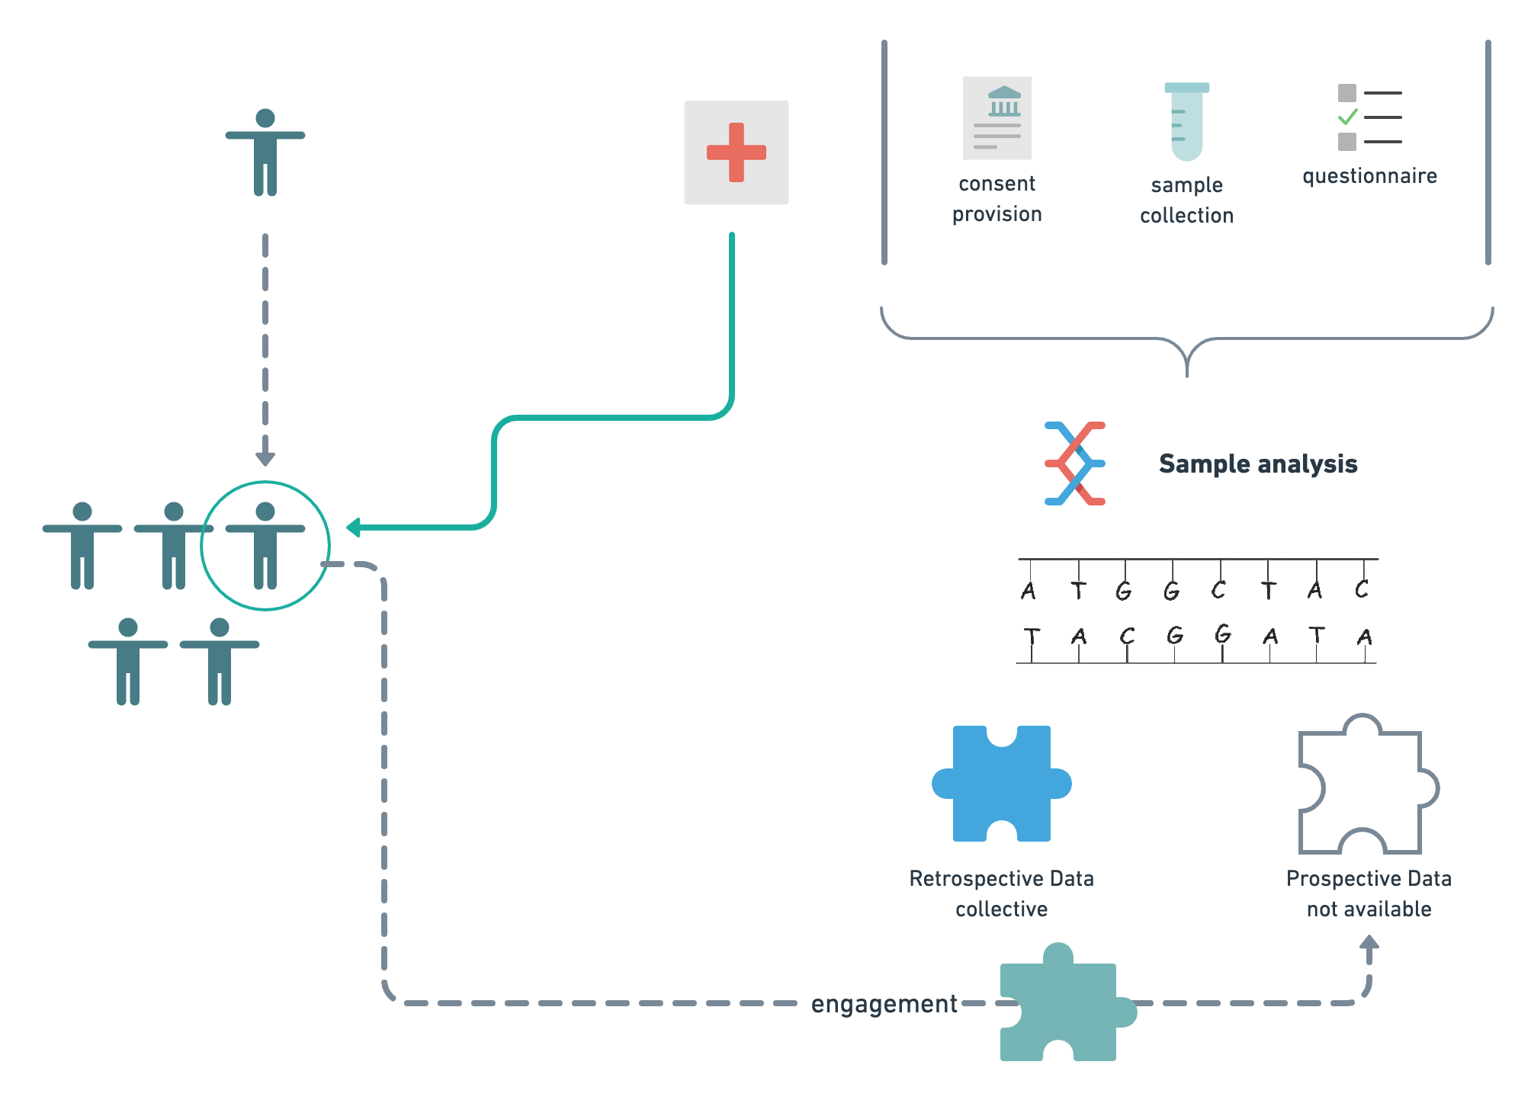

Slide 19
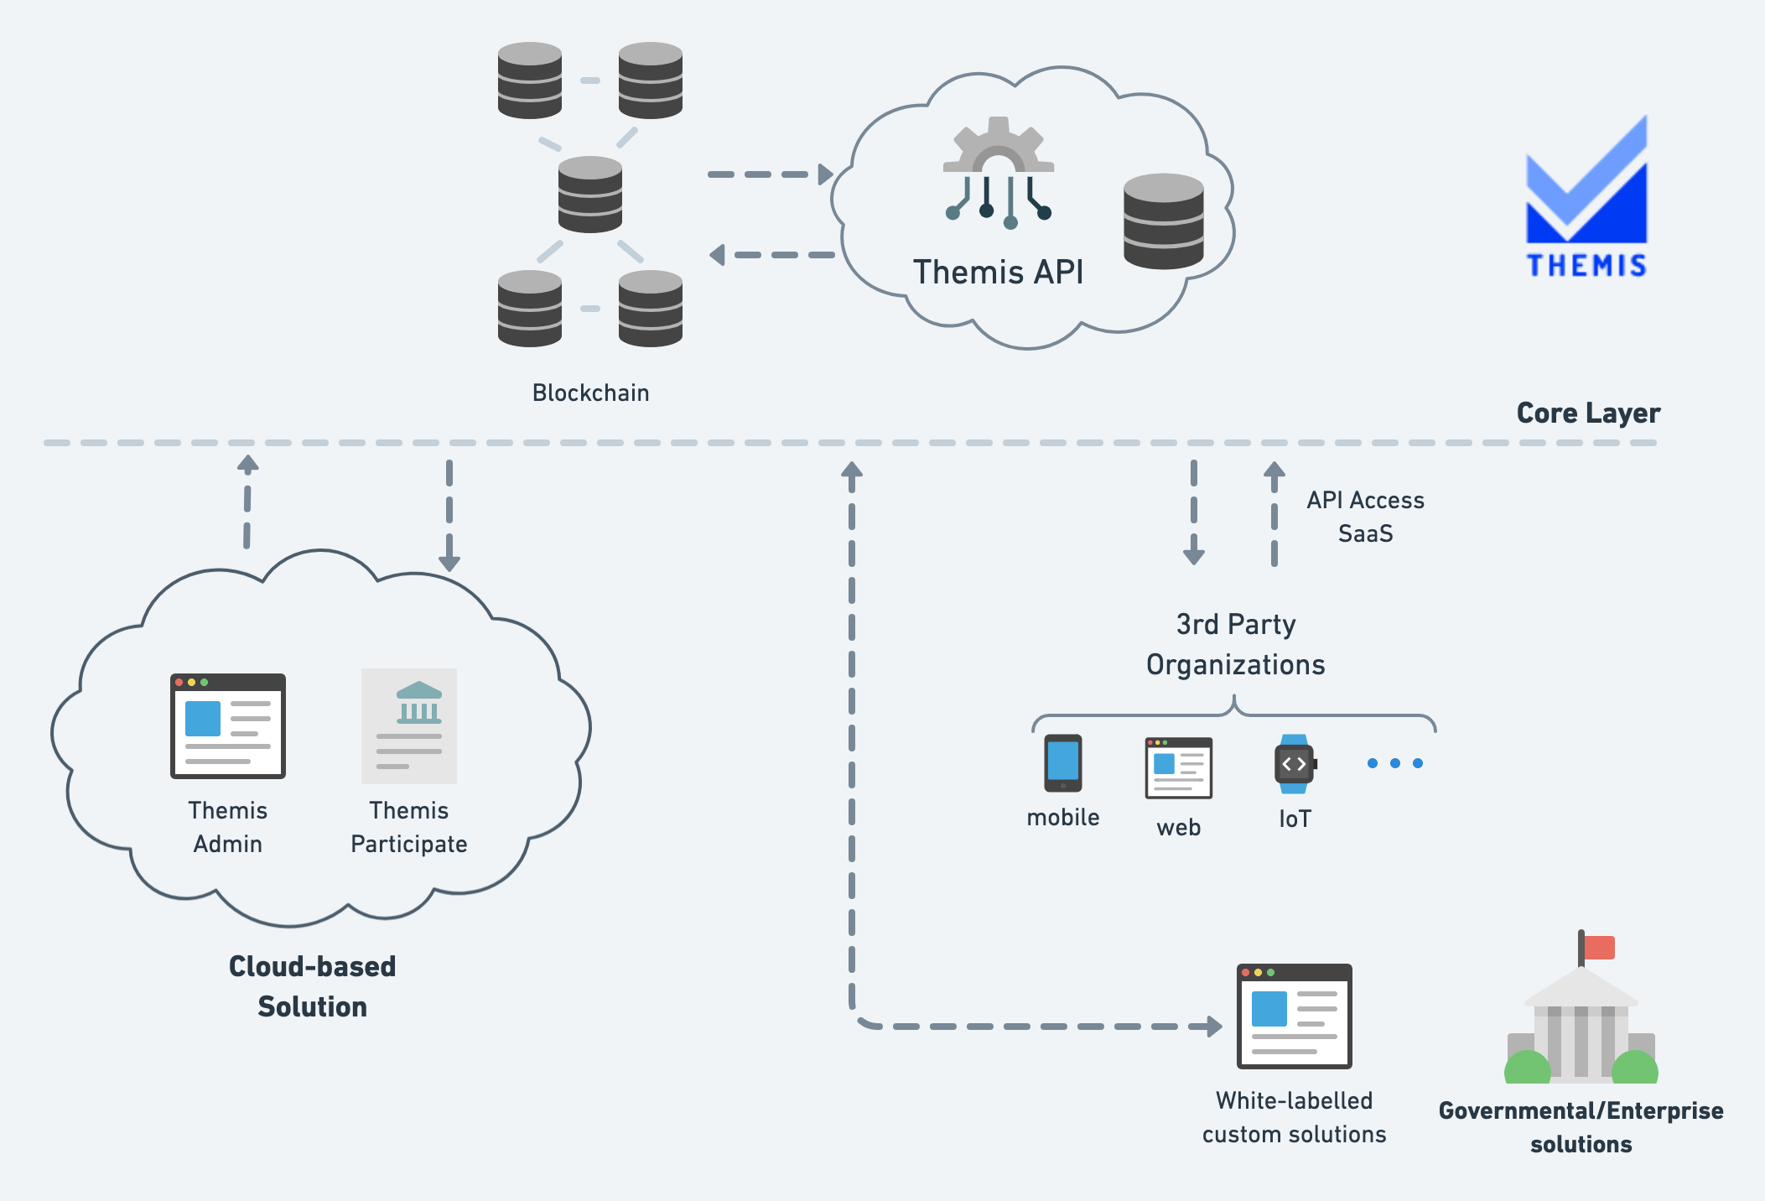

Slide 20
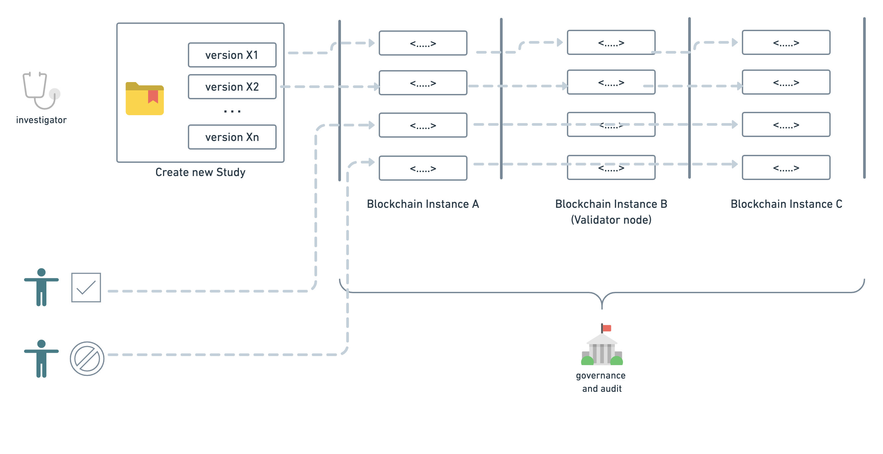

Slide 21
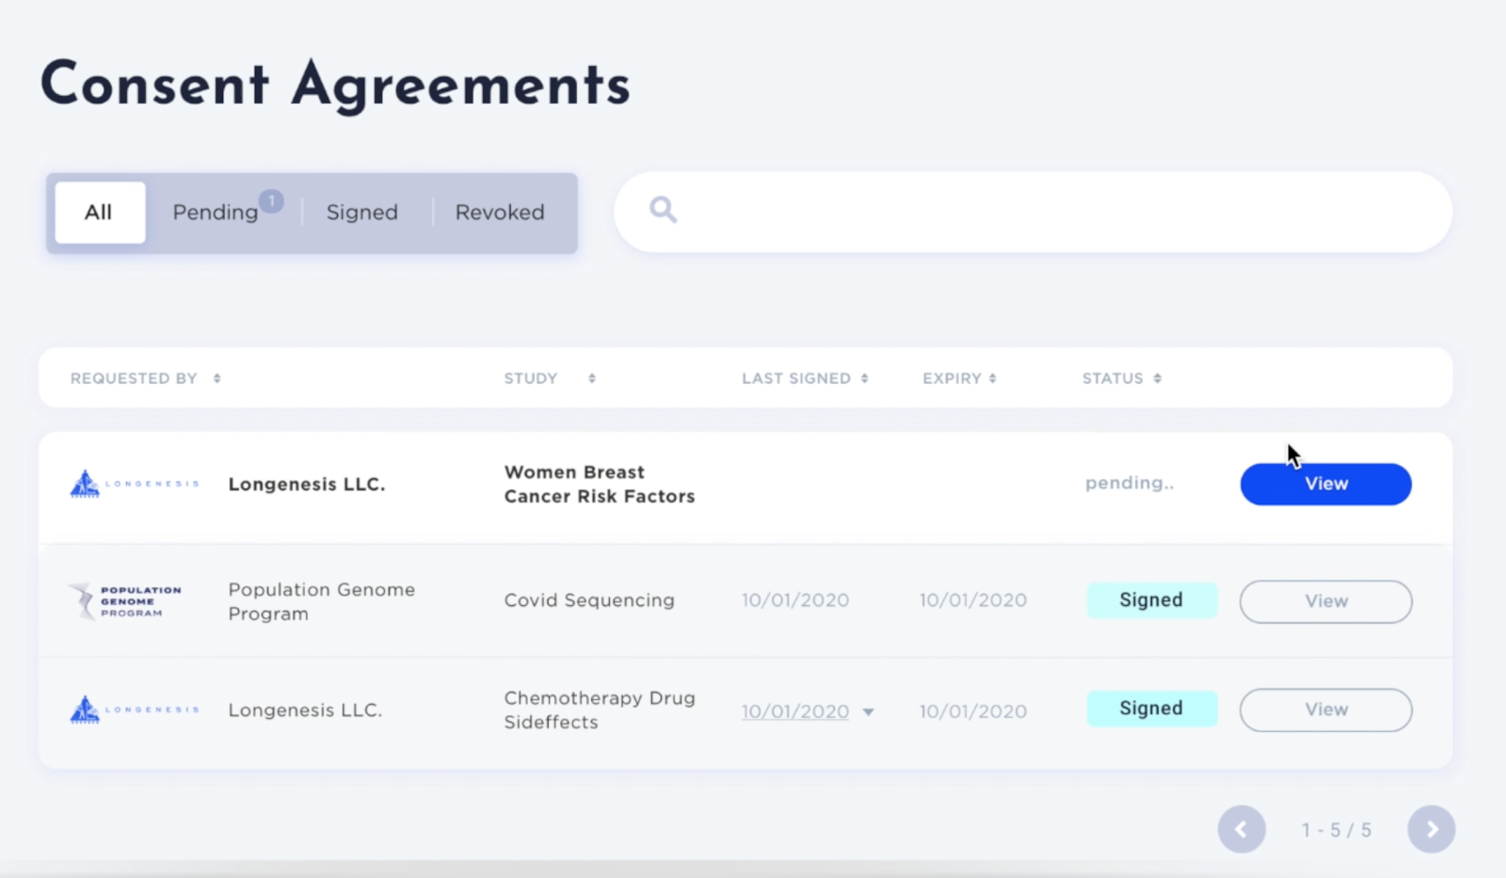
Longenesis.Themis - a digital patient consent management tool that enrols patients into research activities by getting auditable and transferable permissions.
Providing end-to-end consent management for prospective study onboarding for National Population Genome program in the Middle East, SARS-CoV-2 Vaccine trials, and biobank networks in EU.
SaaS product allowing study administrator to create study invitations with custom consent form documents and review the consent provision activity log in real-time.
White-labelled web- and mobile-ready interfaces for participants proactive onboarding and consent requests management.
FDA 21 CRF Part 11 Pending

Slide 23
Interface Demo

Slide 24
Engagement

Slide 25
Challenges
Lack of Data
Oversaturation with Data
Proactive Engagement Mechanisms
Technical Challenges
Data filtering, structuring and normalization
Data security and privacy-by-design
Orchestration with Multiple Data Sources
Non-Technical Challenges
Engagement mechanisms with high rates
Feedback system individualized
Robust data collection experience

Slide 26
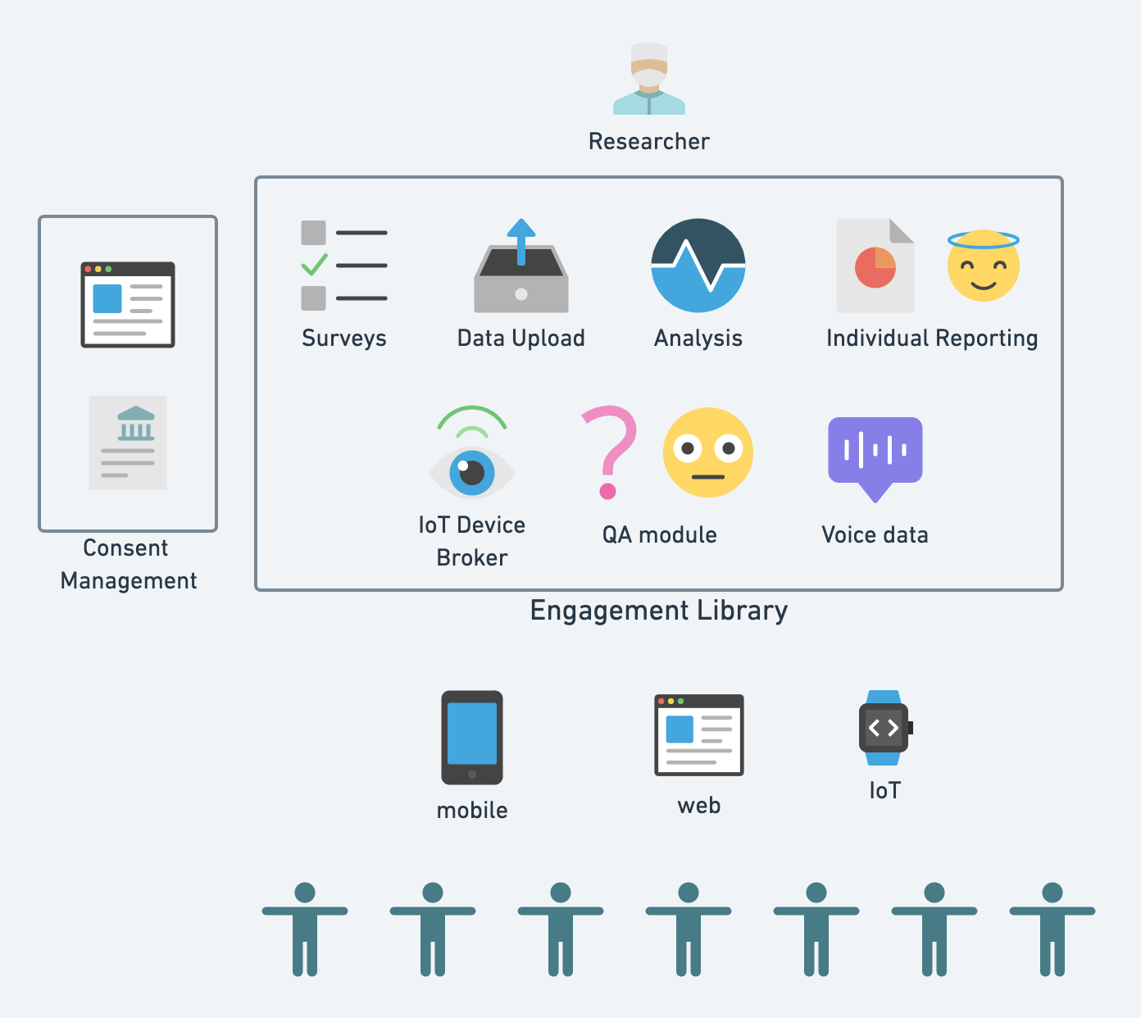
Plug-n-play architecture – a sandbox for researchers to launch RWD studies and orchestrate among multiple data collection instrumentrs
Data collection brokers
“Agnostic to data the source of data. Only metrics collected matter”

Slide 29
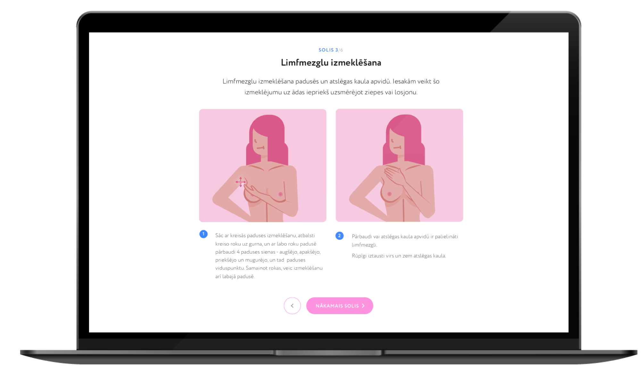
Sabiedrības līdzdalības un izglītošanas platforma, kas:
audzē izpratni par profilaksi
informē par personīgajiem riskiem
sniedz pievienoto vērtību zinātnei

Slide 30
6000+ women engaged into epidemiological study, in collaboration with UL Faculty of Medicine
Application for Cervical Cancer Screening digitalization
Integration for longitudional study pipelines in collaboration with Amazon AWS Global and one of the major BioPharma
Collaboration project with one of the top U.S. universitities (Yale) planned for Q2 2021

Slide 33
Iesaistos.lv platform for COVID-19 research
Vaccination Readiness multi-national study, in collaboration with Holon Institute of Technology (Israel), Boston University (USA), University of Latvia (Latvia)
Personalized risk and severity assessment (in the scope of the National Research program)
FORTHEIM consortium prospective on COVID-19 affecting mental state of health (Horizon 2020)

Slide 34
Pilots launched
MS (Multiple Sclerosis) RWD study, engaging 200 patient in the clinical study, as well as 700 members of Patient advocacy group (Latvia) and 250 members (Macedonia)
T1D (Type 1 Diabetes) QoL prospective study for reimbursement strategy enhancement in Latvia

Slide 35
RESEARCH BY STUDENTS
Arturs Amirovs
«Mobile technologies for monitoring the effectiveness of the type 2 diabetes treatment process», in collaboration with PSKUS and Agate Kalcenaua MD
Laura Fridrihsone
«Voice technology powered dynamic patient triage model for oncological diseases», in collaboration with UCL Oncology Center
Kaspars Eglitis
«Cognitive tests for patients with neurological disorders», in collaboration with Janis Mednieks MD

Slide 36
Identification
Onboarding
Engagement

Slide 37
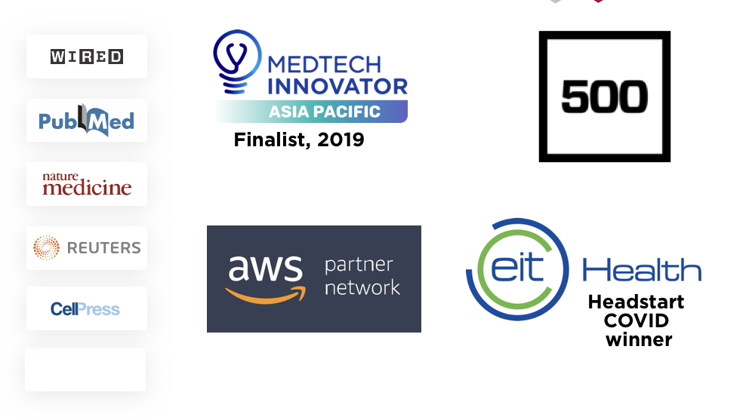

Slide 38
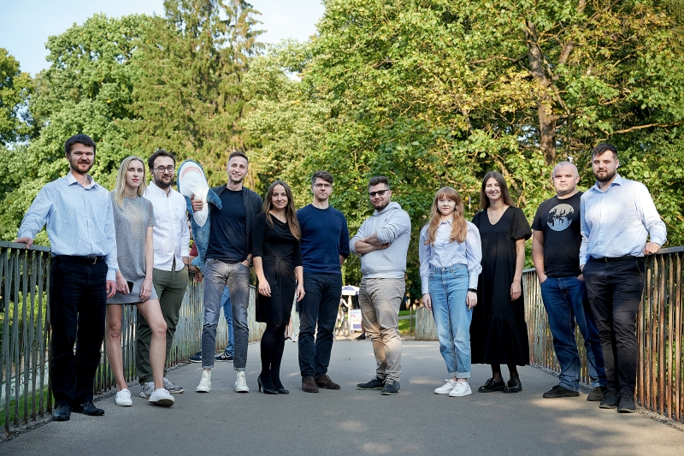
We are hiring!
DevOps Engineer
Full-stack Developer
Front-end Developer
Python Developer
Product Manager
Business Developer
If you are looking to launch your research project, we are here to help ☺

Slide 39
Contacts
Emil Syundyukov | Chief Technical Officer
es@longenesis.com
+371 20201964

