Slide 1
Artificial intelligence in stoichiometric model-based sustainable metabolic engineering of organism strains
Kristaps Bērziņš
PhD student
Notes:
In the first year I was directing my attention towards «engineering of organism strains» part of my title - specifically exploring previously created methods

Slide 2
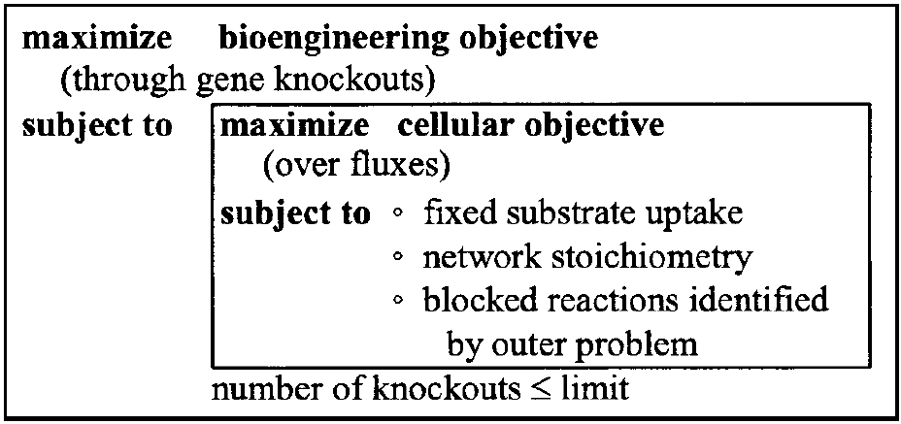
Exploration of methods - optKnock
First method (created in 2003)
Bilevel programming framework
First level – maximize yield of product
Second level – Optimizes growth
Solved using mixed integer linear programming (MILP)
Weak growth-coupling
Notes:
First method that was developed was created in 2003. it was optKnock and later it was implemented in COBRA toolbox that most metabolic engineers use to develop new strains.
It is bi-level programming framework whose first layer tries to maximize yield, but second – maximize growth. Both levels are combined in single Mixed Integer Linear Programming problem that can be solved using commercial solvers. This method gives overly optimistic results and growth coupling was weak

Slide 3
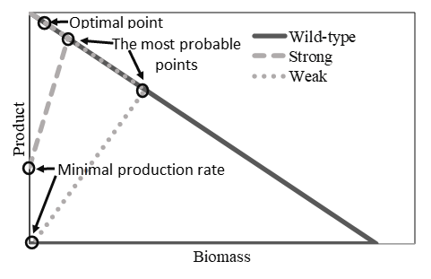
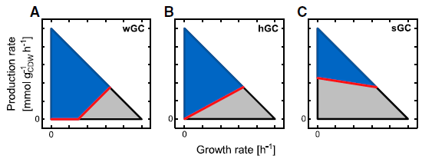
Growth-coupling and Envelopes
When organism grows, it produces target metabolite
Growth-coupling relationship can be represented by projecting flux space onto the product and biomass yield axis
Notes:
Growth coupling is strain design method that forces organism to produce desired metabolite while it grows. It can be easily seen in production envelope, which is flux projection of target product and growth in 2d graph. For metabolic engineers it is useful if organism always produces target metabolite even if the organism does not grow – which is Strong-growth coupling
Growth coupling can be weak, holistic and strong

Slide 4
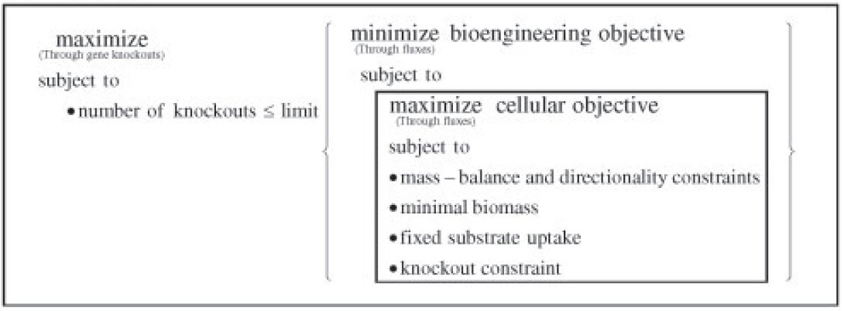
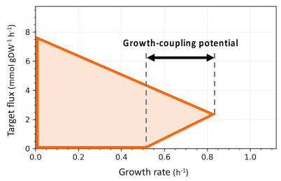
Exploration of methods - robustKnock
Created in 2010
Improves on optKnock
Guarantees that target metabolite is produced
Uses max-min optimization
Solved using mixed integer linear programming (MILP)
Notes:
Next noteworthy method is robustKnock, which improved on optKnock with algorithm that creates smaller MILP problem () and that always finds growth-coupling potential.

Slide 5
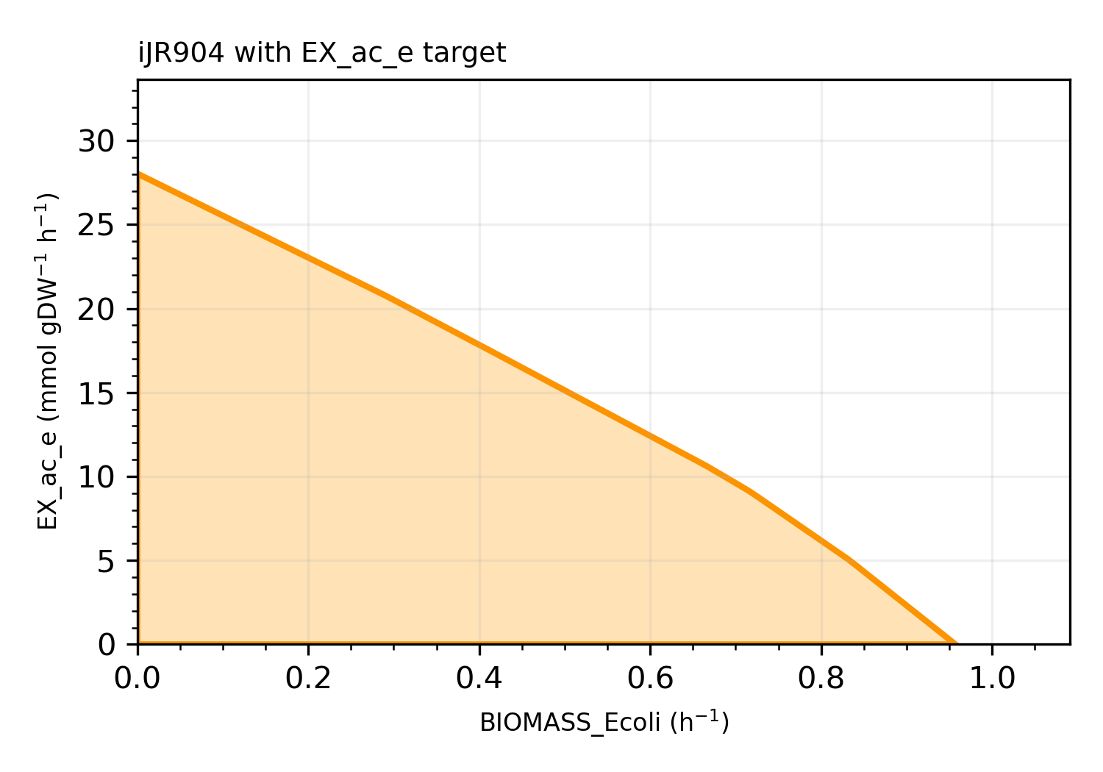
Exploration of methods - optCouple
Created in 2019
Python
Another improvement on optKnock
Possible knock-outs, knock-ins and modification to growth medium
Postprocessing to identify modifications that contribute (improves calculation times)
Notes:
Next method I was looking at was optCouple. This method was first taht was created in Python. This method gives user ability to att reactions to the model as well as take them out.
Creators of this method also worked on reducing calculation times by further decreasing created matrix for MILP problem.

Slide 6
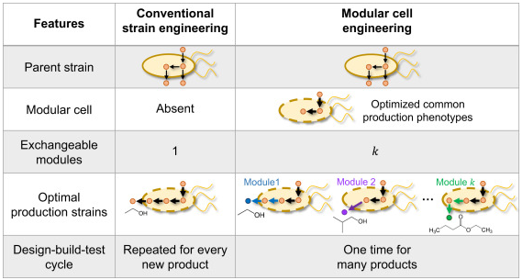
Exploration of methods – ModCell2
Created in 2019
Evolutionary game theory and evolutionary algorithms
Can calculate multiple target metabolites at the same time
Notes:
Next method was ModCell2, which gave user posibility to calculate multiple target functions at the same time by creating «cells». It was complicated for me to make this method work for any other model that was not mentioned in tutorials as there had to be created multiple CSV files just so the model would be able to run.
Also this was method uses genetic algoritms to reach the result. I will have to explore the code to see what exactly is the optimization function and how it works.
There are not large number of methods that uses AI.
Also authors described their approach using game theory where one player tries to produce biomass, while other tries to create target product

Slide 7
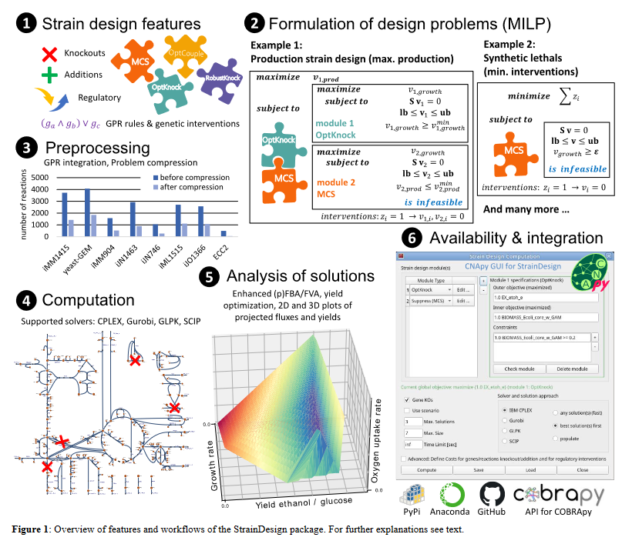
Exploration of methods – strainDesign
Created in 2022
Python GUI
Combines four previous methods
User input is minimized
MILP creation is automated
Can include desired and undesired regions
Notes:
Latest method that I was able to find, is strainDesign. This method also uses python, but creators have made graphical user interface for ease of use. It uses several previously created methods to improve potential results. They also included ability to set desired and undesired reģions firther increasing usefulness of their method.

Slide 8
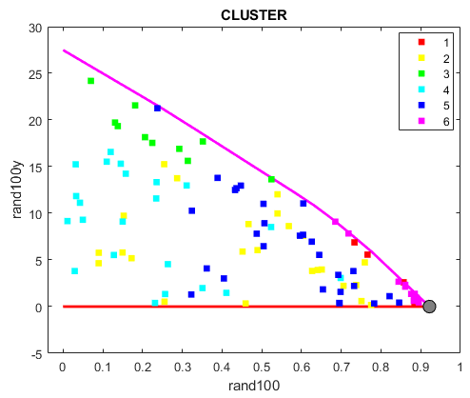
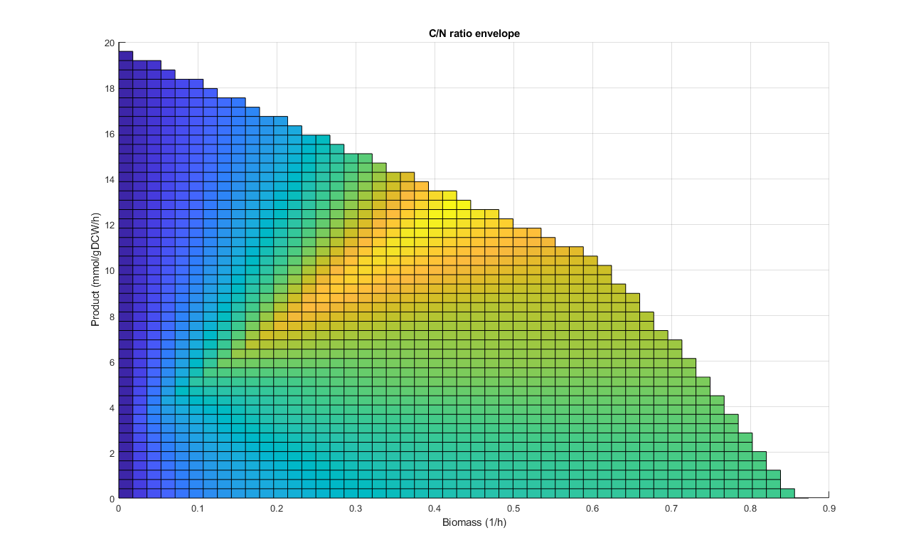
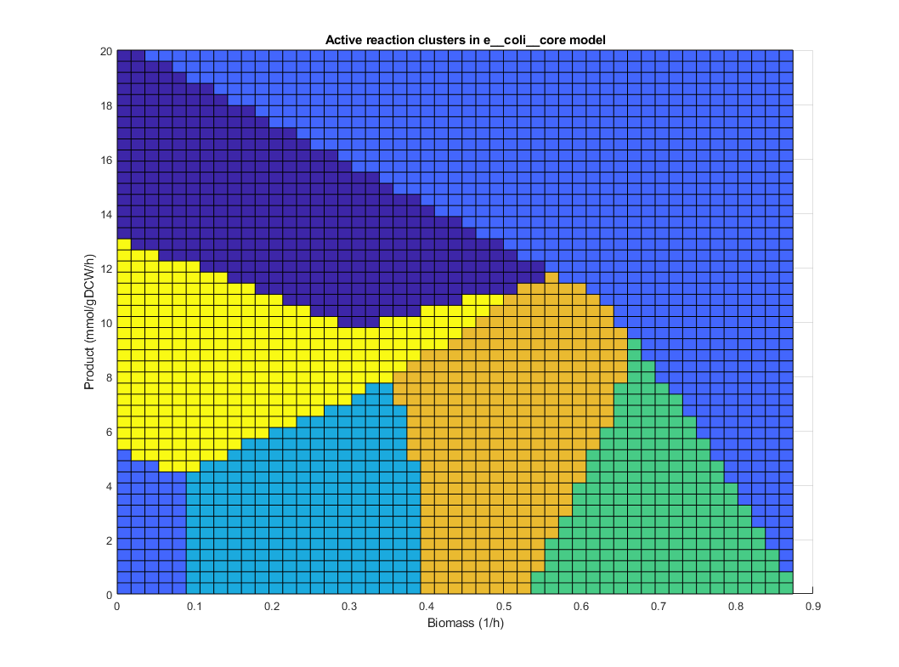
Designing novel method – active reactions
Constant zero flux
Variability including zero
Variability excluding zero
Constant non-zero flux
Notes:
Based on these previous methods I am trying to create new method that hopefully will use some kind of AI to improve on the calculation times and results
Currently I am looking at active reactions
Each situation can be described with active reactions – underlined points.

Slide 9
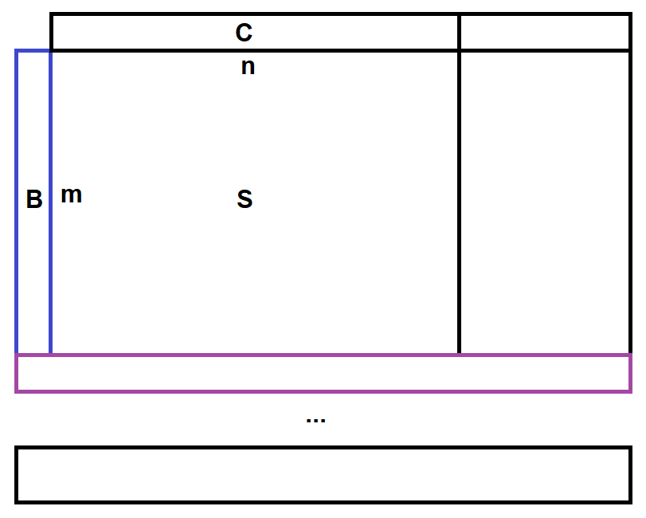
Understanding MILP matrix
Stoichiometric matrix S
Reactions n
Metabolites m
Constraints C
Objective B

Slide 10
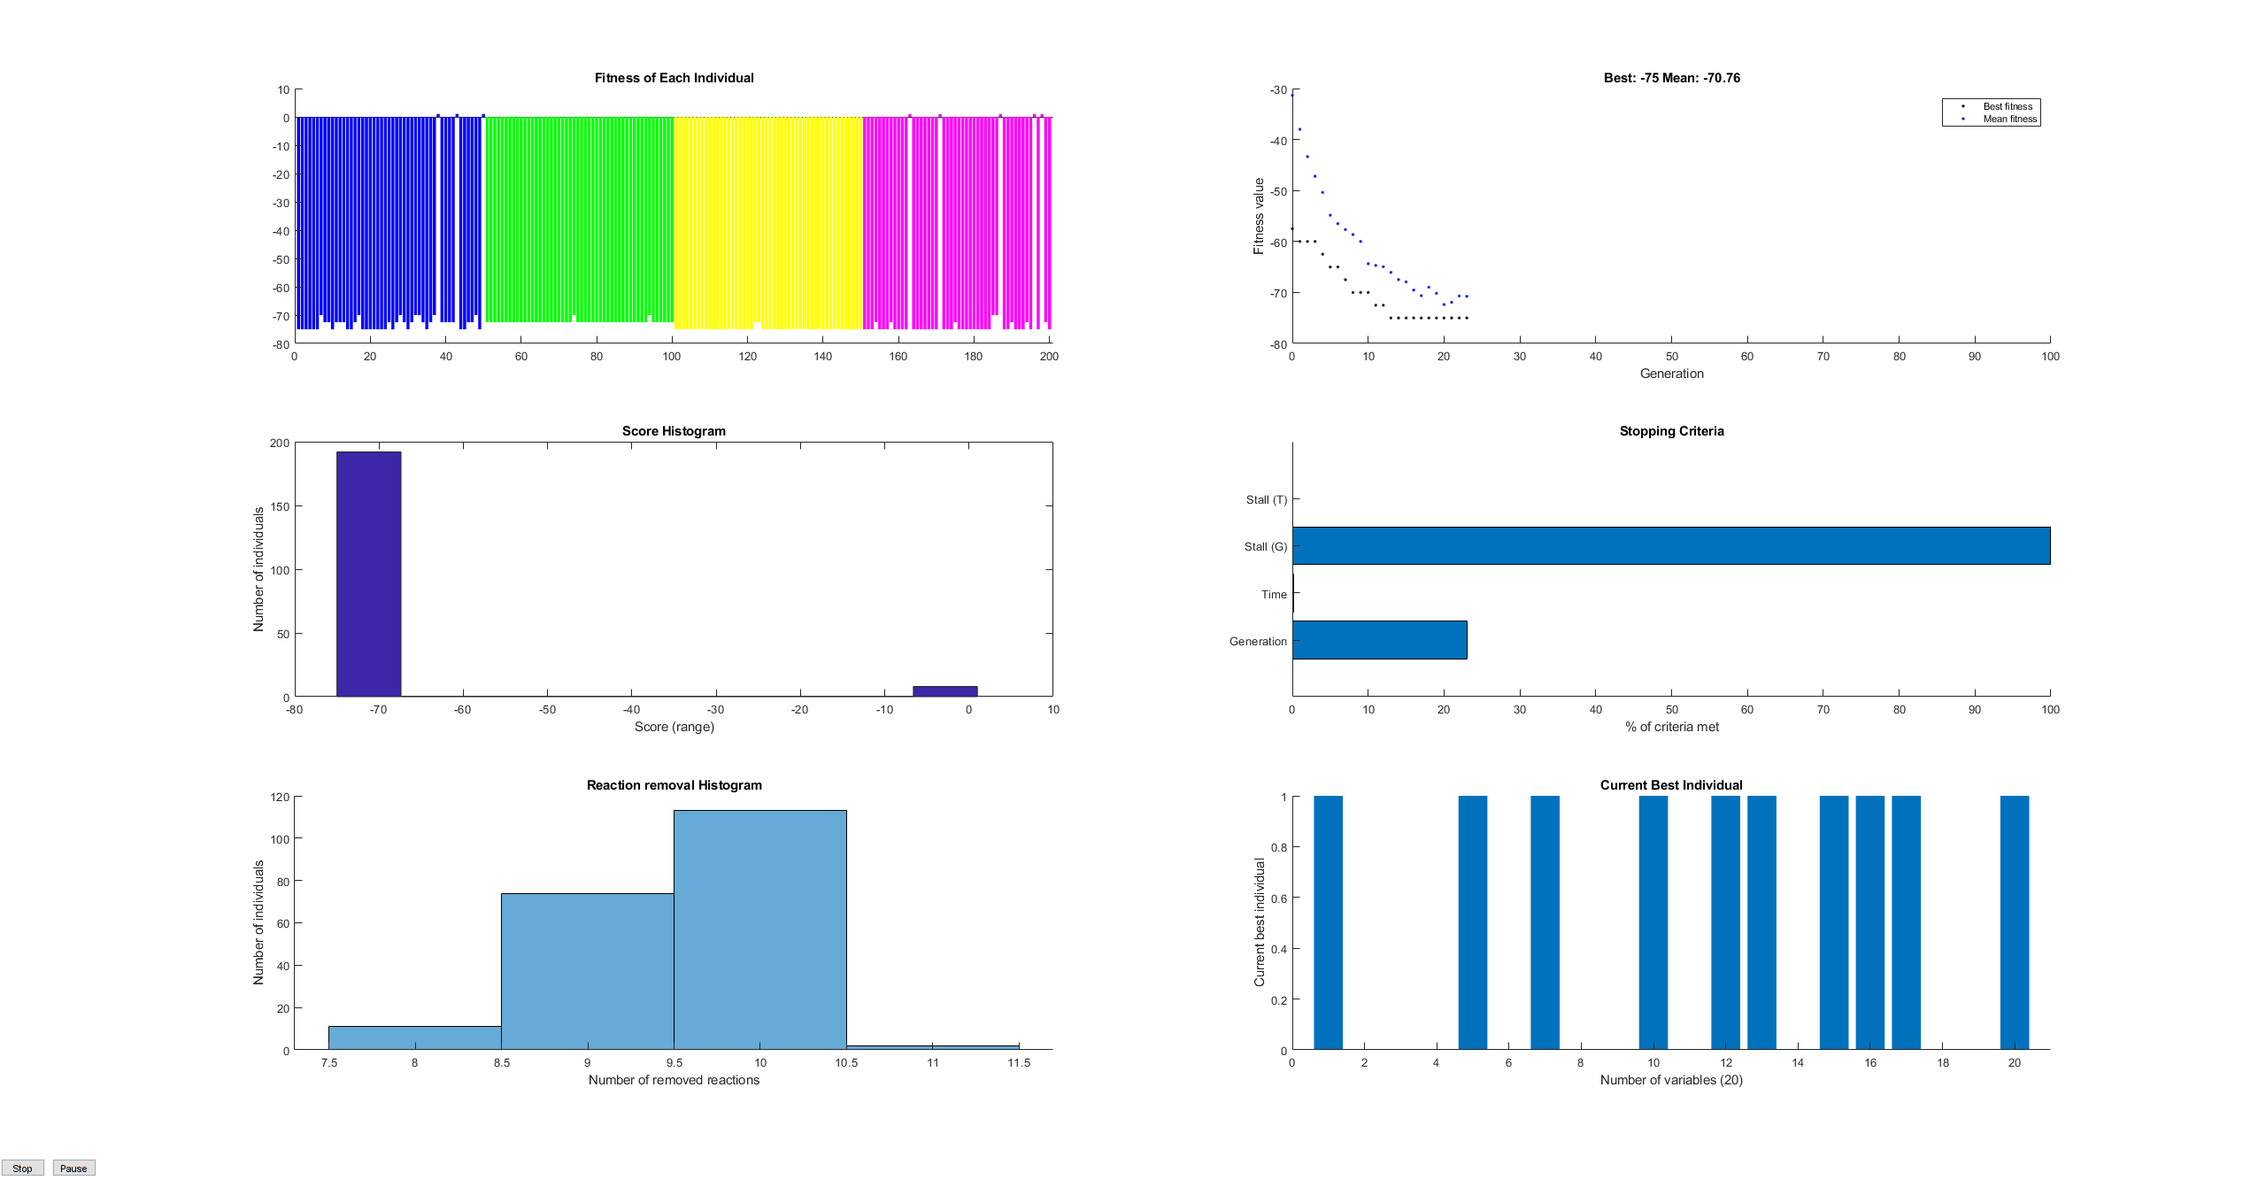
Artificial Inteligence
Genetic Algorithms
ModCell2
optGene
kStrain
Neural network

Slide 11
Thank you

