Slide 1
VARIOUS POLYOMINO PACKING PROBLEM ALGORITHMIC DECIDABILITY AND COMPUTATIONAL COMPLEXITY
Author: Dmitrijs Grekovs
Supervisor: Aleksandrs Belovs, Dr. dat., doc.

Slide 2
Current situation
Polyomino packing problems first appeared in 1960s, however results regarding algorithmic complexity begun to appear only in 2000 and they are very few.
Therefore, there are a lot of open problems, which could be tackled, as well as it’s possible to define new problems and modify or generalize existing ones.

Slide 3
Goals
Research literature for known polyomino packing problems and related ones
Research and analyze algorithmic complexity/decidability of those problems
Highlight problems which don’t have known complexity/decidability and attempt to find those
Define new polyomino related problems and attempt to find algorithmic complexity/decidability of those problems

Slide 4
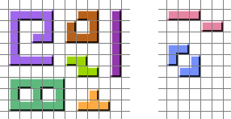
What is a polyomino?
A polyomino is a plane geometric figure formed by joining one or more equal squares edge to edge.
Famous example – shapes from game Tetris, they are polyominoes with area 4 and are called tetrominoes
Polyomino
Not a polyomino

Slide 5
What is algorithmic decidability?
Formally, a problem is decidable if and only if exists Turing machine (an algorithm), which solves the problem for all inputs in finite time
Simplest undecidable problem is Halting problem – to decide if given Turing machine halts (finishes in finite time)
This can be easily seen by looking at this pseudocode function which gives a contradiction if it’s possible to decide if given algorithm halts:
bool F () { if (halts(F)) { while (true) {} } return false; }
Notes:
Saskaņā ar Čerča-Tjuringa tēzi, jebkura funkcija var principā būt aprēķināta, tad un tikai tad, ja eksistē Tjuringa mašīna kas to aprēķina

Slide 6
What is algorithmic complexity?
Algorithmic complexity of a problem is a property of given problem which reflects what resources are required to solve the problem with best possible algorithm
Usually time and space worst case complexity is analyzed
Time and space complexity can differ depending on computational model used, e.g. Turing machine or RAM machine
Usually difference in models is not significant
Notes:
Laiks labākājam algoritmam sliktākājā gadījumā.

Slide 7
What is algorithmic complexity?
Worst case complexity is denoted as $O(f\left(n\right))$, where $n$ – input data length and $f$ – some function
That means that exist constants $c$ and $n_{0}$, and an algorithm, which solves the problem for all inputs of length $n>n_{0}$ in time (or space), which is not greater than $c×f(n)$
For example time complexity of a sorting problem is $O\left(n\log{n}\right)$ (on RAM machine)
For a lot of problems exact complexity is not known, therefore problems are divided into complexity classes

Slide 8
Some examples of time complexity classes
Linear time $O(n)$
Polynomial time $O(n^{c})$
Exponential time $O(c^{n^{k}})$
NP – such problems, for which a given solution for given input can be checked in polynomial time
NP-hard – such problems, that any problem in NP can be reduced to this problem. That means if we can solve NP-hard, we can solve any NP problem
NP-complete – problems which are both in NP and NP-hard

Slide 9
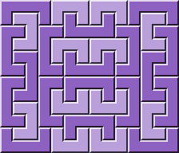
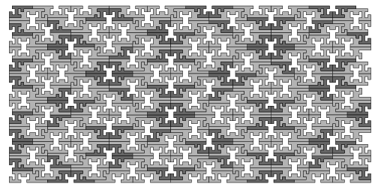
Polyomino packing problem
Packing problem – decide whether some amount of polyomino copies from given set could be packed into given figure without holes and overlapping.
Usually polyominoes are allowed to rotate and reflect. Sometimes a restriction is added, that polyomino of each type should be used at least once
General polyomino set packing into general region is a NP-complete problem
Most researched regions are rectangle and plane (Euclidean)

Slide 10
Polyomino packing into rectangle
If rectangle size is given, then problem is NP-complete
Not known, is problem is still NP-complete if polyomino set size is restricted
If only one dimension of rectangle is given, but second is to be found, then such problem is still decidable, but it is unknown if it is NP-hard (it cannot be NP, because output could be exponential)
If problem is to decide whether any rectangle exists, where given polyomino set can be packed, then such problem is undecidable.
Not known if problem remains undecidable when polyomino set size is restricted
Interesting fact: for fixed polyomino set there always exist linear algorithm, which says if there is a solution for any rectangle dimensions, however finding such algorithm is undecidable problem.

Slide 11
Polyomino plane tiling
Problem is undecidable
Still undecidable if polyomino set size is 5
Not known if undecidable if set size is smaller than 5
If polyomino set size is 1 and only parallel translation is allowed, then solvable in linear time depending on polyomino perimeter

Slide 12
Less researched packing regions
Author is planning to analyze complexity/decidability for different regions which are formed by gluing opposite sides of a rectangle in different ways (gluing in such way that arrows are matched)

Slide 13
Author’s current results
Problem of deciding if there exists region from previous slide of any size is undecidable
For torus it is trivial consequence from existing similar proof for Wang tiles
For other regions, author modified existing proof for rectangle, which is based on PCP (Post-correspondence problem) reduction
Simple algorithm with better time complexity for finding number of domino packings into a rectangle, new time – $O\left({\left(wh\right)}^{2}\right)$, old – $O\left({\left(wh\right)}^{3}\right)$ using FKT algorithm (more general though)

Slide 14
Future work
Find complexity/decidability for earlier mentioned regions if one or both dimensions are given
Attempt to tighten polyomino set size restrictions of already known problems, such as 5 for plane tiling, or to find such restriction for rectangle

Slide 15
Other problems with polyominoes
Polyomino common multiple – find a figure, which can be packed by all given polyominoes from given set, separately by each
«Baiocchi figure» - find figure with maximal symmetry which can be packed by given polyomino set
There are plenty of examples on the Internet (found by computer or manually) but no any theoretic results.
Polyomino common multiple
Baiocchi figure

Slide 16
Thanks!
Questions?

