Slide 1
Bioimpedance in a wearable device
Mg.cs.ing Didzis Lapsa https://www.edi.lv/team/didzis-lapsa/
PhD Student, LU and EDI
Supervisor of Dissertation: Dr Atis Elsts
Rīga, 27/03/2022

Slide 2
Agenda
Projekts
Simple BioZ explanation
Product level description
Hardware overview
Data representation
New fields of research
Signal analysis
Conclusions

Slide 3
Projects
As a researcher at the Institute of Electronics and Computer Science, I am involved in the (Body-Coupled Communication) BCC [1]
As well as TIME-AMP project – (Technology for high-precision time-amplitude analysis of event flow) [2]
And a FEATURE projekt, which ended in December 2021 and whose achievements were significant in the development of wearable devices [3]

Slide 4
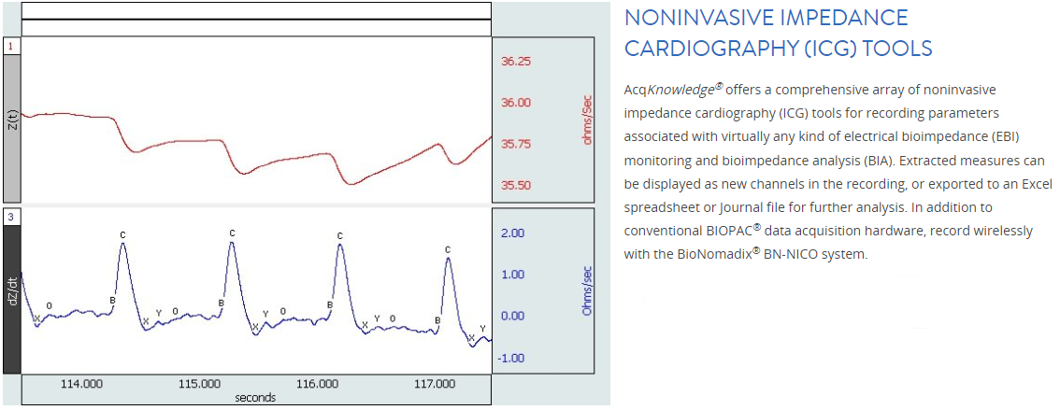
What I’m doing
By measuring tissue resistance, our goal is to obtain a heart rate
Expected BioZ
signal
Signal after detecting BPM
Picture reference [4],[5]

Slide 5
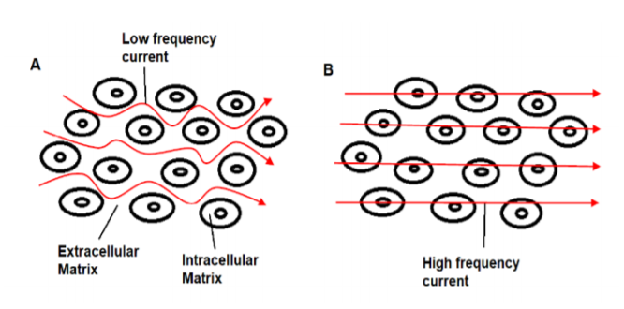
Flow of electrical current through biological tissue: A) At lower frequencies, current flows between the cells and through the extracellular fluid, B) At high frequencies, current penetrates the cell membranes and flows through intracellular and extracellular fluid. [6]

Slide 6
Levels of work
Electric level
Physical level
Digital level

Slide 7
Electric level
In the first year of study, the work is mainly at this level, for example, hardware design and data acquisition
Also the research covers most of the physical aspects such as environmental impact, temperature, area of measured tissue, human skin inequality, how strong is the heartbeat and all related physical anomalies.
Getting to know the research aspects in more depth, this leads to endless diving in a new research topics such as electrodes, test leads, measuring equipment, processing unit, and so on.
In conclusion, this is the most important basis for a good measurement result, as well as the basics of obtaining quality data.
Physical level
Digital level

Slide 8
Electric level
Physical level
Digital level
This is the level at which electrical impulses are received from human tissue.
It is the level at which transform the blood pressure changes in tissues, arteries as an electrical impulse as the changes in received electrical signal
At this level, all electrical connections and junctions must comply with low signal interference and must be well designed to lower the impact of measurements.

Slide 9
This is the final step in signal processing and display of the data as a final result
Different data filtering and separation must be performed to obtain the best output
This is a place for more research and analysis to get better results
As one of the main goals is to reduce the energy consumption of the wearable device, some of the state of the art, data processing techniques, models and neural network methods need to be researched and followed at this level.
Electric level
Physical level
Digital level

Slide 10
Hardware overview
Proposed wearable device architecture block diagram
Battery
IMU
Microcontroller – nRF5340
IMU – ICM-20600 accelerometer
PPX – ADPD105 heart rate meter
BI – Bioimpedance MAX30002
SG – signal generator
LCD – display
nRF53
PPX
BI
LCD
SG

Slide 11
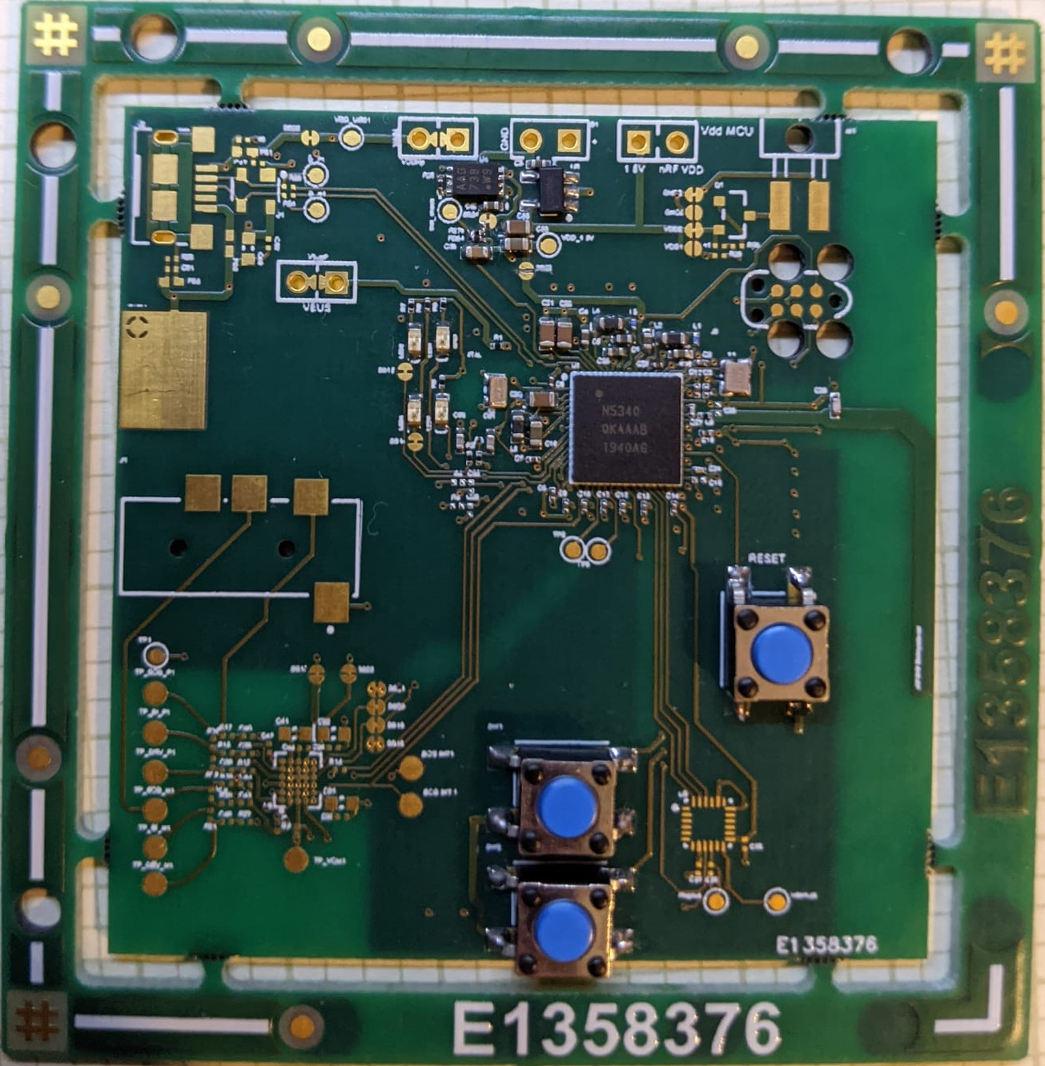
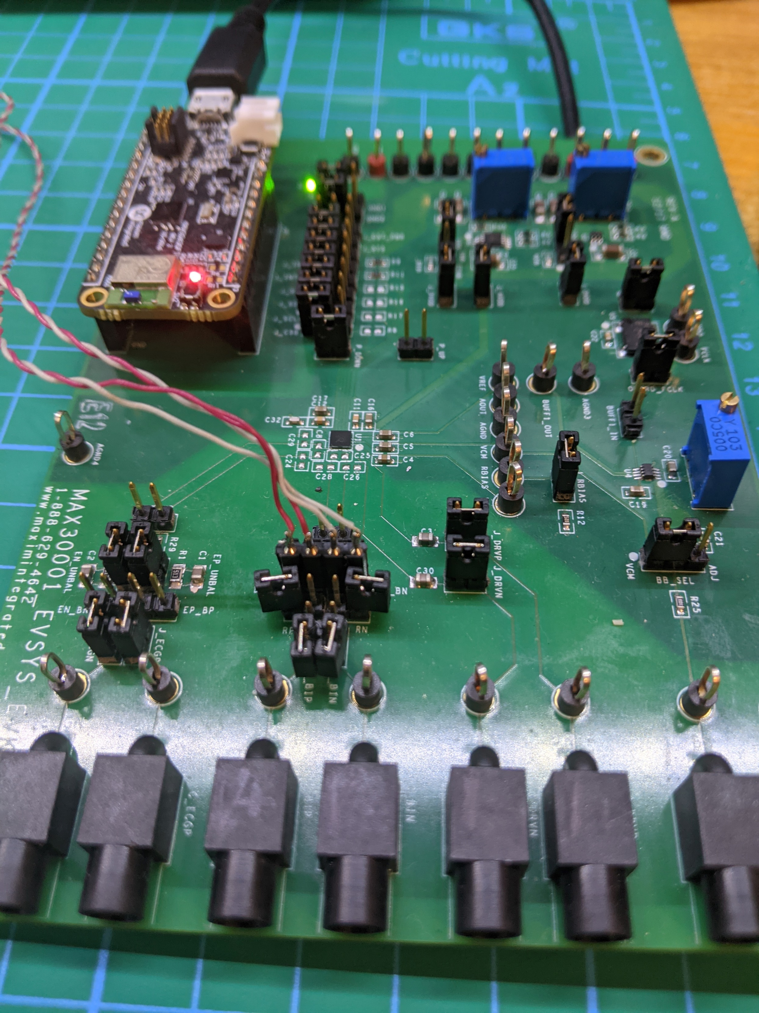
Hardware overview
The main PCB has been developed but is not yet complete
MAX30001 has not been tested yet
Algorithm not developed

Slide 12
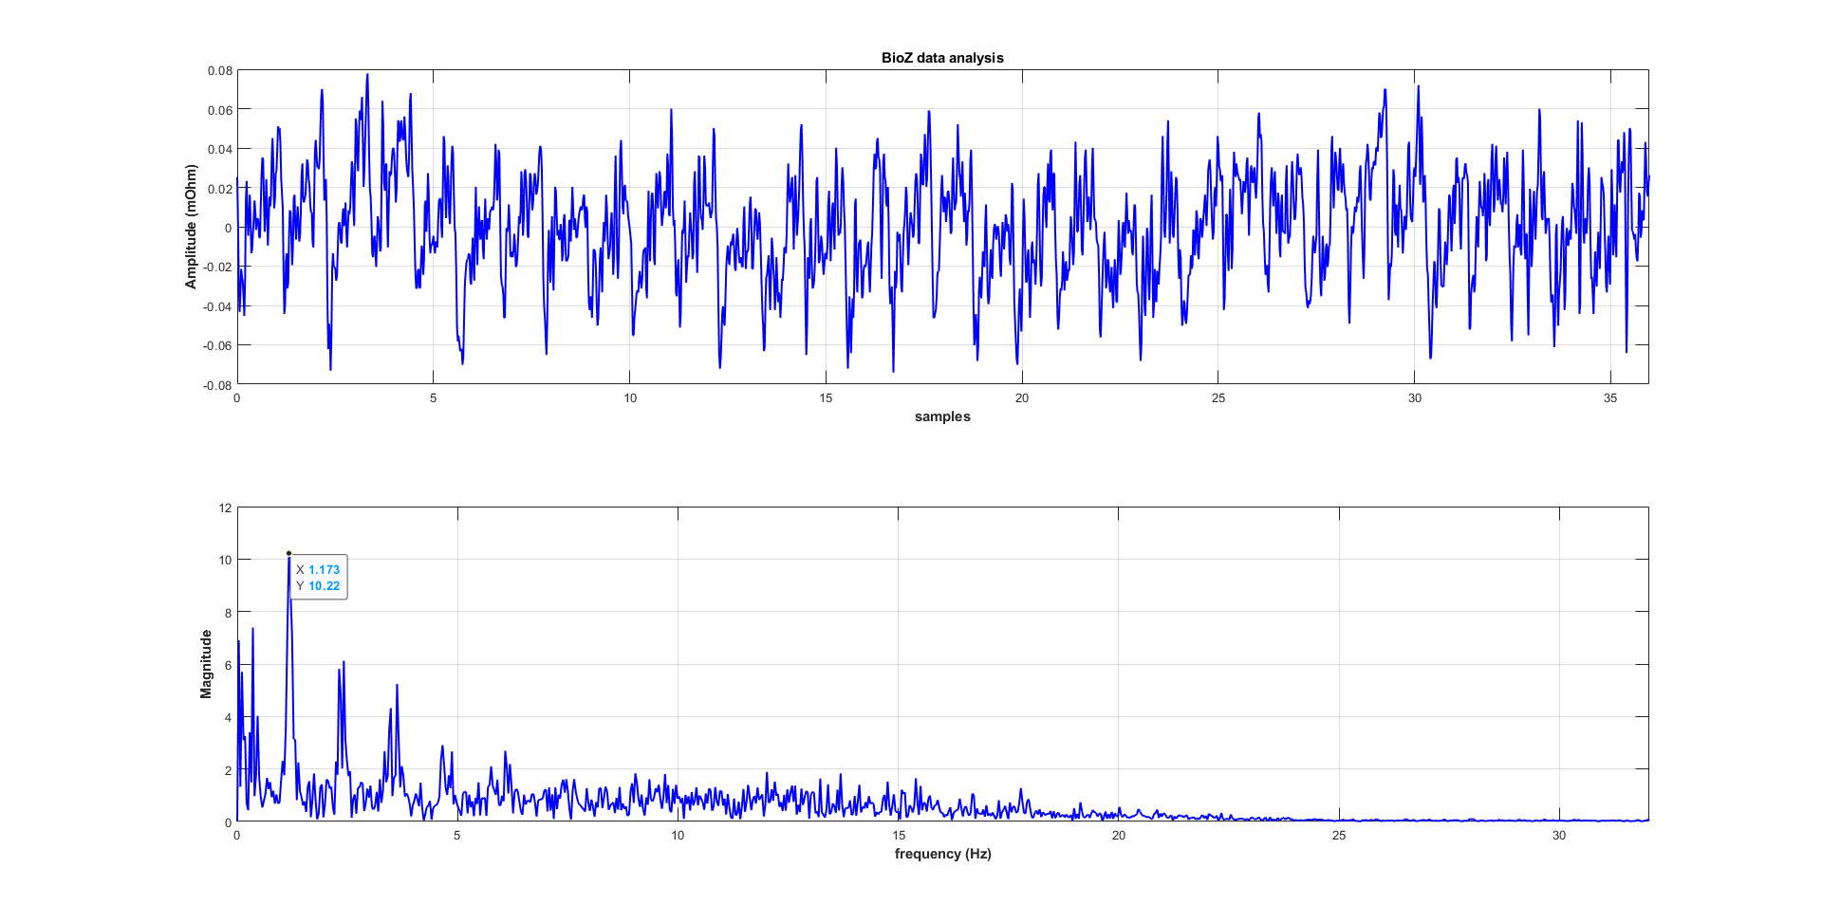
MAX30001 data acquisition
Data acquisition using max30001 development board [7]
Display of the signal on the time axes as well as composed FFT on the frequency axes using MATLAB

Slide 13
Wavelet analysis

Slide 14
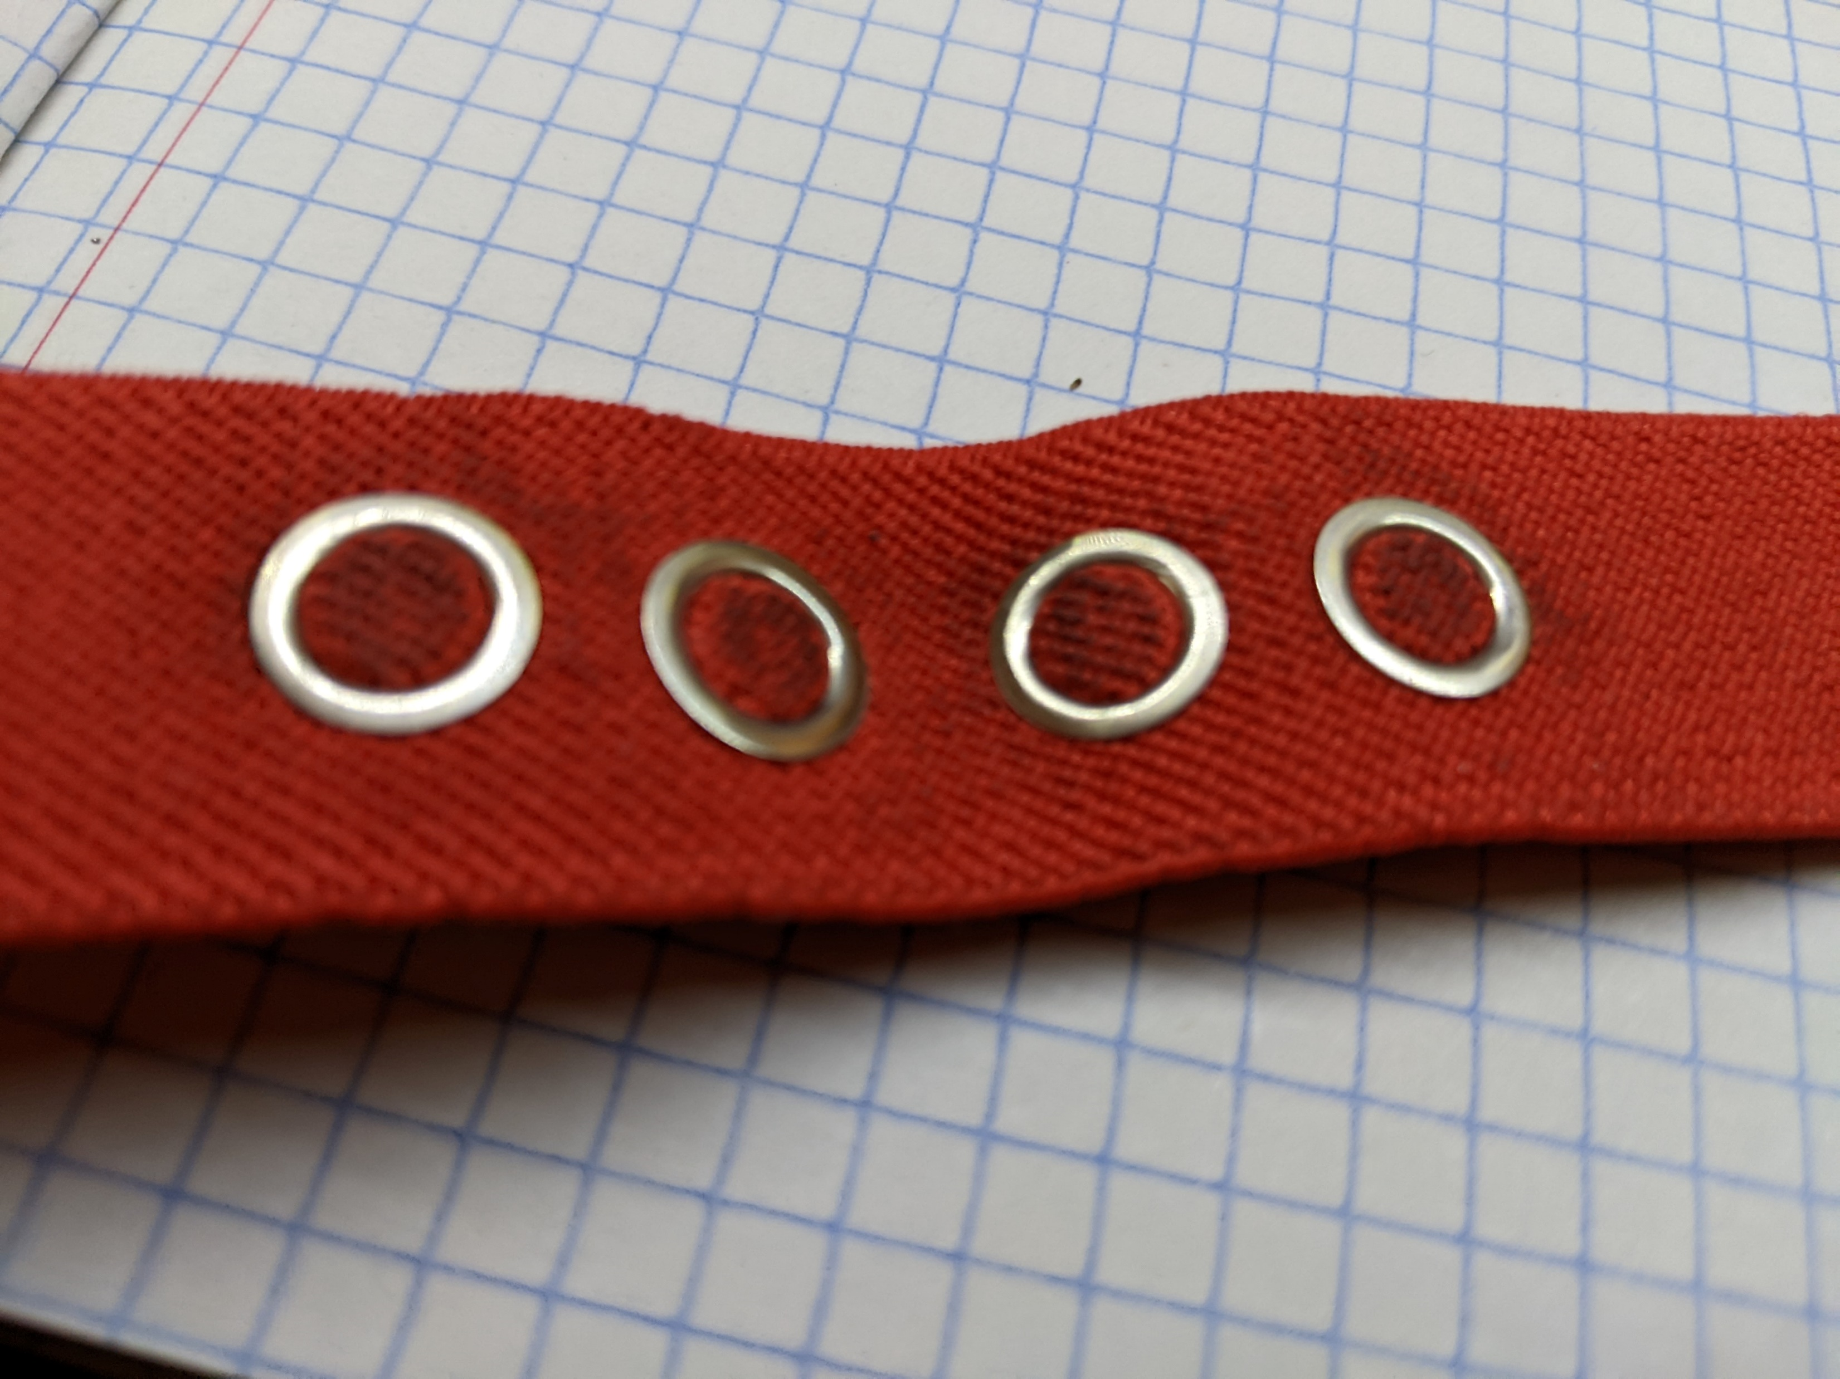
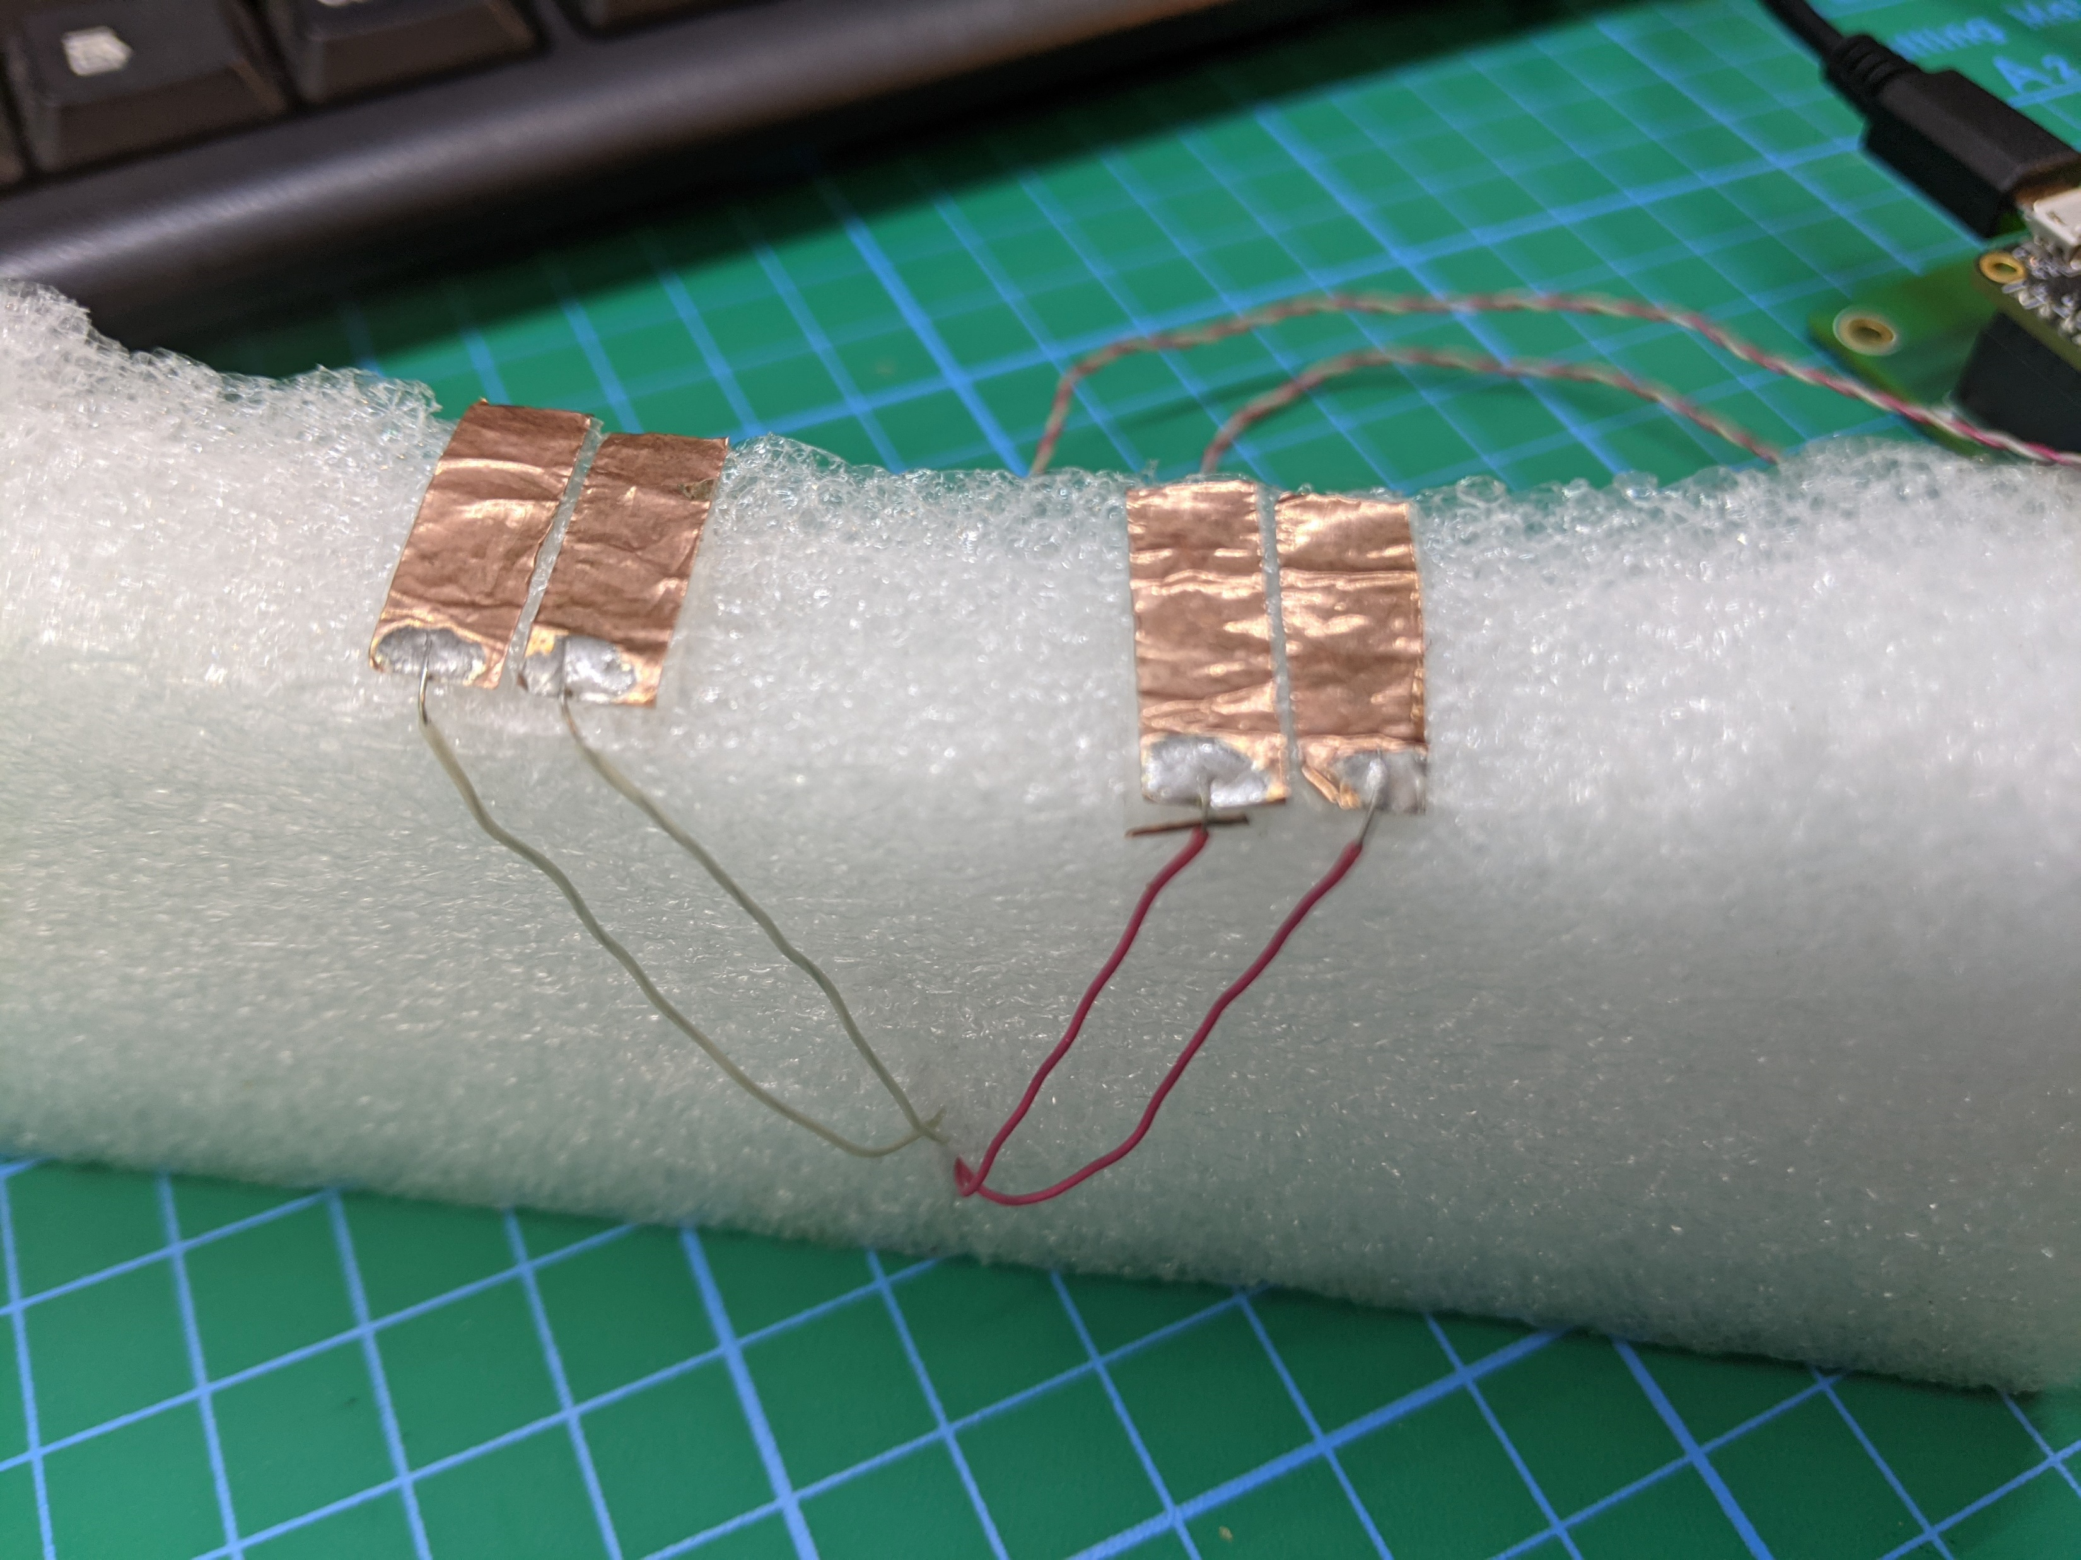
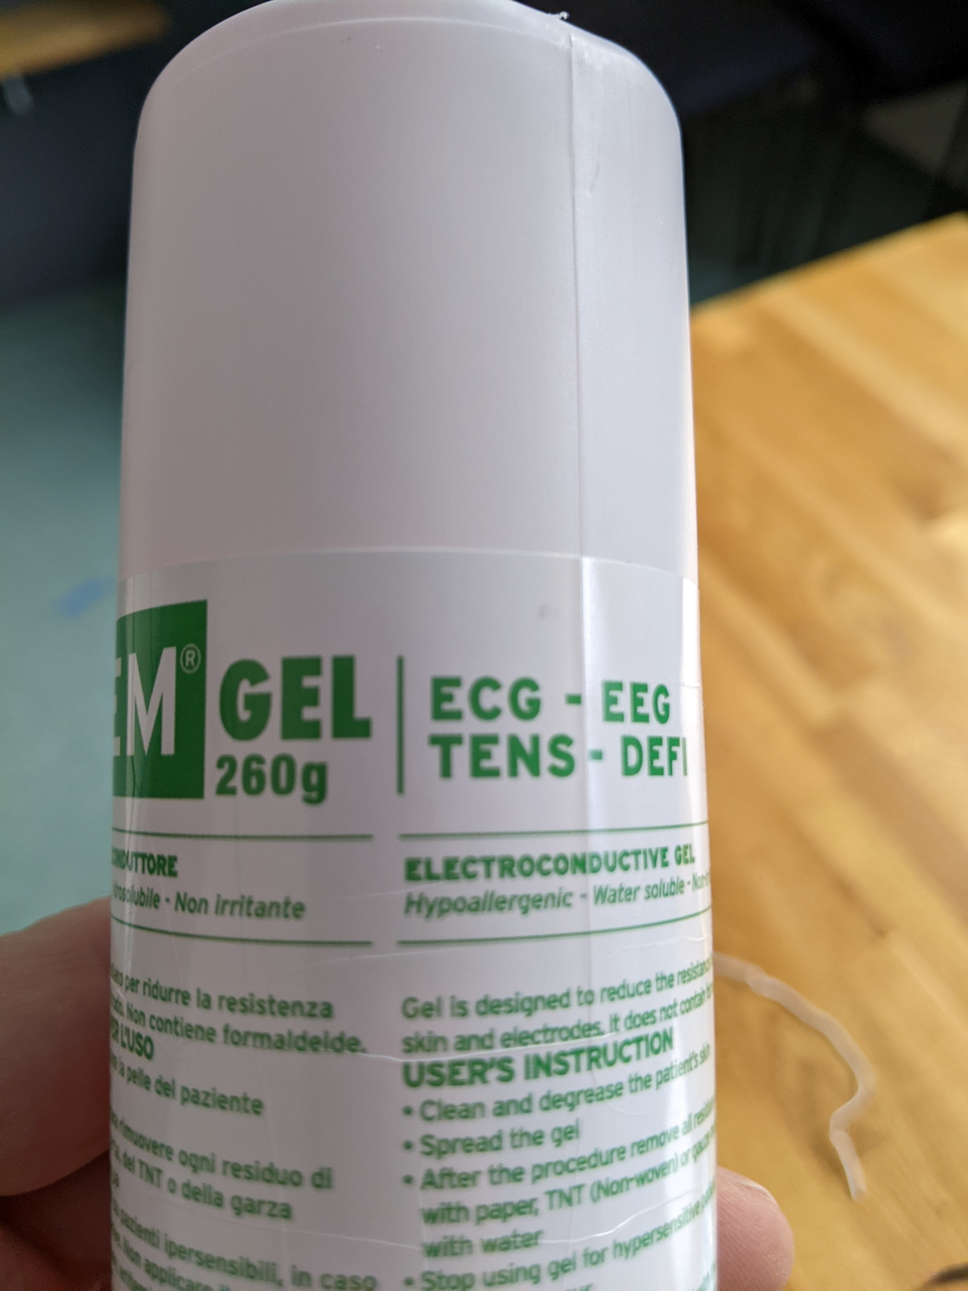
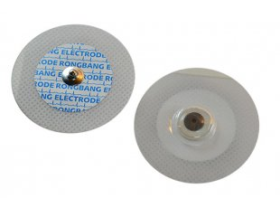
Electrodes
Types of electrodes used in the experiments.
EEG liquid gel for better signal conduction
Right top type electrodes was given the results mentioned before

Slide 15
Impedance analyzer
This is the expensive impedance analyzer, from zhinst [8], cost 11K
Used for MAX30001:
Data validation
Calibration
Ground truth reference
Signal analysis of the tissue (absolute value)
AS well as skin impedance measurement

Slide 16
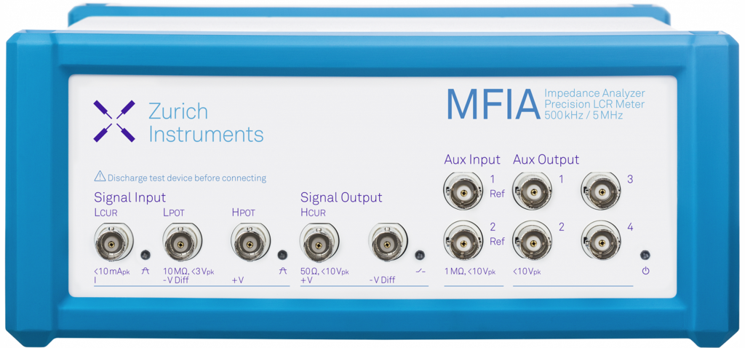
Data output from MFIA

Slide 17
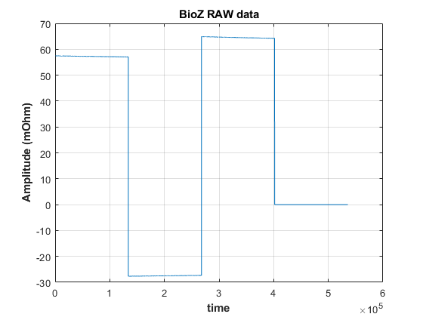
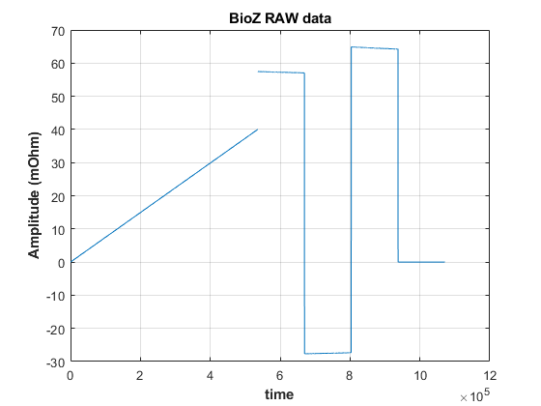
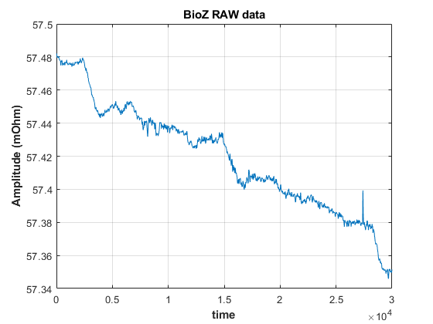
MFIA data

Slide 18
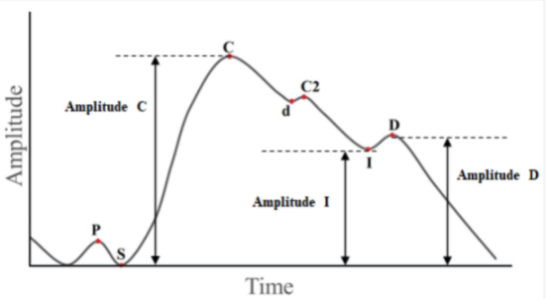
Setup
Picture reference [8]

Slide 19
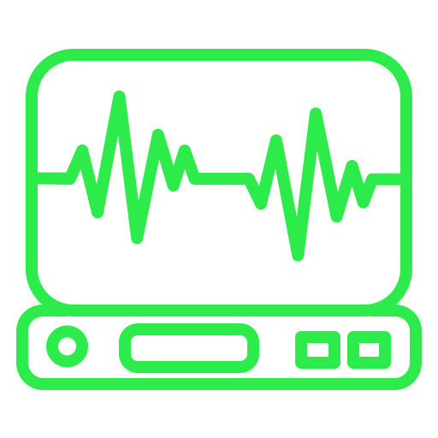
Long term goals
A fully fledged medical or healthcare device
Reliable and secure data source
Convenient and profitable device

Slide 20
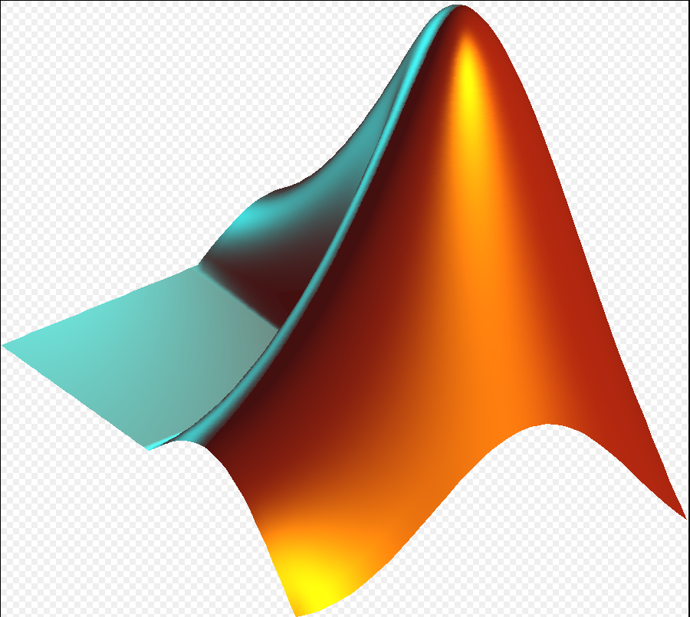
Signal analysis
FFT
WAVELET
MOVING AVAREGE
MOVING SUM
Python scripts
Picture reference [11]

Slide 21
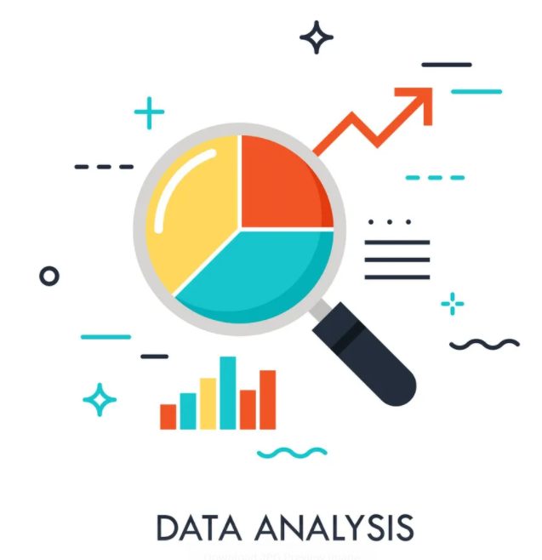
Data analysis

Slide 22
Conclusions
Research is still needed to improve BI device and data measuring model
It is necessary to conduct a more detailed study of data analysis to obtain more reliable signal output
More study in nearest fields is necessary to improve the measurement setup and data process models
Perform more repeatable experiments to publish in future academic articles

Slide 23
References
1. https://www.edi.lv/projects/komunikacijas-sistema-caur-cilveka-kermeni-ar-pielietojumiem-kermena-meroga-bezvadu-tiklos-bcc/
2. https://www.edi.lv/projects/tehnologija-notikumu-plusmas-augstas-precizitates-laika-amplitudas-analizei-time-amp/
3. https://www.edi.lv/projects/energoefektiva-veselibas-stavokla-un-uzvedibas-noverosana-ar-valkajamam-iericem-un-lietu-internetu-feature/
4. https://onlinelibrary.wiley.com/doi/10.1002/tee.23388
5. https://www.biopac.com/application/icg-impedance-cardiographycardiac-output/
6. Amini, M., Hisdal, J., & Kalvøy, H. (2018). Applications of bioimpedance measurement techniques in tissue engineering. Journal of Electrical Bioimpedance, 9(1), 142-158.
7. https://www.maximintegrated.com/en/products/analog/data-converters/analog-front-end-ics/MAX30001.html
8. https://www.zhinst.com/europe/en/products/mfia-impedance-analyzer?gclid=Cj0KCQjwuMuRBhCJARIsAHXdnqN0o3zpN9o7a9ZNRSg0p0v9oQ6cUW7wllqKk3M0Bgk7fxvIuelhZoEaAs2rEALw_wcB
9. https://www.mdpi.com/1424-8220/22/1/138/htm
10. https://www.nordicsemi.com/Products/Development-hardware/nrf5340-pdk
11. https://www.mathworks.com/products/matlab.html

Slide 24
Thanks for participating
Have a nice evening!

