Slide 1
Bioimpedance in a wearable device
Didzis Lapsa https://www.edi.lv/team/didzis-lapsa/
PhD Student, LU and EDI
Supervisor of Dissertation: Dr Atis Elsts
Rīga, 10/02/2021

Slide 2
Agenda
Project goals
Bioimpedance overview
Types of BI
Applied BI method for our use case
Hardware overview
Applications
Summary
References

Slide 3
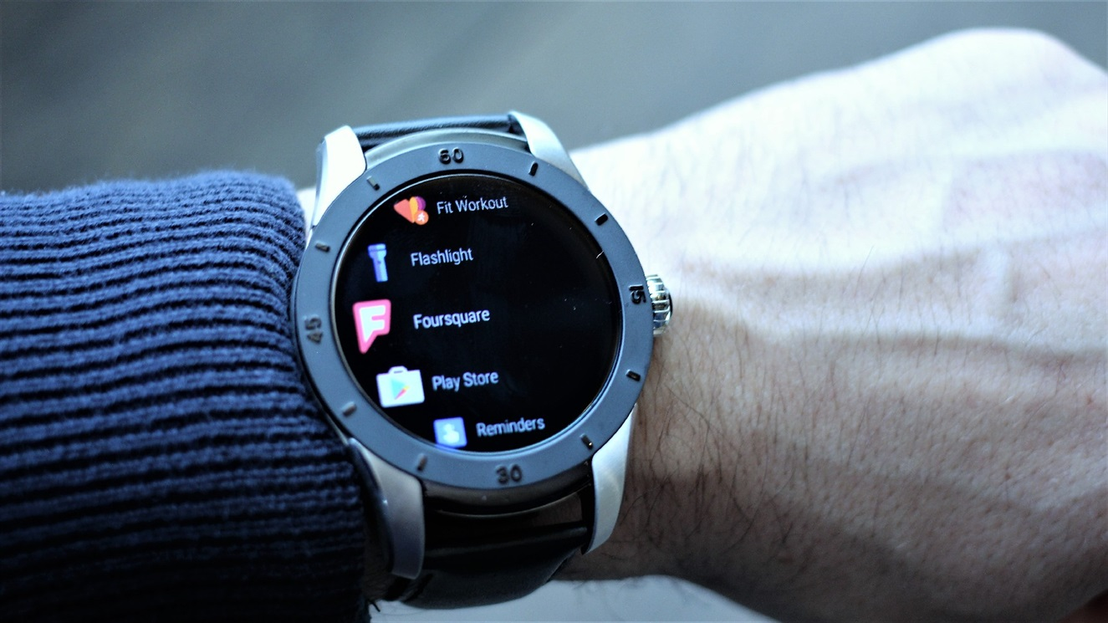
Project goals
As a researcher at the Institute of Electronics and Computer Science, I am involved in the (Body-Coupled Communication) BCC and (Energy-efficient health and behavior monitoring with wearable devices and the Internet of Things) FEATURE projects with the aim of creating a smart watch for power consumption Bioimpedance measurements applications for monitoring human body parameters.

Slide 4
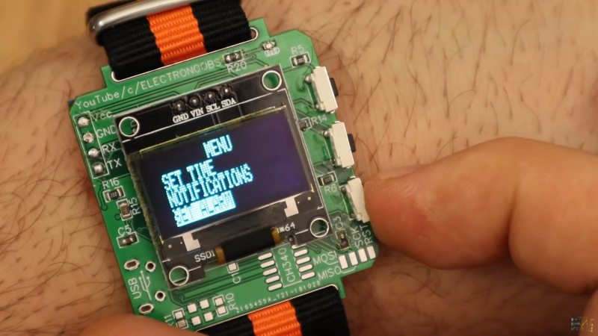
Project goals
As a researcher at the Institute of Electronics and Computer Science, I am involved in the (Body-Coupled Communication) BCC and (Energy-efficient health and behavior monitoring with wearable devices and the Internet of Things) FEATURE projects with the aim of creating a smart watch with low power consumption based for Bioimpedance measurements applications for monitoring human body parameters.

Slide 5
Functional electrical stimulation
Bioimpedance tomography
BIOIMPEDANCE
Bioimpedance analysis
Body Coupled Communication / Intra-body communication

Slide 6
Functional electrical stimulation
Functional electrical stimulation (FES) is a technique that uses low-energy electrical pulses to artificially generate body movements in individuals who have been paralyzed due to injury to the central nervous system.
The functional electrical stimulation device including two cuffs, a foot switch, and a control unit [1].

Slide 7
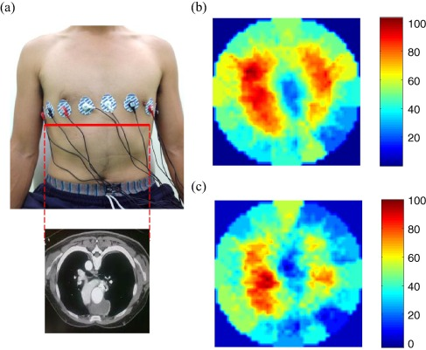
Bioimpedance tomography
Electrical impedance tomography (EIT) is a noninvasive type of medical imaging in which the electrical conductivity, permittivity and impedance of a part of the body is inferred from surface electrode measurements and used to form a tomographic image of that part. Electrical conductivity varies considerably among various biological tissues (absolute EIT) or the movement of fluids and gases within tissues (difference EIT)
Cross-section image of human chest, and reconstructed impedance images when (b) inhaling air and (c) holding air in lung respectively [2]

Slide 8
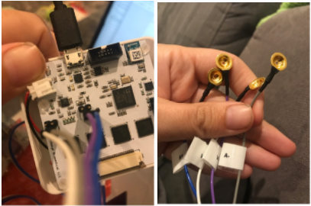
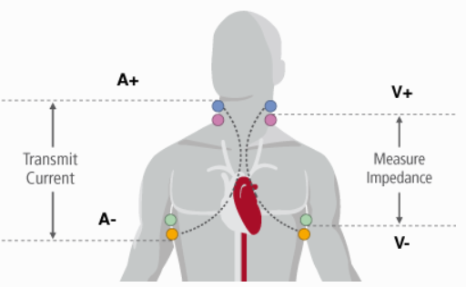
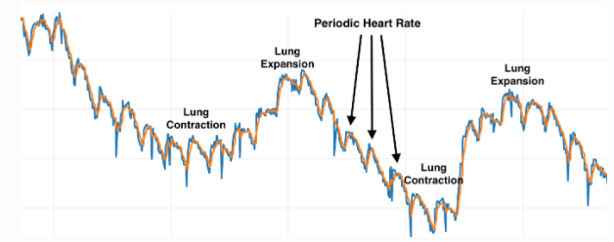
OpenEIT
Biomedical Imaging has previously been expensive and near impossible to hack and experiment with. If more people experimented and understood how imaging works we could move it forward much faster and make these transformative technologies available to everyone. OpenEIT(EIT is for electrical impedance tomography) uses non-ionizing AC current to recreate an image of any conductive material, such as your lungs, arm or head, using the same tomographic reconstruction technique as a CATSCAN. The PCB is only 2" square, with bluetooth, making it a portable and hackable way to do biomedical imaging! [3]

Slide 9
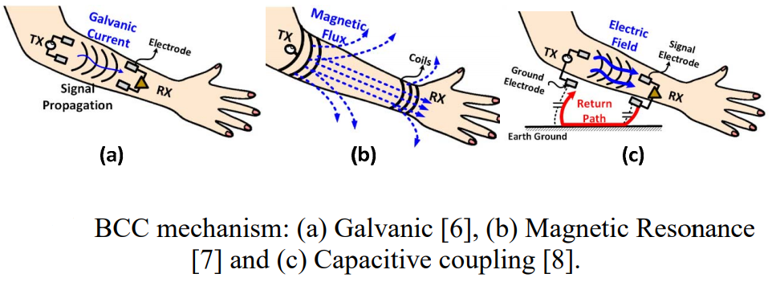
Body Coupled Communication / Intra-body communication
Body Coupled Communication (BCC) utilizes human body itself as a communication medium to provide energy-efficient connectivity between nodes on or around the body. Although BCC is an attractive way for composing a Body Area Network (BAN), the BCC still has several challenges to overcome to be commercially viable. These challenges include 1) varying channel gain over space, time and subject, 2) varying environment, and 3) stringent power consumption requirements. This paper reviews the issues related to BCC, and several efforts to overcome such issues. An example application that benefits from BCC is also discussed
Galvanic
Magnetic resonance
Capacitive coupling
Ultrasonic

Slide 10
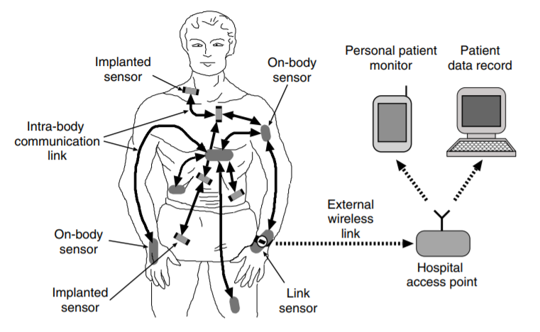
Body Coupled Communication / Intra-body communication
Modern hospital monitoring network: Sensors record and transmit their data to monitoring devices. The sensors on or inside the body use intra-body communication techniques for data transmission to other sensors. Eventually, the data is transferred from one central link sensor to a hospital access point and can be analyzed on personal monitoring devices or stored in the patient’s electronic record [4]

Slide 11
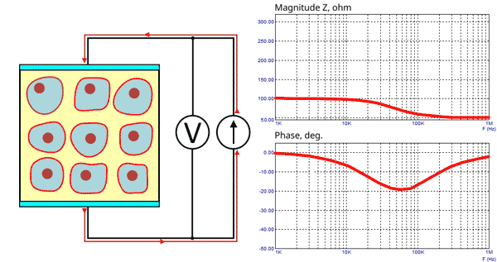
Bioimpedance analysis/ Bioelectrical impedance analysis
Bioelectrical impedance analysis (BIA) is a commonly used method for estimating body composition, in particular body fat and muscle mass. In BIA, a weak electric current flows through the body and the voltage is measured in order to calculate impedance (resistance) of the body.
It is likely to be used in the project as a basic method for measuring heart rate and other parameters.
The changes in the ratio between the inter- and intracellular volume can be monitored in the impedance.
Both relative permittivity and conductivity of the cells are found to be a function of frequency
Within the frequency range the cellular structure of tissue produces the dispersion
dispersions of the impedance for muscle tissue - covers the range from 100 Hz to 20 GHz

Slide 12
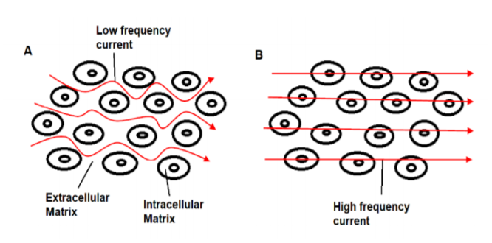
Flow of electrical current through biological tissue: A) At lower frequencies, current flows between the cells and through the extracellular fluid, B) At high frequencies, current penetrates the cell membranes and flows through intracellular and extracellular fluid. [6]

Slide 13
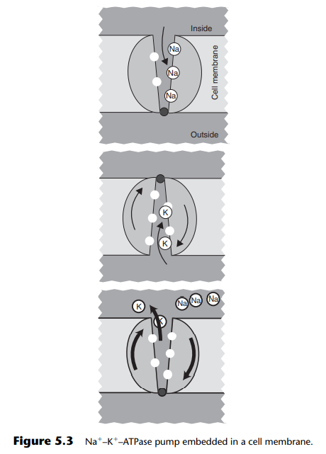
Cellular membrane
Such a pump is a molecular device embedded in a cell membrane that is capable of generating a pure electric current throughout the membrane and thus electrogenicity.

Slide 14
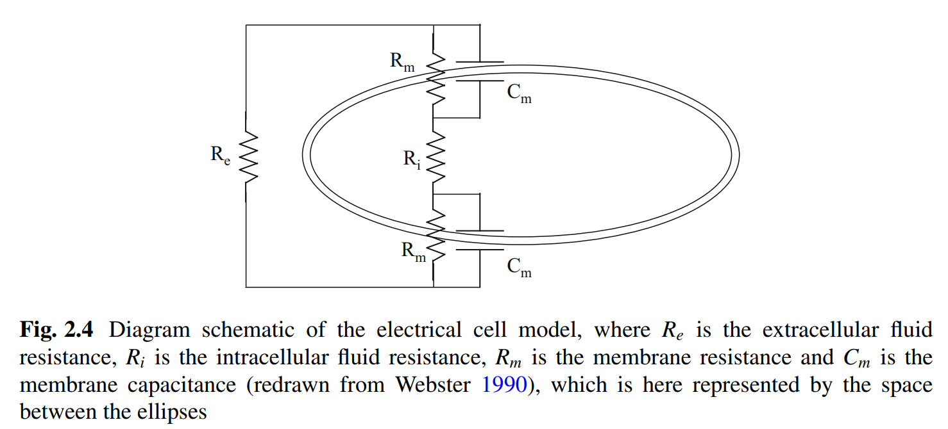
Basic principle of different tissue measurement
Biological objects consist of different tissues that are made up of single cells. In electrical terms, all cells are encapsulated by a very thin dielectric membrane, which has a rather big electrical capacitance. The cell itself is filled with intracellular fluid and the space between the individual cells is filled by intercellular fluid. Both fluids are good ionic conductors. Cole–Cole equations [5]

Slide 15
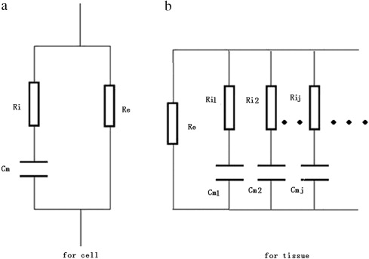
Biological cell equivalent scheme, including intracellular and extracellular fluids as resistors and cell membranes as capacitors. The main difference is the conductivity through extracellular and the cells, at different frequency ranges, which gives an insight into human physiological parameters.(a,b) [9]
[10]

Slide 16
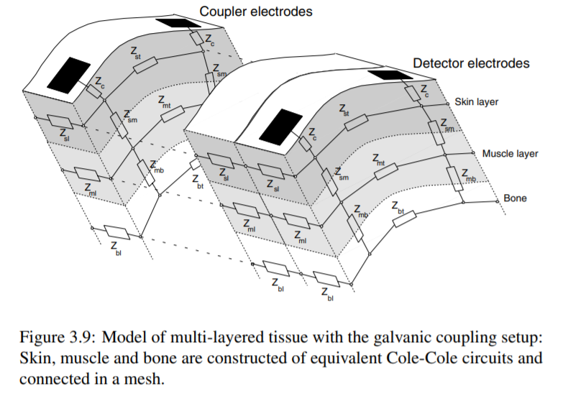
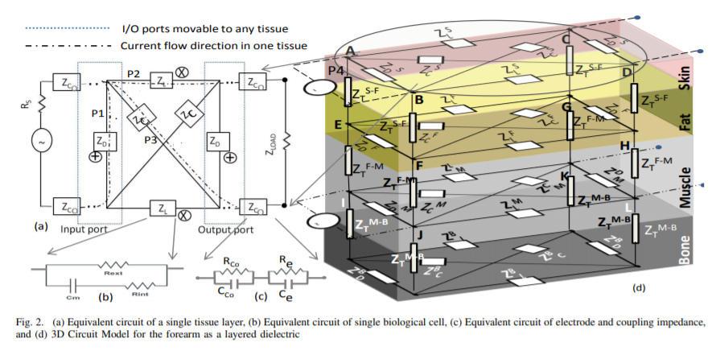
More complex model
Equivalent electrical multidimensional model of the resistance array for the perspective of different tissue layers. It depicts the complex resistance or conductivity of layers of internal body tissues such as skin, muscles, fat, bones. [10] , [11]

Slide 17
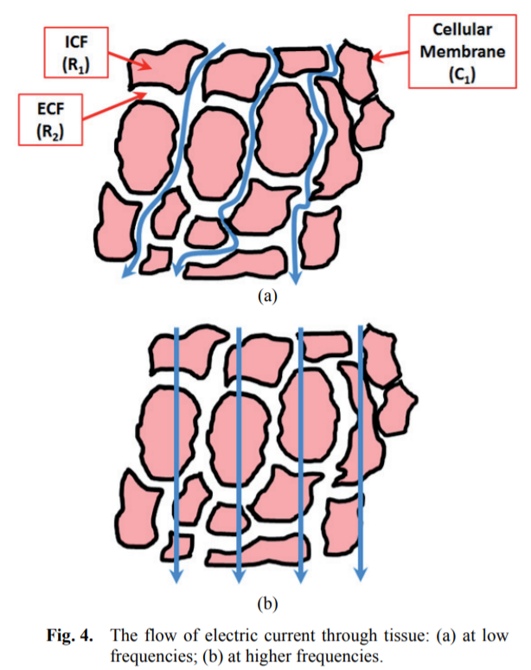
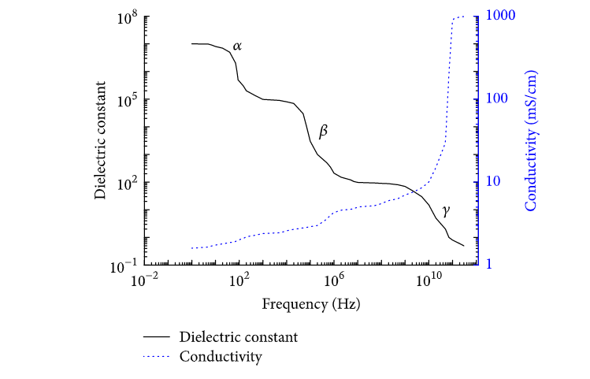
The electrical properties of tissues and cells change with frequency in three different stages called α, β and γ dispersions [7], [8]

Slide 18
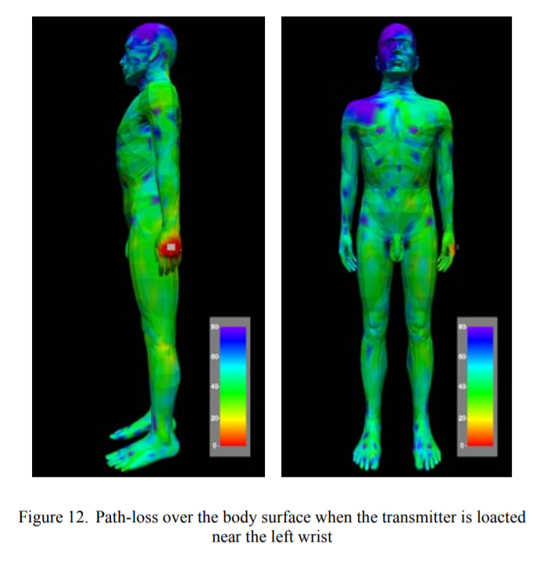
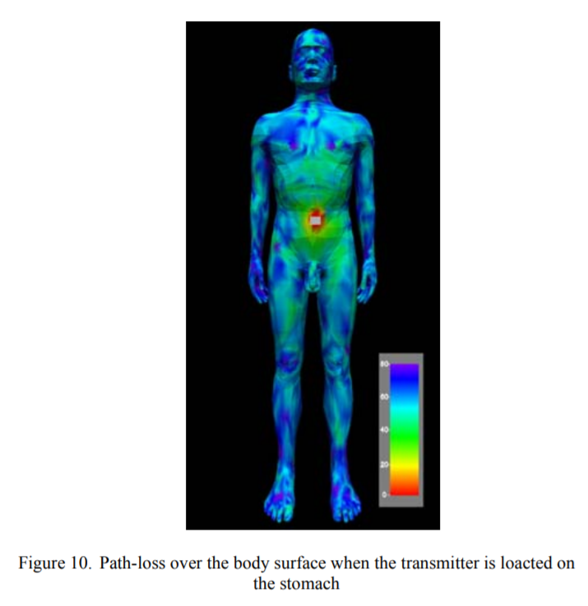
Path-loss
Signal loss during the measurements of the human body

Slide 19
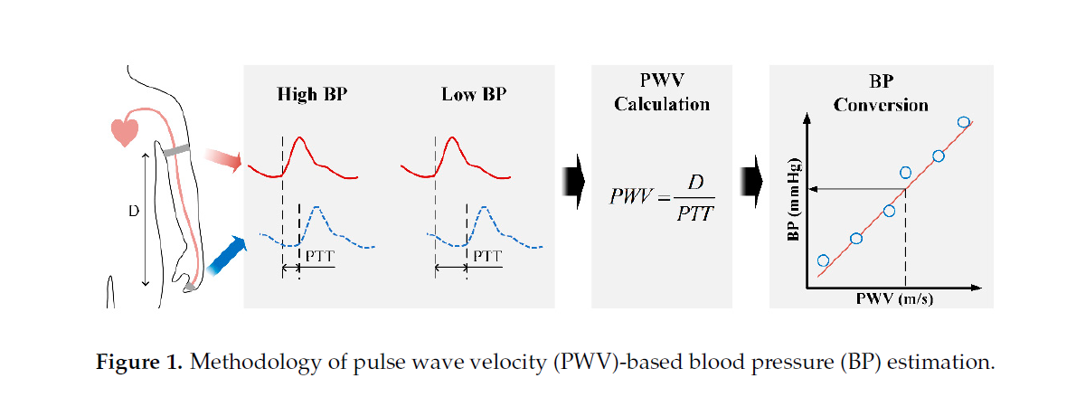
Constant frequency BIA
PWV – Pulse wave velocity ; D – Distance; PTT – Pulse transiet time;
Change in BP can be reflected by the change in the arterial cross-sectional area: where ∆A is the change arterial cross-sectional area, ∆Z is the change in measured impedance, ρ_{b} is the resistivity of blood, and Zb represents the basal impedance of the segment. Thus, BI measurement has some notable aspects for BP [12]

Slide 20
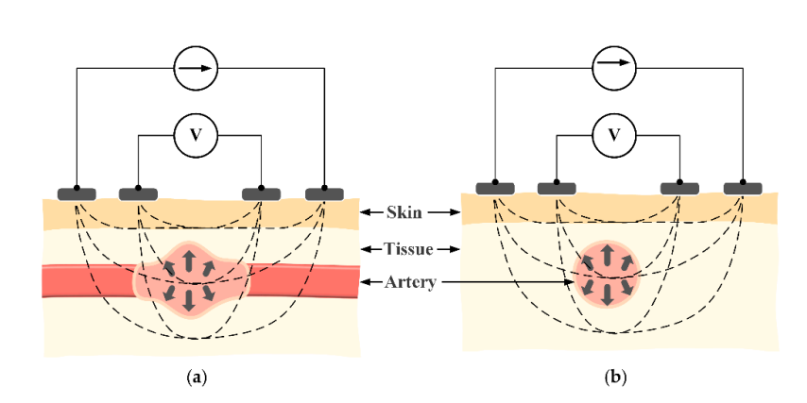
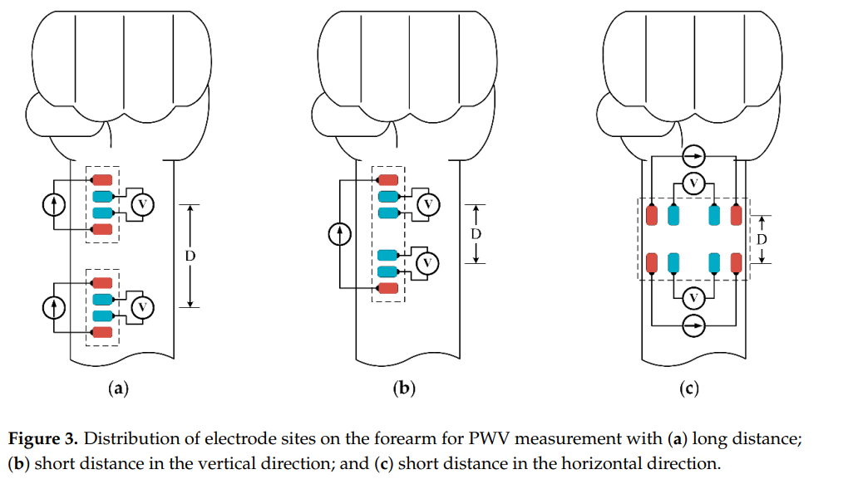
Principle of bioimpedance (BI) measurement with alternating current flowing through external electrodes in (a) a vertical structure and (b) a horizontal structure
To measure the impedance waveform electrodes are placed above the radial artery in a vertical direction
To measure two pulse waveforms at a short distance, this structure still requires a fairly large length (vertical structure is relatively large in size )
horizontal structure shows an advantage in length compared to the vertical structure, which is suitable in size for a smartwatch
This paper proposes to employ the horizontal structure at the wrist to calculate PWV values and compare those values to BP levels [12]

Slide 21
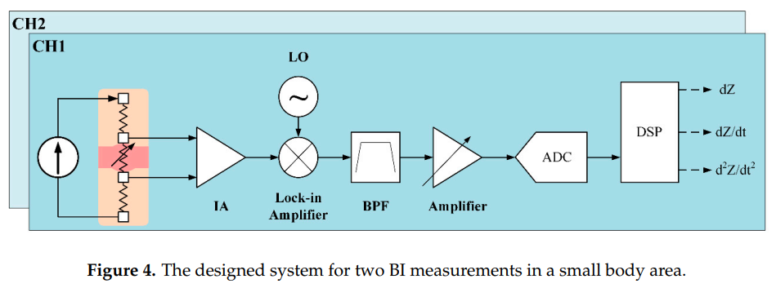
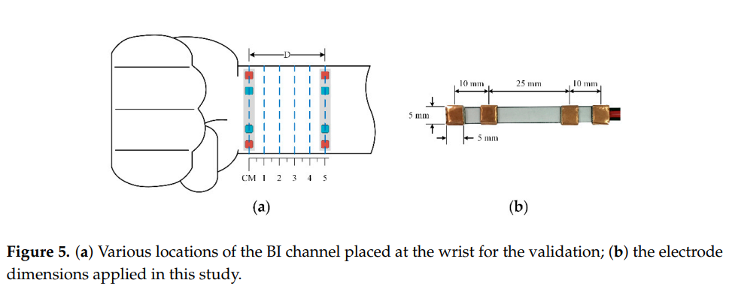
Circuit consists of Wien Bridge oscilator sine wave 500uA at 100kHz
Capacitively coupled tehnology was applied at the IA input pins
IA – instrumental amplifier;
BPF – bandpass filter;
Low noise IA – 1nV √HZ
third-order Chebyshev Sallen–Key bandpass filter, with cutoff frequencies at 0.1 Hz and 3 Hz
ADC 50kHz sampling rate for extremely short distance measurement
Actual base impedance Zb, is measuref as voltage drop over the resistor R (100 Ohm) instead of the skin impedance.
Z = Z_{b} + dZ = R(K_{a} + V_{S}.K_{b}) The total radial impedance Z; base impedance Z_{b} ; impedance variation dZ;
For further analysis, the first and second derivatives of impedance variation waveform were obtained using differential amplifiers [12]
Flexible belt to allow stretchability
3MTM conductive copper foil.

Slide 22
Hardware overview
Current progress is investigating a microcontroller suitable for our requirements
Battery
IMU
Microcontroller – nRF5340
IMU – ICM-20600 accelerometer
PPX – ADPD105 heart rate meter
BI – Bioimpedance MAX30002
SG – signal generator
LCD – display
nRF53
PPX
BI
LCD
SG

Slide 23
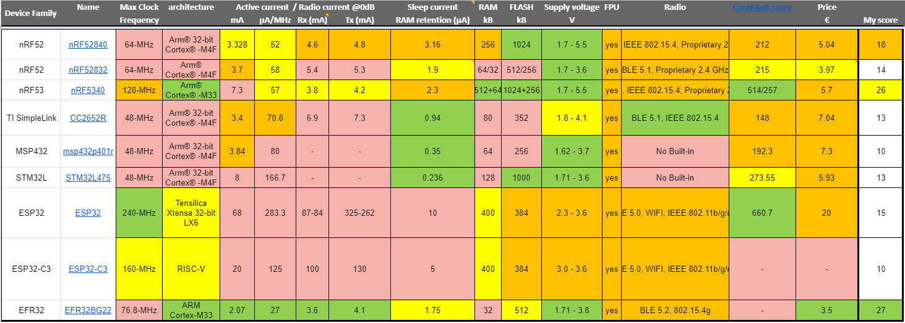
Hardware overview
An overview of the latest microcontroller comparisons in LowPower area.

Slide 24
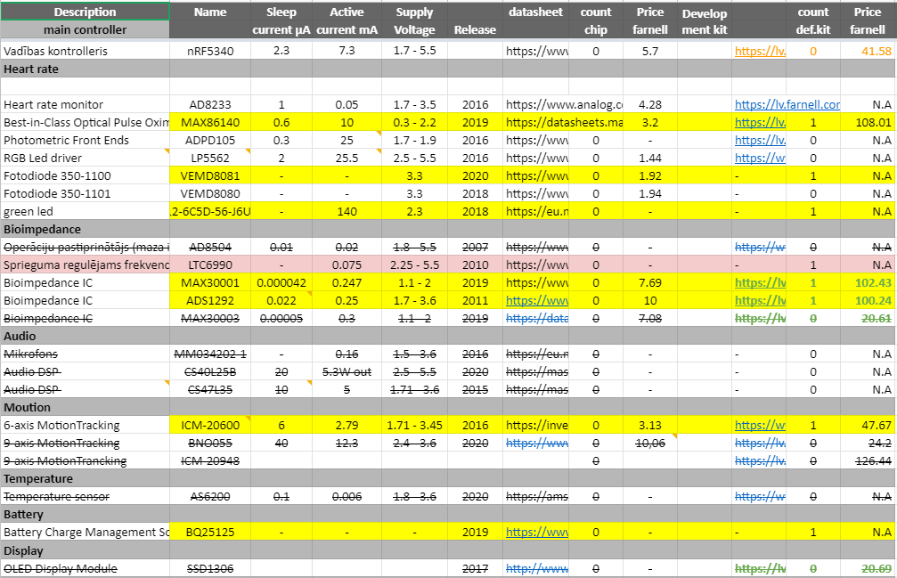
Sensor and peripheral research

Slide 25
Some of the Applications
Bioimpedance analysis is used to:
Improve body health by analyzing tissue and cell data
Medicine and body recovery, monitoring and simulation regions in the body.
Measuring sports and activities, as well as determining the level of stress.
Fundamental research.

Slide 26
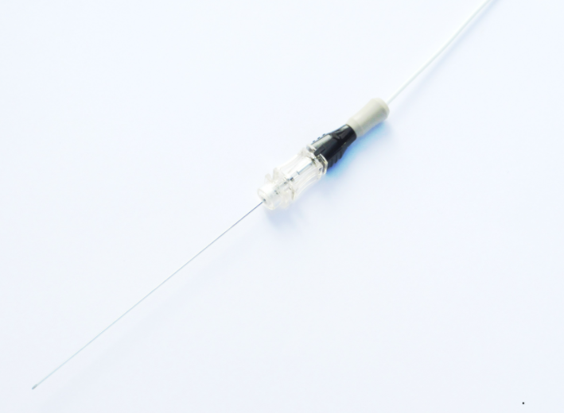
Some of the Applications
Quadra powers the new generation smart needle
Injeq technology and products can be adapted for use in different clinical applications. A completed clinical study in rheumatology has confirmed that the smart needle is suitable for intra-articular injections. An on-going study in spinal anaesthesia aims to assess the performance of the smart needle in detecting the cerebrospinal fluid inside the subarachnoid space in the spinal canal. Quadra is clearly able to identify the correct tissues as the clinical studies have shown excellent results so far [13]

Slide 27
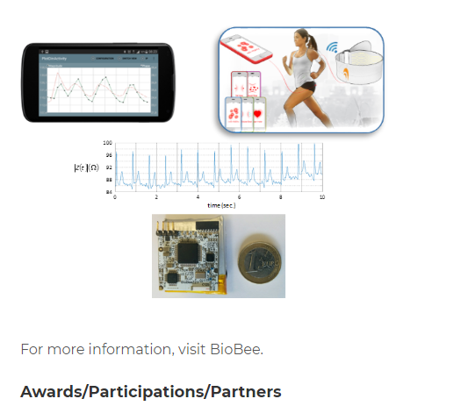
Some of the Applications
BioBee Technologies has developed a novel cost-effective wireless electrical bioimpedance measurement system. The prototypes in form of wearable devices of few cm2 printed circuit board perform bioimpedance measurement which supply information about several pathologies (body composition, cardiac output, respiratory, muscle status). [14]

Slide 28
Summary
Research is still needed to improve BI compliance and the use of wearable devices.
It is necessary to conduct a more detailed study of the hardware and create several physical models of wear.
Greater level of immersion in biological processes at the cellular level, consistent with conductivity.

Slide 29
References
1. van Bloemendaal, Maijke, et al. "Gait training assisted by multi-channel functional electrical stimulation early after stroke: study protocol for a randomized controlled trial." Trials 17.1 (2016): 1-8.
2. Huang, Ji-Jer, et al. "Design of wearable and wireless electrical impedance tomography system." Measurement 78 (2016): 9-17.
3. https://github.com/OpenEIT/OpenEIT
4. Wegmüller, Marc S. Intra-body communication for biomedical sensor networks. Diss. ETH Zurich, 2007.
5. Cole, Kenneth S., and Robert H. Cole. "Dispersion and absorption in dielectrics I. Alternating current characteristics." The Journal of chemical physics 9.4 (1941): 341-351.
6. Amini, M., Hisdal, J., & Kalvøy, H. (2018). Applications of bioimpedance measurement techniques in tissue engineering. Journal of Electrical Bioimpedance, 9(1), 142-158.
7. Jilani, M. T., Wen, W. P., Cheong, L. Y., Zakariya, M. A., & Rehman, M. Z. (2014). Equivalent circuit modeling of the dielectric loaded microwave biosensor. Radioengineering, 23(4), 1038-1047.
8. Schwan, H. P. (1994, November). Electrical properties of tissues and cell suspensions: mechanisms and models. In Proceedings of 16th Annual International Conference of the IEEE Engineering in Medicine and Biology Society (Vol. 1, pp. A70-A71). IEEE.
9. Yang, Y., Wang, Z. Y., Ding, Q., Huang, L., Wang, C., & Zhu, D. Z. (2013). Moisture content prediction of porcine meat by bioelectrical impedance spectroscopy. Mathematical and Computer Modelling, 58(3-4), 819-825.
10. Wegmüller, M. S. (2007). Intra-body communication for biomedical sensor networks (Doctoral dissertation, ETH Zurich).
11. Swaminathan, M., Cabrera, F. S., Pujol, J. S., Muncuk, U., Schirner, G., & Chowdhury, K. R. (2015). Multi-path model and sensitivity analysis for galvanic coupled intra-body communication through layered tissue. IEEE transactions on biomedical circuits and systems, 10(2), 339-351.
12. Huynh, Toan Huu, Roozbeh Jafari, and Wan-Young Chung. "A Robust Bioimpedance Structure for Smartwatch-Based Blood Pressure Monitoring." Sensors (Basel, Switzerland) 18.7 (2018).
13. https://www.eliko.ee/bioimpedance-spectroscopy-based-smart-needle/
14. http://startup-scaleup.eu/portfolio/biobee/

Slide 30
Thanks for participating
Have a nice evening!

