Slide 1
Sim2Real transfer for Reinforcement Learning
Mg.sc.ing. Anatolijs Zencovs
2nd year Phd student
Research assistant
Institute of Electronics and Computer Science
anatolijs.zencovs@edi.lv
+371 67558129
14 Dzerbenes street, Riga, Latvia, LV1006
23.11.2022.

Slide 2
Presentation content
What is Reinforcement Learning
Main project tasks
Research on the topic
Latest achievement in sim2real transfer
Current challenges on moving forward
Next steps

Slide 3
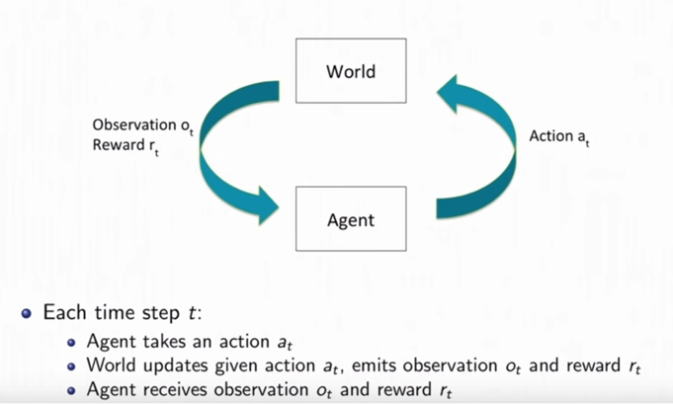
What is Reinforcement Learning
Reinforcement learning is a type of machine learning technique that enables an agent to learn in an interactive environment by trial and error using feedback from its own actions and experiences.
Content
What is Reinforcement Learning
Main project tasks
Research on the topic
Latest achievement in sim2real transfer
Current challenges on moving forward
Next steps

Slide 4
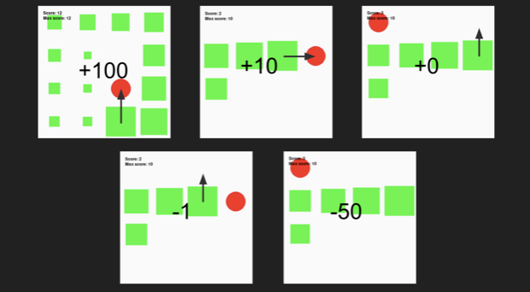
What is Reinforcement Learning
RL learning to play Snake game
Content
What is Reinforcement Learning
Main project tasks
Research on the topic
Latest achievement in sim2real transfer
Current challenges on moving forward
Next steps

Slide 5
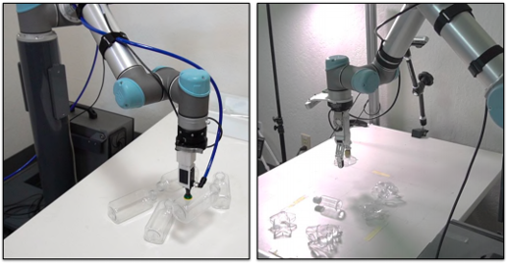
Project and main tasks
IMOCO4.E (Horizon 2020) - the Industry 4.0 project
Pick and Place task by UR5e collaborative robot on Madara cosmetics production line
Demonstrator and result evaluation at Madara premises
Content
What is Reinforcement Learning
Project and main task
Research on the topic
Latest achievement in sim2real transfer
Current challenges on moving forward
Next steps

Slide 6
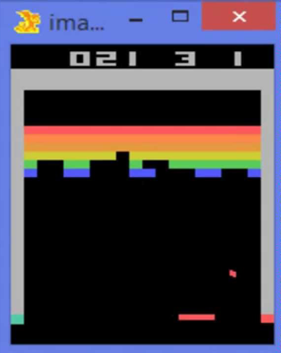
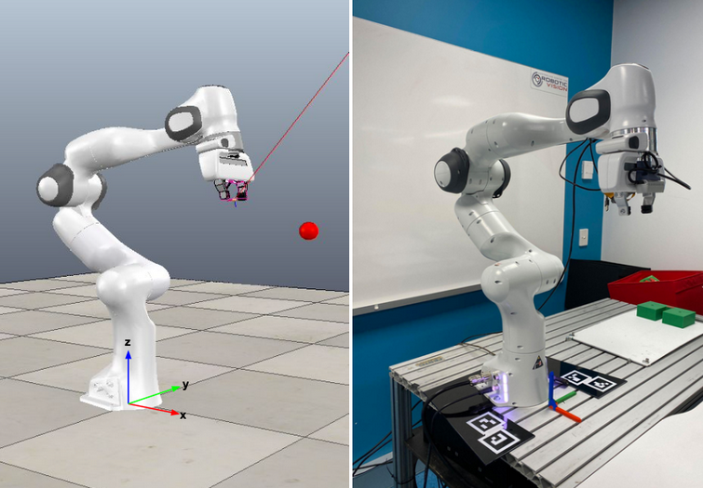
Research on the topic
Good results using RL algorithms in
playing arcade games
Harder to implement in industrial
robotics (due to reality gap)
Not much of the successful sim2real
transfer for robotics
Content
What is Reinforcement Learning
Main project tasks
Research on the topic
Latest achievement in sim2real transfer
Current challenges on moving forward
Next steps

Slide 7
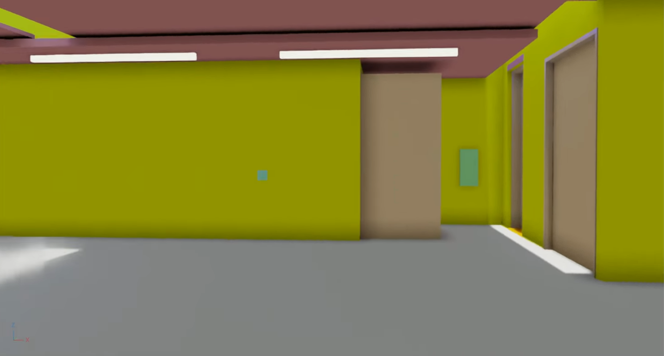
Research on the topic
Sim2Real gap can be divided into appearance gap and content gap
Domain randomization and visual enhancements as a solution to minimize gap
Content
What is Reinforcement Learning
Main project tasks
Research on the topic
Latest achievement in sim2real transfer
Current challenges on moving forward
Next steps

Slide 8
Research on the topic
Content
What is Reinforcement Learning
Main project tasks
Research on the topic
Latest achievement in sim2real transfer
Current challenges on moving forward
Next steps

Slide 9
Research on the topic
Content
What is Reinforcement Learning
Main project tasks
Research on the topic
Latest achievement in sim2real transfer
Current challenges on moving forward
Next steps

Slide 10
Research on the topic
Content
What is Reinforcement Learning
Main project tasks
Research on the topic
Latest achievement in sim2real transfer
Current challenges on moving forward
Next steps

Slide 11
Research on the topic
Content
What is Reinforcement Learning
Main project tasks
Research on the topic
Latest achievement in sim2real transfer
Current challenges on moving forward
Next steps

Slide 12
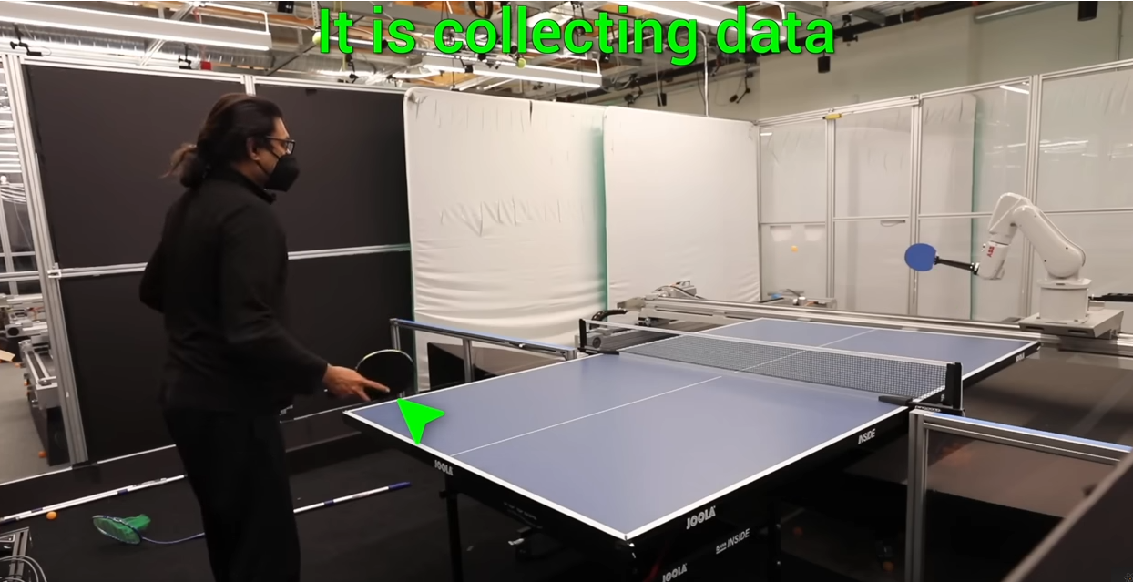
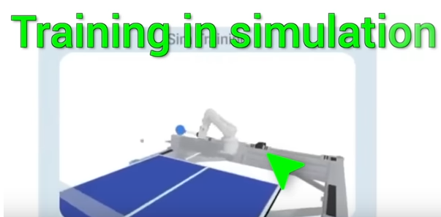
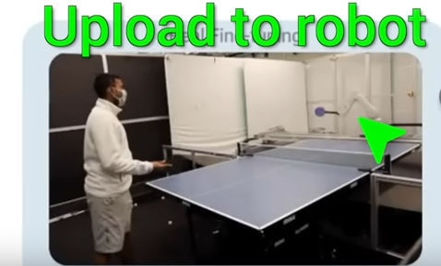
Latest achievement in sim2real transfer
Iterativ-S2R, Google AI learns to play tennis (https://sites.google.com/view/is2r)
Content
What is Reinforcement Learning
Main project tasks
Research on the topic
Latest achievement in sim2real transfer
Current challenges on moving forward
Next steps

Slide 13
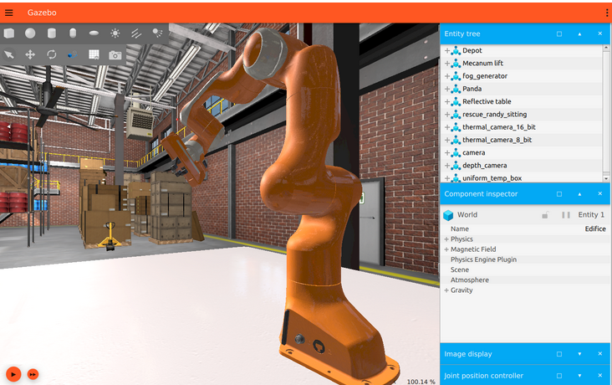
Current challenges on moving forward
Simulator selection (Isaac Sim, Gazebo, …)
Creating robot (UR5e with gripper)
Creating simulated environment
Content
What is Reinforcement Learning
Main project tasks
Research on the topic
Latest achievement in sim2real transfer
Current challenges on moving forward
Next steps

Slide 14
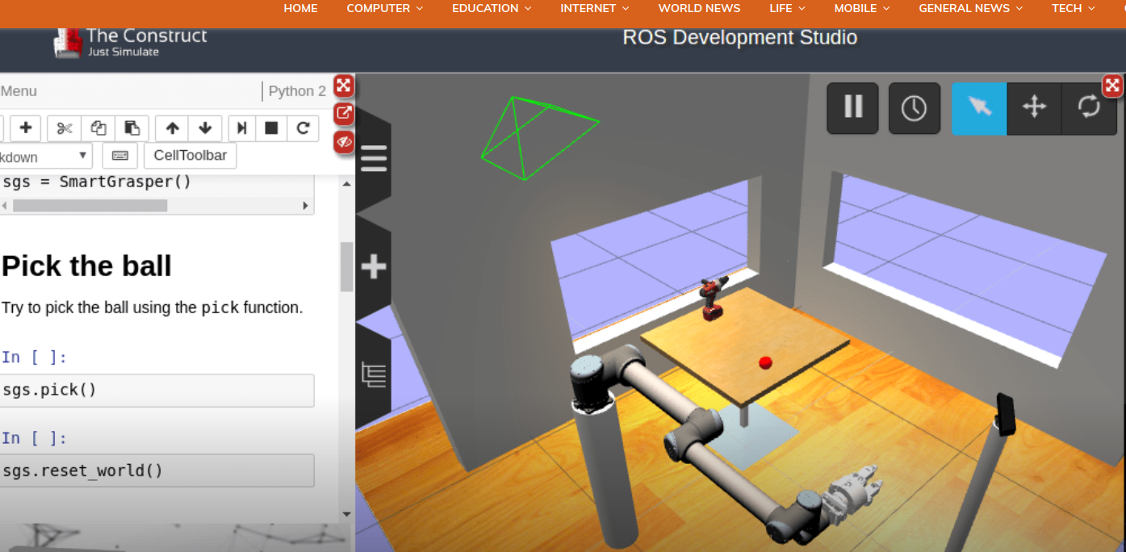
Current challenges on moving forward
Robot operating system (ROS2)
Content
What is Reinforcement Learning
Main project tasks
Research on the topic
Latest achievement in sim2real transfer
Current challenges on moving forward
Next steps

Slide 15
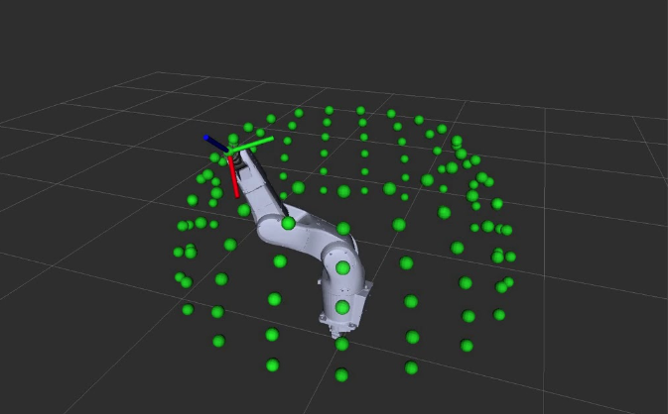
Current challenges on moving forward
Moveit2 (robotic manipulation platform)
Content
What is Reinforcement Learning
Main project tasks
Research on the topic
Latest achievement in sim2real transfer
Current challenges on moving forward
Next steps

Slide 16
Current challenges on moving forward
RL algorithms (Stable Baselines)
SAC - Soft Actor Critic
DDPG - Deep Deterministic Policy Gradient
TD3 - Twin Delayed DDPG
TQC - Truncated Quantile Critics
Content
What is Reinforcement Learning
Main project tasks
Research on the topic
Latest achievement in sim2real transfer
Current challenges on moving forward
Next steps

Slide 17
Current challenges on moving forward
The big picture (putting all together)
https://www.figma.com/file/ISmaogh3nlpWAJdfVMFjat/phd?node-id=0%3A1&t=o80BohwBMeMMFAjd-0
Content
What is Reinforcement Learning
Main project tasks
Research on the topic
Latest achievement in sim2real transfer
Current challenges on moving forward
Next steps

Slide 18
Next steps
Finish implementation Moveit2 -> Gazebo Sim and Moveit2 -> ROS2
Create 3D environment from Madara cosmetics production line for Simulation
Connect Stable Baselines with the rest of the system
Start experimenting on simulated and real robot
Narrow down the research topic
Write survey on sim2real transfer
Content
What is Reinforcement Learning
Main project tasks
Research on the topic
Latest achievement in sim2real transfer
Current challenges on moving forward
Next steps

Slide 19
References
Sutton, Richard S., and Andrew G. Barto. Reinforcement learning: An introduction. MIT press, 2018.
Internet resource - https://developer.nvidia.com/blog/closing-the-sim2real-gap-with-nvidia-isaac-sim-and-nvidia-isaac-replicator/
Abeyruwan, Saminda, et al. "i-sim2real: Reinforcement learning of robotic policies in tight human-robot interaction loops." arXiv preprint arXiv:2207.06572 (2022).
Internet resource - https://gazebosim.org/home
Internet resource - https://docs.ros.org/en/humble/
Internet resource - https://moveit.picknik.ai/humble/index.html
Internet Resource - https://stable-baselines.readthedocs.io/en/master/
High-Resolution Image Synthesis with Latent Diffusion Models, Robin Rombach*, Andreas Blattmann*, Dominik Lorenz, Patrick Esser, Björn Ommer
Szepesvári, Csaba. "Algorithms for reinforcement learning." Synthesis lectures on artificial intelligence and machine learning 4.1 (2010): 1-103.
François-Lavet, Vincent, et al. "An introduction to deep reinforcement learning." Foundations and Trends® in Machine Learning 11.3-4 (2018): 219-354.
Content
What is Reinforcement Learning
Main project tasks
Research on the topic
Latest achievement in sim2real transfer
Current challenges on moving forward
Next steps
References

Slide 20
End of presentation
Thank you!

