Slide 1
Solving Relevant Problems with
Quantum Machine Learning Algorithms
Andris Locāns

Slide 2
Solving Relevant Problems with
Quantum Machine Learning Algorithms

Slide 3
Solving Relevant Problems with
Quantum Machine Learning Algorithms
Andris Locāns

Slide 4
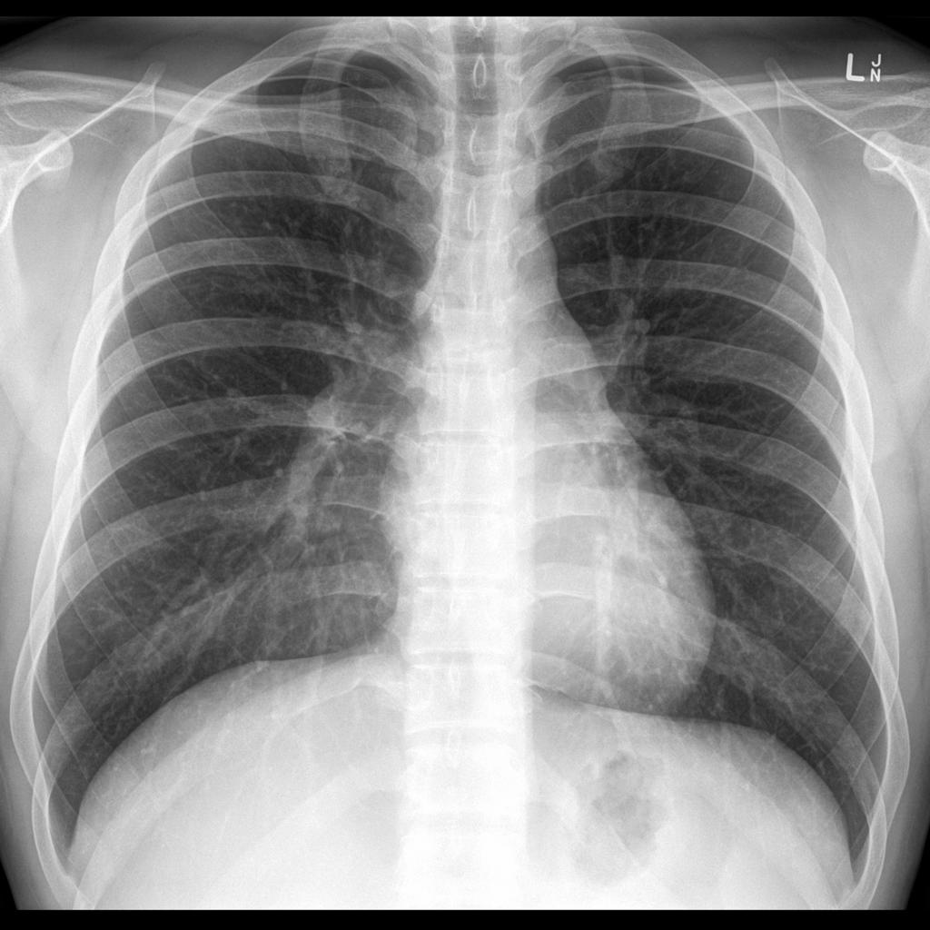
Solving Relevant Problems with
Quantum Machine Learning Algorithms
Andris Locāns

Slide 5
Solving Relevant Problems with
Quantum Machine Learning Algorithms
Andris Locāns

Slide 6
Solving Relevant Problems with
Quantum Machine Learning Algorithms
Quantum Restricted Boltzmann Machine
Andris Locāns

Slide 7
Restricted Boltzmann Machine

Slide 8
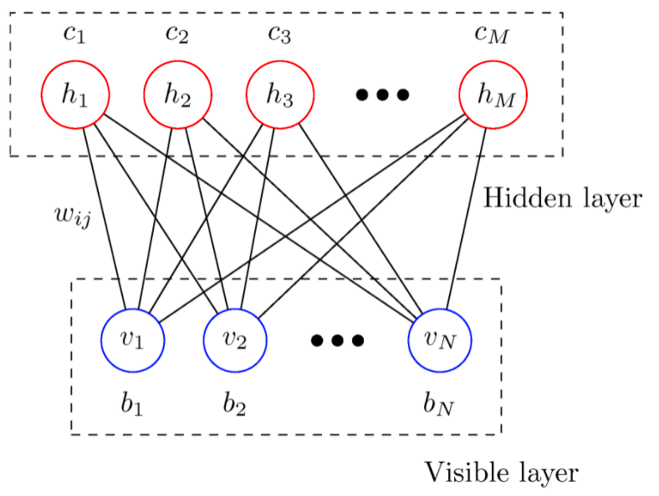
Restricted Boltzmann Machine

Slide 9
Restricted Boltzmann Machine

Slide 10
Restricted Boltzmann Machine

Slide 11
Restricted Boltzmann Machine

Slide 12
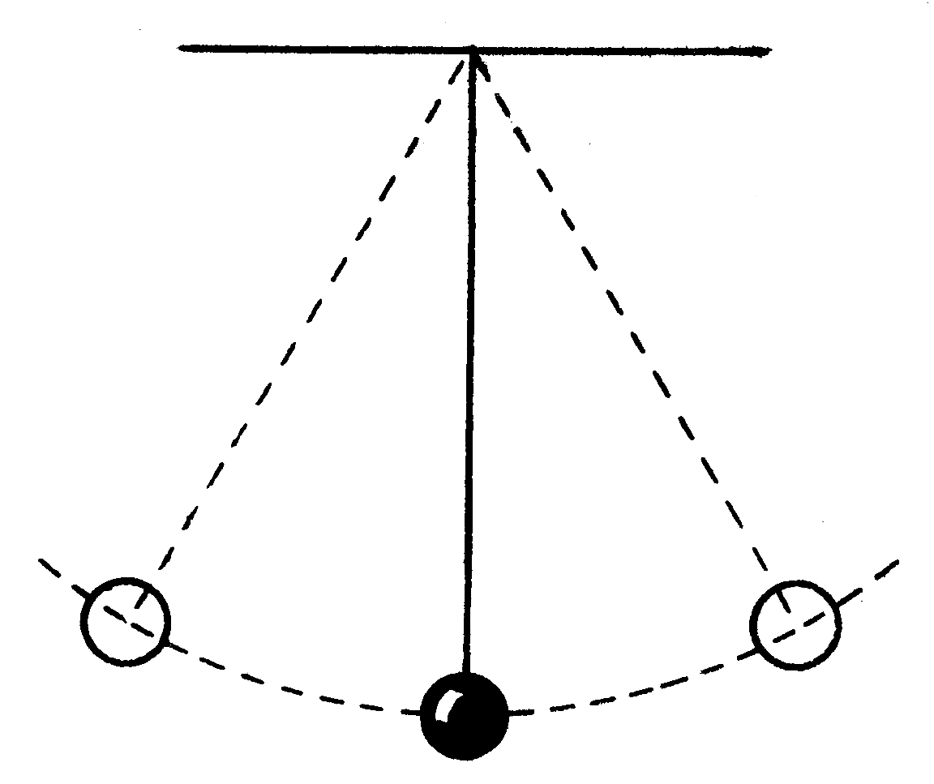
Restricted Boltzmann Machine

Slide 13
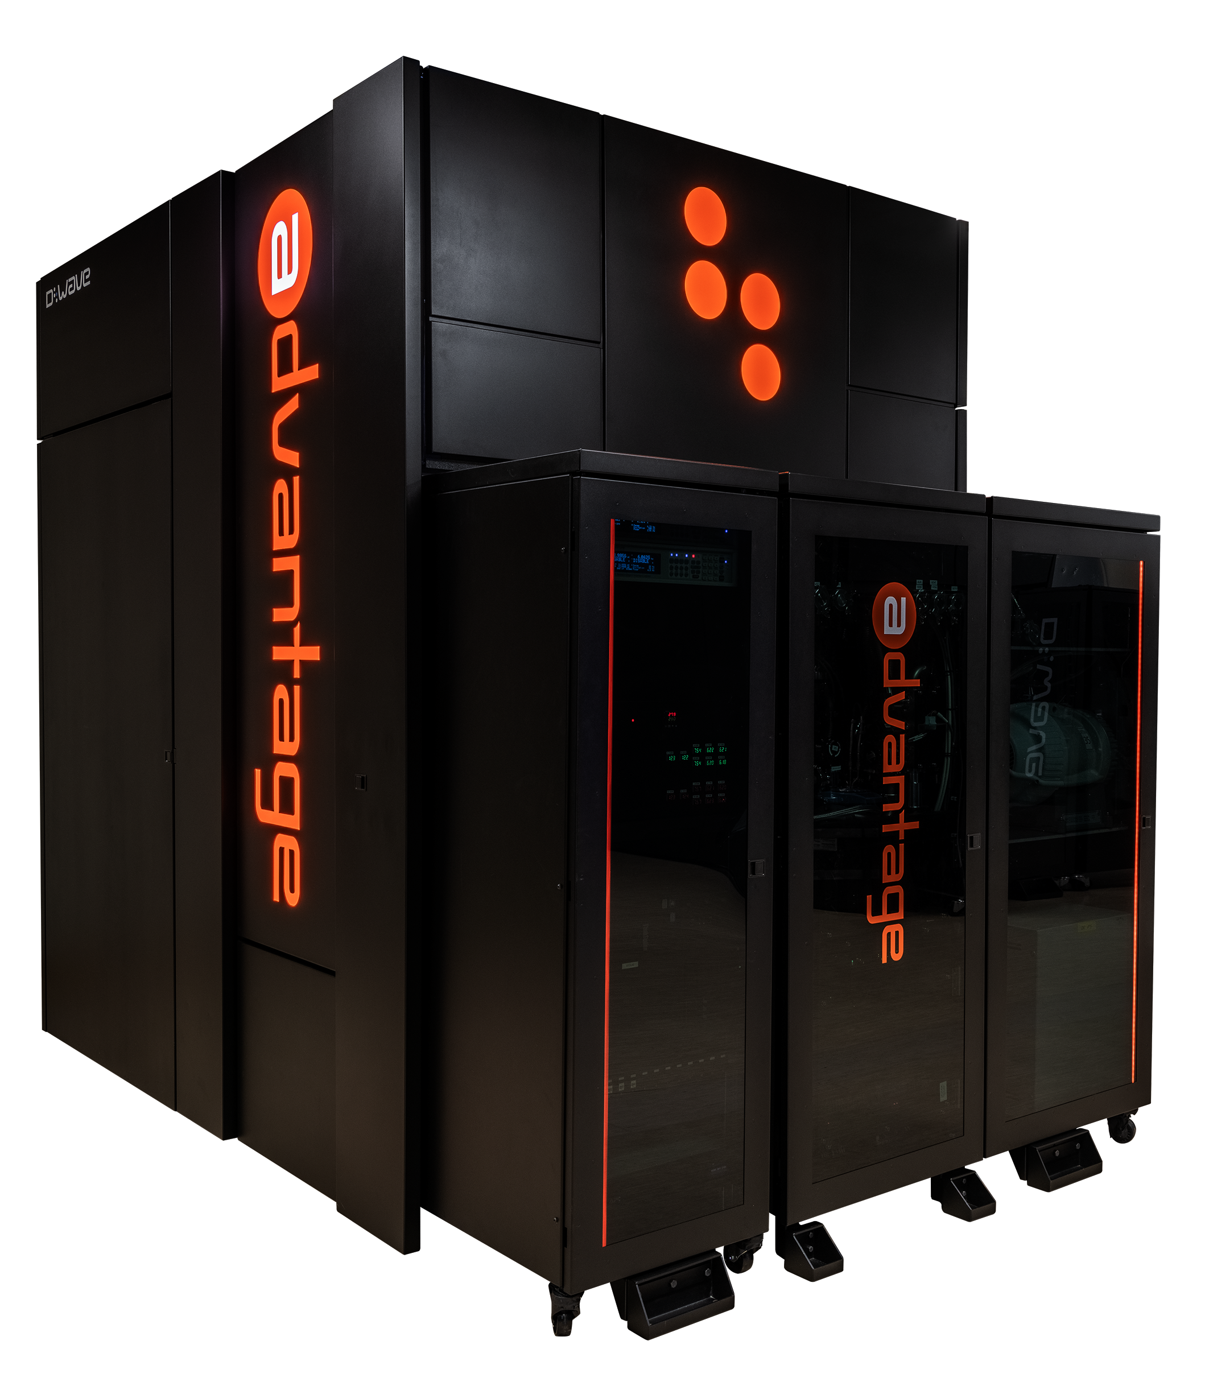
Restricted Boltzmann Machine
D-Wave

Slide 14
OptDigits database

Slide 15
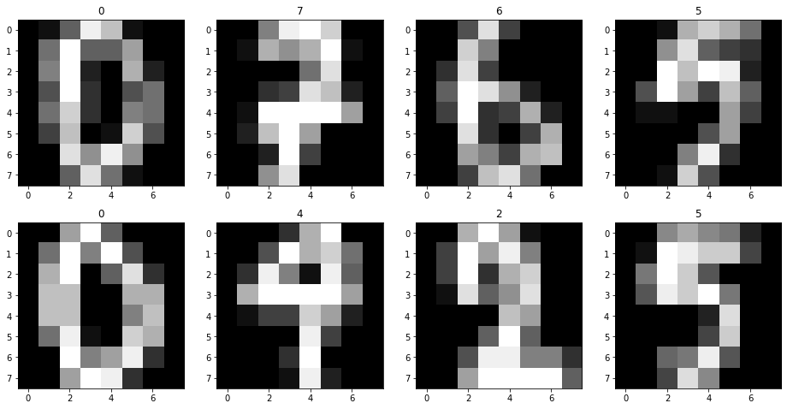
OptDigits database

Slide 16
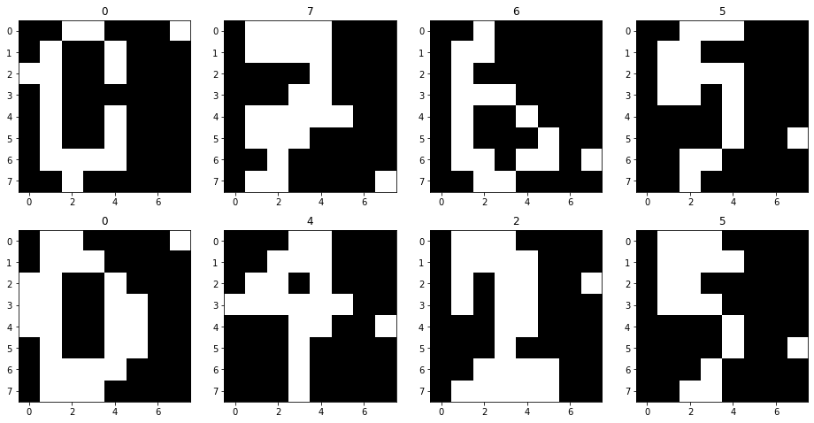
OptDigits database

Slide 17
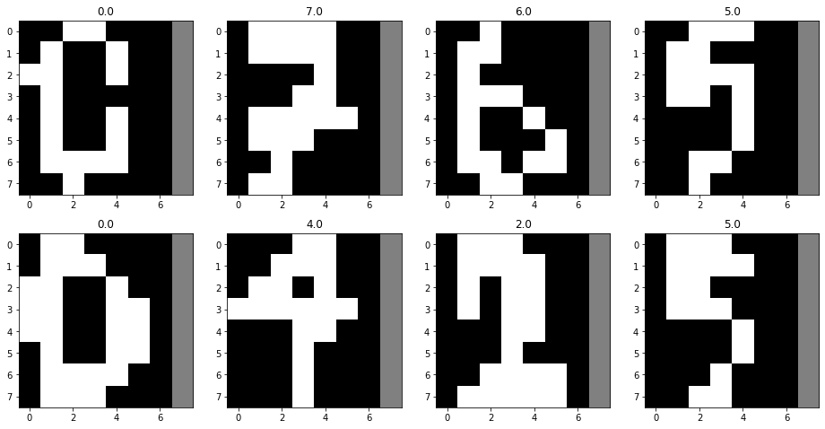
OptDigits database

Slide 18
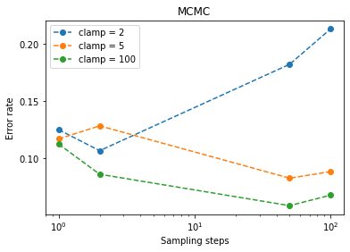
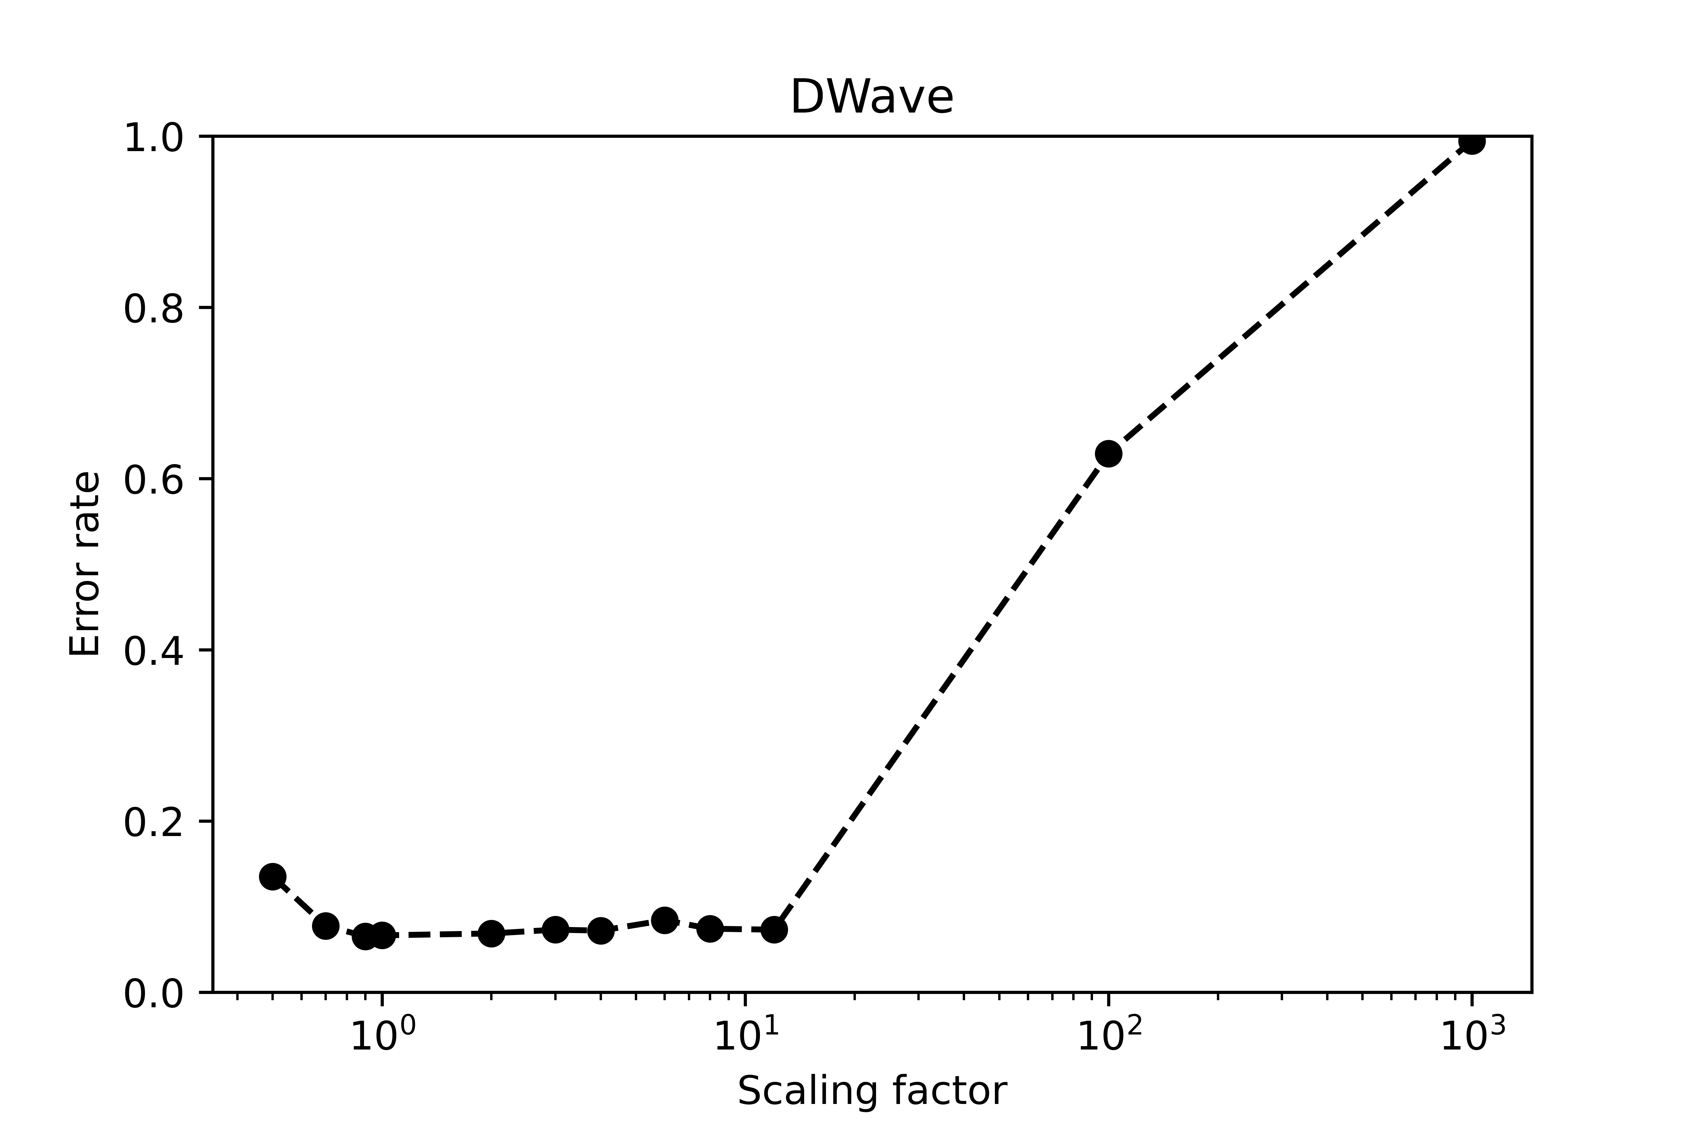
Classical classification
Quantum classification
6% error rate
7% error rate
Similar experiment to https://arxiv.org/abs/1905.00159

Slide 19
I'm happy to answer your questions :)

