Slide 1
Application log processing methodologies in a service oriented architecture
Bogdans Ozerkins
LU, 2020

Slide 2
Application data collection
Human generated
Low volumes
Persistent storage
References data management systems
Machine generated
High volumes
Volatile storage
References to technical components

Slide 3
Application logs purpose
Centralized log collection
Security audit logs
Database replication logs

Slide 4
Programming language toolkit
Focused on interface
Error handling / reporting
Freedom of format (default: raw)
Freedom of storage (default: local file)
Freedom of delivery mechanism (default: direct connection)

Slide 5
Centralized log collection
Write logs to file
Write directly
Use special agent
Ship files to destination

Slide 6
Non-discardable logs collection
Save to persistent storage (database)
Ship to centralized service
Replication logs
Hight-Availability storage

Slide 7
Data centralization methods
Database replication
Event / Enterprise bus
Message queues
Service abstraction (HTTP / TCP API)

Slide 8
Cloud platform data collection
CloudWatch Logs
Stdout / Stderr
HTTP
CloudWatch agent (File System + HTTP)
CloudWatch Metrics
HTTP API
Azure Monitor
File System
TCP

Slide 9
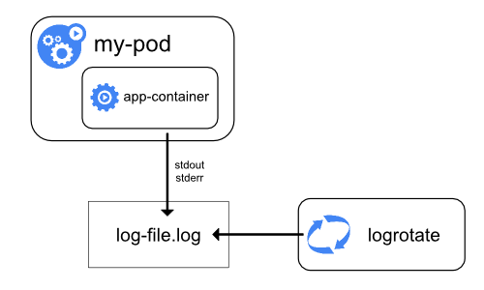
Kubernetes logs - Node-level logging
Stdout / Stderr logs
Handled by Kubernetes host

Slide 10
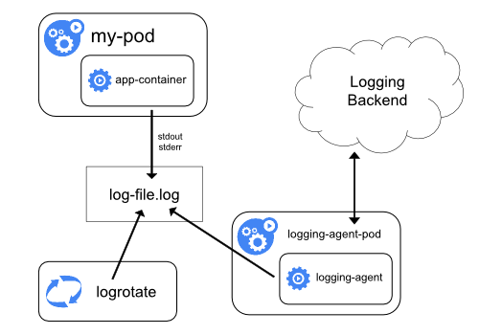
Kubernetes logs - Cluster-level logging
Stdout / Stderr logs
Pod-level agent
Logging Backend

Slide 11
Research Problem
There are different use cases for logs
Write first, analyze later approach
Differences in delivery mechanisms
Differences in logs usage
Size and velocity of service architecture components defines log collection techniques

Slide 12
Research Direction
Construct a service architecture prototype variations
Test out different log collection & aggregation approaches
Define key aspects of log analysis in service architecture
Research how the approach changes depending on volume changes

Slide 13
b.ozerkins@outlook.com

